Slide 1


St Thomas of Canterbury Catholic Primary School
Welcome to the EYFS
Parent Information Meeting
Friday 12th January 2024

Slide 2

Our School Values
inclusive
respectful
Our children of
St. Thomas of Canterbury
are …
spiritual
curious
responsible
resilient

Slide 3
The EYFS Team
Miss B Paul - Year Group Leader & Class RP teacher
Mrs S Coppin (Assistant Headteacher) and
Mrs J Lee - Class RC teachers
Miss L Levett - Class RL teacher
Mrs C Ashdown and Mrs K Watras - EYFS support staff
Mrs A Davies - HLTA
Mrs N Kaur - LSA - Blossom
Mrs M Hall - SENCo

Slide 4

Attendance and Punctuality
Good attendance and punctuality is essential. Pupils cannot achieve their full potential if they do not regularly attend school. If children arrive late, they are missing out on learning time. Please note that holidays are not permitted in term time.
Unauthorised absence may result in the school referring to the Local Authority for sanctions and/or legal proceedings. This may include issuing each parent/carer with a Penalty Notice.
Please note the following times:
8:40am - Gates open
8:55am - Children are expected to be in the classroom for the register to be taken by 9:00am. If
your child arrives after this time, they will be marked as late.
9:15am - Pupils will receive a mark of absence if they do not attend school before this time.

Slide 5
Absence Procedures
If your child is absent for any reason, you should contact the school office via telephone before 9:00am on the first day of absence. You will be expected to provide an explanation for the absence and an estimate of how long the absence will last, e.g. one school day.
Please note that coughs and colds are very common, especially in the winter, and generally do not require your child to be absent from school. Illnesses such as diarrhoea and vomiting only require 48 hours absence from school. If in doubt, please check for guidance on https://www.nhs.uk/live-well/is-my-child-too-ill-for-school/
or contact the school office.

Slide 6


The best option is to speak with the class teacher. From 8:40am staff are working with children so please speak to the teacher at the end of the school day.
Email or call the school office to request to meet with a member of staff.
admin@stthomasofcanterbury.thurrock.sch.uk
How can parents communicate
with the school?
Email the class teacher.
Call the school office who may be able to answer your question immediately or pass a message to staff.
01375 375826
Talk with Mrs Poulteney or any of our senior leaders:
Mrs Coppin
Mrs Smith
Ms McAnally
Speak with the staff on the school gate at the beginning or the end of the day.
Send in a note with your child.

Slide 7
Uniform
At St. Thomas of Canterbury, we are proud that our uniform fosters a sense of belonging within our school community.
We have listened to parental views and updated our uniform policy which has now been ratified by our Governors- see the changes on the next slides.
Information about school uniform can be found on the school website:
https://www.stthomasofcanterbury.thurrock.sch.uk/uniform/
Our uniform is available to purchase from Uniformwise in Stanford-Le-Hope: https://www.uniformwise.co.uk/ Please ensure that all uniform items are clearly
marked with your child’s name.

Slide 8
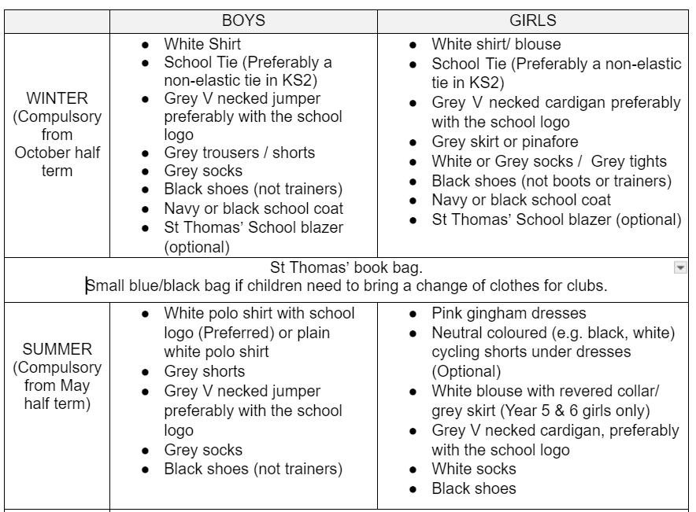
Uniform - updates
Jumpers, cardigans and polo shirts with the school logo are preferred.
Grey socks are permitted for girls in the winter
Summer uniform- Year 5&6 girls- white blouse with a revered collar and grey skirt.

Slide 9
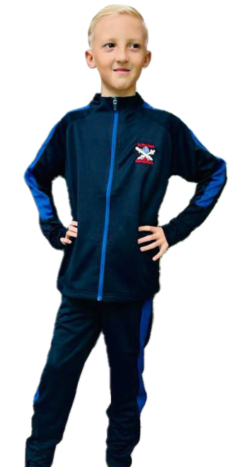
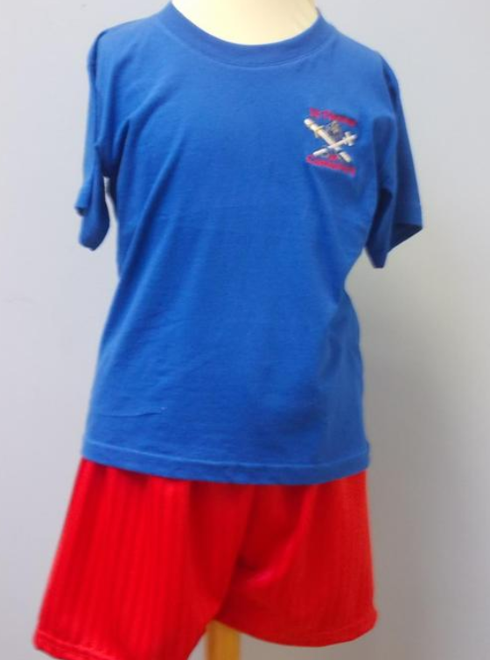
PE kit - updates
Reception’s PE day is Friday.
Your child should wear their PE kit to school on their PE day.
Children should wear their PE shorts and T-Shirt underneath their tracksuit as they will only need to wear the T-shirt with their shorts for indoor PE lessons.
Please note that in the winter months, the St. Thomas of Canterbury tracksuit should be worn.
Children should wear black plimsolls or black trainers on their PE days.

Slide 10
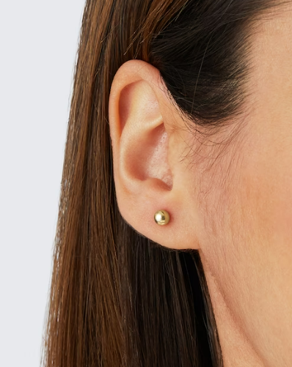

Hair/ Accessories - Updates
Hair accessories must be kept to a minimum and should be in school colours. Red, white, blue in winter. Pink, white or blue in summer.
Hair braids should be natural hair colours.
One small stud earring per ear. (Children must not wear earrings on PE days.)

Slide 11
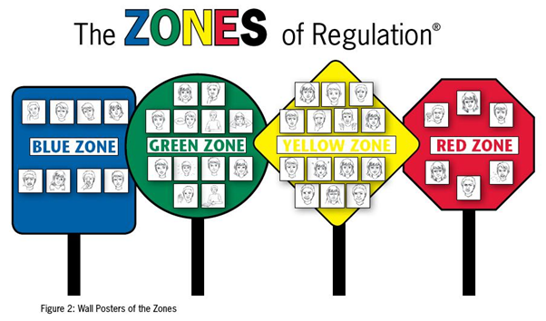


We have updated our behaviour policy at St Thomas’s to better equip our children in understanding and articulating their feelings and emotions by using the Zones of Regulation.

Slide 12


We believe in a preventative approach, where children are treated with respect and where sanctions, when applied, are consistent.
Rewards for good behaviour at St Thomas’s include:
Verbal praise
Communicating praise to parents
House Points and stickers
Certificates linked to our school values
Prize ceremonies and special assemblies

Slide 13
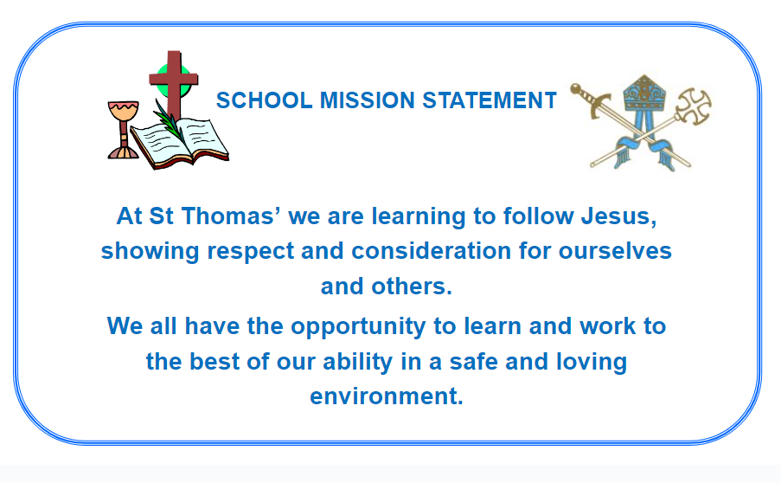


Religious Education
2 RE lessons per week
Weekly Assembly, Celebration of the Word and Hymn Practice
Fr Stephen and Deacon Matus celebrate Mass regularly at school/church
for whole school/year groups.
Deacon Matus supports learning in RE.

Slide 14
Religious Education - Our learning this term
This term, children start by looking at Celebrating - the various celebrations which take place in Church and how we celebrate as a Parish family.
We will then begin the topic of Gathering - how and why people gather together and the joy of gathering together to celebrate at Mass.
Our last topic this term is Growing. Throughout this topic we will be learning that Spring is a time when things begin to grow and that Lent is a time to grow in love to be more like Jesus and to look forward to Easter.

Slide 15

PSHE
We implement our PSHE curriculum through the use of the resource Life to the Full. This allows us to cover all the statutory requirements of Relationships and Health Education based on the structure of the Model Primary RSE Curriculum from the Catholic Education Service.
In EYFS, we cover areas of PSHE through the Prime area PSED (Personal, Social, and Emotional Development). Alongside this, we also ensure we include important events throughout the year such as: Anti-Bullying Week, Black History Month, Children’s Mental Health Week and Remembrance Day.
In each classroom, we have the Zones of Regulation to aid the
children with understanding their emotions and
feelings and knowing how to deal with them.

Slide 16
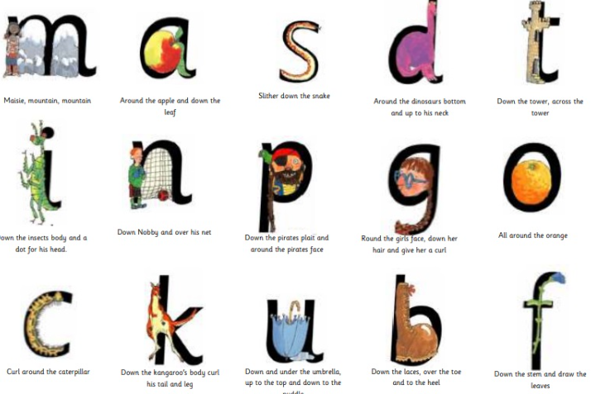
Phonics
We follow the RWI phonics scheme and children are taught phonics every day.
We have now moved on from whole-class phonics - the children have been assessed and grouped.
Your child will be given a phonics book in their book bags weekly for them to practise their blending skills at home.
Please ensure that the books are kept in book
bags so that we can change these.

Slide 17
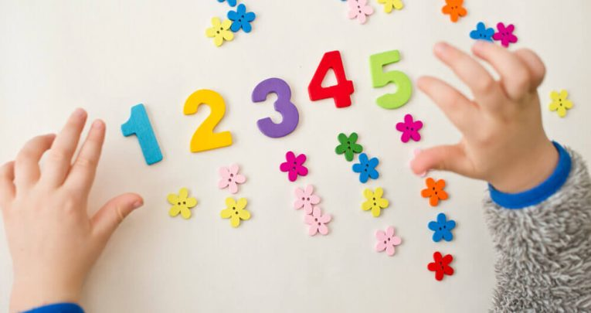
Our learning this term
Writing - Spring 1 - continuing with writing all of their name independently, writing letters correctly, starting to write phrases independently using their own ideas/experiences.
Spring 2 - Forming lower case letters and capital letters correctly, spelling words by identifying the sounds and then writing the sound with letter/s. Using High Frequency/Red words in their writing. Starting to form simple sentences independently.
Maths: Spring 1 - Mass and Capacity, Growing 6,7,8, Length, Height and Time
Spring 2 - Building 9 and 10, Exploring 3D shapes.

Slide 18

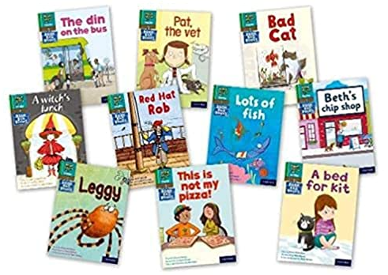
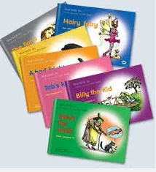
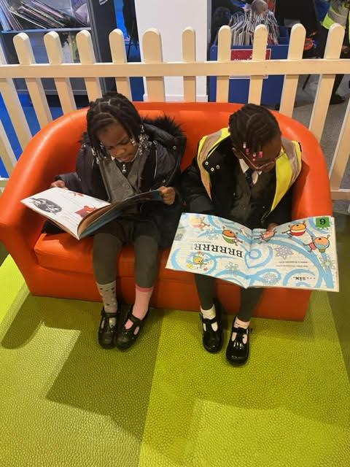
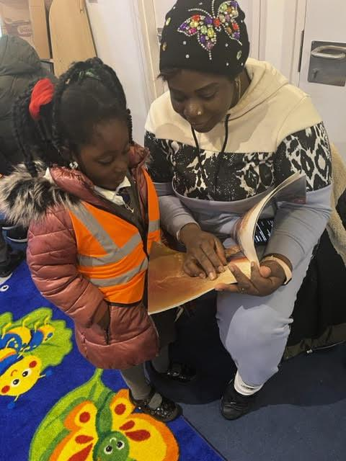
Reading
Becoming a fluent, skilled and attentive reader starts at the earliest stages. Therefore, making sure that children become engaged with reading at the earliest opportunity is one of the most important ways to make a difference to their life chances.
Books are changed weekly. Please listen to your child read every day and
leave a comment in his/her reading record.
Join us every Thursday at 2.45pm for our Parent reading sessions.

Slide 19

Homework
Weekly homework will be set on ‘Evidence Me’ on a Friday afternoon. Please take the time to support your child with this homework and take photographic or video evidence which you can send to your class teacher on the ‘Evidence Me’ app.
Reception will start to receive 5 spellings a week based on their phonics knowledge and set by their phonics teacher. On some weeks they will receive one or two High Frequency words (some of which cannot be sounded out - sight words) which we have been learning in class. Please help your child to practise and learn these spellings.

Slide 20
Educational Visits
Spring 1: St Thomas of Canterbury Church Grays - Monday 9th January.
We have already visited the church to kick off our new topic - Celebrating. This is a great opportunity for the children to experience being inside a church and seeing some of the signs and symbols within the church.
For local visits we do not require a consent form as you have already signed a local visit permission slip as part of the new entrant paperwork.
For other trips, consent forms must be returned by every child before we can allow them to participate. Verbal consent is not accepted for children to take part in
any activity.

Slide 21


After school clubs
We are delighted to offer an increased range of after-school clubs this academic year, details of which are sent out at the beginning of each term.
Parents/carers can also access Jules et Lis before and after school clubs, run by an external provider. Details can be found on https://julesetlis.co.uk/

Slide 22
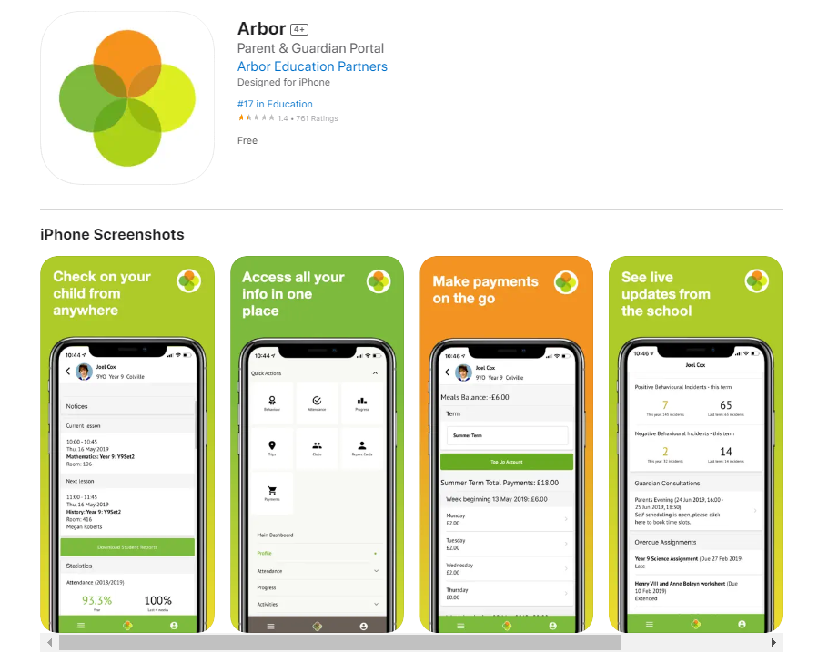
Arbor
All correspondence,
payments and club bookings will be sent electronically through Arbor.

Slide 23
Dates for your diary
St Thomas of Canterbury Church trip: Tuesday 9th January
Parents’ Evening: Tuesday 13th February and Thursday 15th February
Ash Wednesday Service led by Year 3: Wednesday 14th February
February Half Term: Monday 19th February - Friday 23rd February
End of term: Thursday 28th March
Start of Summer Term: Monday 15th April

Slide 24



Come and join us!
Mrs Foley, our Community Involvement Lead, is leading the establishment of the
Friends of St. Thomas of Canterbury.
If you would like to be a part of this parent support group, who come together to help raise much needed money for our school, you can contact our email address: friendsofstoc@stthomasofcanterbury.thurrock.sch.uk
We got together to organise the tea, coffee and sweet treat sales after the recent Nativities and concerts. We will be arranging; fetes, discos, non-uniform days and other fundraising events. We look forward to seeing you there.
Please speak to one of the FOST parent
support group after this meeting.
If you would like to join our Parent Heritage Group - leave your email address and telephone number with the office and Miss Paul will contact you.

Slide 25
Questions?
Should you have any questions, please do not hesitate to speak to your child’s class teacher or email your child’s class teacher directly.
miss.paul@stthomasofcanterbury.thurrock.sch.uk
miss.levett@stthomasofcanterbury.thurrock.sch.uk
mrs.coppin@stthomasofcanterbury.thurrock.sch.uk
mrs.lee@stthomasofcanterbury.thurrock.sch.uk

