Slide 1


St Thomas of Canterbury Catholic Primary School
Welcome to the Reception
Parent Information Meeting
Thursday 28th September 2023

Slide 2
The Year 1 Team
Miss B Paul - Year Group Leader & Class RP teacher
Miss L Levett - Class RL teacher
Mrs S Coppin / Mrs J Lee - Class RC teachers
Mrs A Davies - Reception HLTA
Mrs C Ashdown, Mrs K Watras, Miss N Kaur - Reception support staff
Mrs M Hall - SENCo

Slide 3

Attendance and Punctuality
Good attendance and punctuality is essential. Pupils cannot achieve their full potential if they do not regularly attend school. Please note that holidays are not permitted in term time.
Unauthorised absence may result in the school referring to the Local Authority for sanctions and/or legal proceedings. This may include issuing each parent/carer with a Penalty Notice.
Please note the following times:
8:40am - Gates open
8:55am - Children are expected to be in the classroom for the register to be taken by 9:00am.
If your child arrives after this time, they will be marked as late.
9:15am - Pupils will receive a mark of absence if they do not attend school before this time.

Slide 4
Absence Procedures
If your child is absent for any reason, you should contact the school office via telephone before 9:00am on the first day of absence. You will be expected to provide an explanation for the absence and an estimate of how long the absence will last, e.g. one school day.
Please note that coughs and colds are very common, especially in the winter, and generally do not require your child to be absent from school. Illnesses such as diarrhoea and vomiting only require 48 hours absence from school. If in doubt, please check for guidance on https://www.nhs.uk/live-well/is-my-child-too-ill-for-school/
or contact the school office.

Slide 5
Uniform
At St. Thomas of Canterbury, we are proud that our uniform fosters a sense of belonging within our school community.
Information about school uniform can be found on the school website:
https://www.stthomasofcanterbury.thurrock.sch.uk/uniform/
Our uniform is available to purchase from Uniformwise in Stanford-Le-Hope: https://www.uniformwise.co.uk/
Please ensure that all uniform items including are clearly marked with your child’s name.

Slide 6
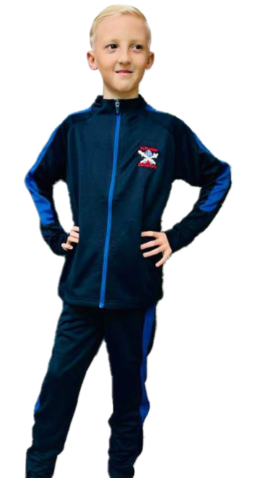
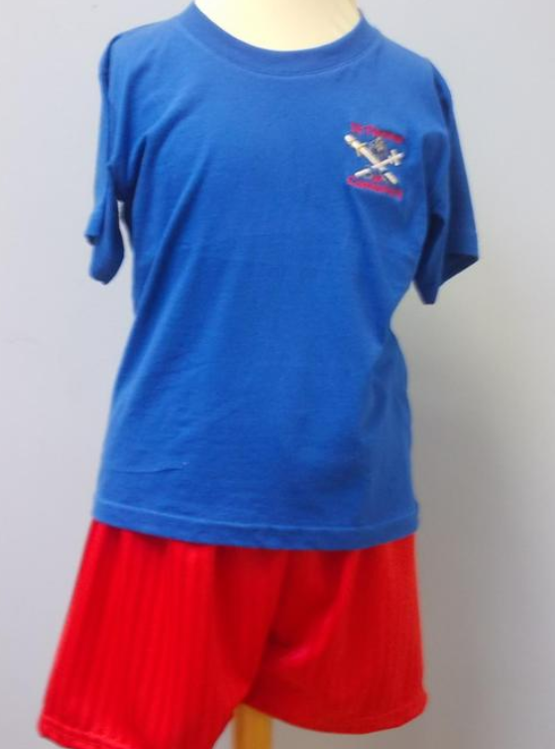
PE kit
Reception’s PE day is Friday.
Your child should wear their PE kit to school on their PE day.
Please note that in the winter months, the St. Thomas of Canterbury tracksuit should be worn.
Children should wear black plimsolls or black trainers on their PE days.

Slide 7
Religious Education
As a Catholic school, we are proud that Christ and the Gospel values are central to our curriculum.
At St. Thomas of Canterbury, we follow the Come and See Religious Education Programme. This accounts for 10% of the entire curriculum time excluding liturgies, assemblies and collective worship.
The children are taught the basis of the Catholic Faith, spirituality, morality and social issues which are constantly related to their own life experiences. Children are helped to come to a fuller knowledge and love of God which will develop into mature Christian living. On Holy Days of Obligation and at the beginning and throughout each term, we celebrate the Eucharist in School.
Fr Stephen visits school to say Mass and takes time to visit the children in their classes.

Slide 8

The Early Years Foundation Stage
Early Years Foundation Stage - Prime Areas
Communication and Language
Physical Development (gross and fine motor skills)
Personal, Social and Emotional Development

Slide 9

The Early Years Foundation Stage
Early Years Foundation Stage - Specific Areas
Literacy
Maths
Understanding the World
Expressive Arts and Design

Slide 10
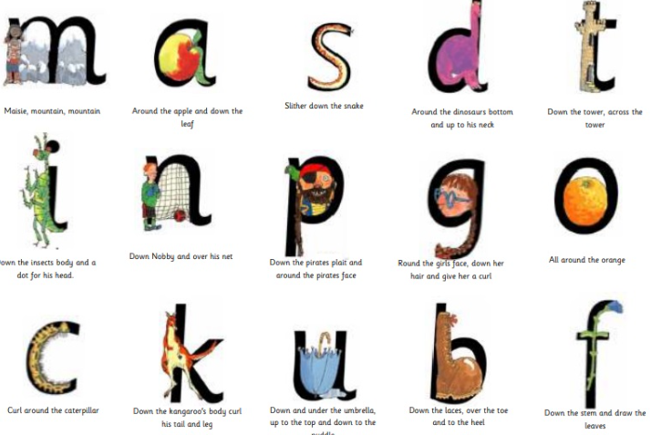
Phonics
We follow the RWI phonics scheme and children are taught phonics every day. Children learn a different sound each day and how to form the letter alongside it. We begin by teaching the Set 1 sounds: m, a, s, d, t, i, n, p, g, o, c, k, u, b, f, e l, h, r, j, v, y, w, z, x, qu, sh, th, ch, ng, nk.
You can access phonics books on Oxford Owl which the class teacher will set for each child. Your child will also be given a phonics book in their book bags weekly for them to practise their blending skills at home.
Please ensure that the books are kept in book
bags so that we can change these.

Slide 11
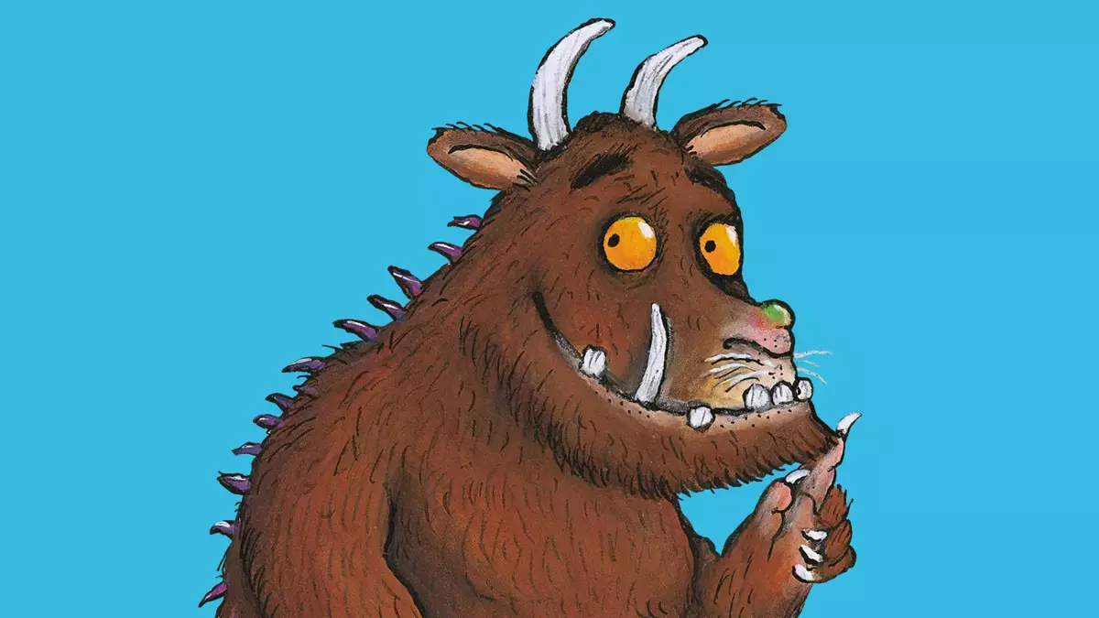

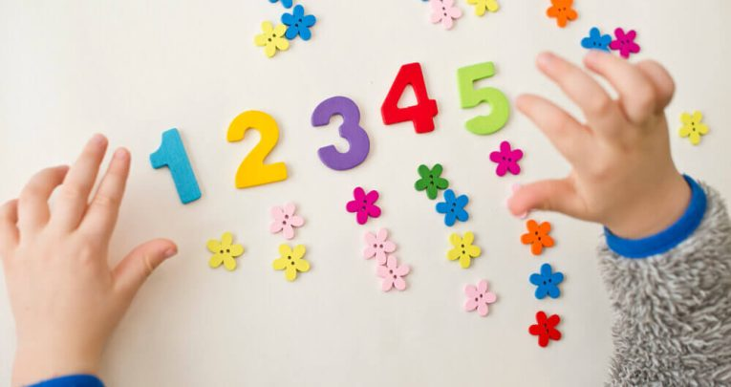
Our learning this term
Throughout the Autumn term, this is what we will be covering:
Autumn 1 - Our book focus will be Traditional and Familiar Tales (The Gruffalo, Little
Red Riding Hood, The Smartest Giant in Town, Jack and the Beanstalk, We’re Going on
a Bear Hunt).
Autumn 2 - Our book focus will be Together We Can (The Kindness Elves, A Day to Remember, The Colour Monster, Together We Can, A Letter to Father Christmas, The Nativity).
Writing - Autumn 1 - writing some or all of their name, writing some letters correctly.
Autumn 2 - Forming lower case letters and capital letters correctly, spelling words by identifying the sounds and then writing the sound with letter/s.
Maths: Autumn 1 - Matching, sorting and comparing amounts,
Talking about measure and patterns, 1,2,3.
Autumn 2 - Circles and triangles, 1,2,3,4,5.

Slide 12

Reading
Becoming a fluent, skilled and attentive reader starts at the earliest stages. Therefore, making sure that children become engaged with reading at the earliest opportunity is one of the most important ways to make a difference to their life chances.
We encourage children to read the following: In Reception, a decodable book
(related to the RWI phonics scheme), and a book for pleasure from their Class Library
to share with an adult. Bug Club is also available for extra reading books online.
Books are changed weekly. Please listen to your child read every day and
leave a comment in his/her reading record. If you have read with your child 5 times a week, their reading stars will be displayed on the classroom window and their names will be put into a prize draw to win a reading book at the end of the half term.
Please come and join us at 2:45pm every Thursday for our parent reading session.

Slide 13






Homework
Weekly homework will be set on ‘Evidence Me’ on a Friday afternoon. Please take the time to support your child with this homework and take photographic or video evidence which you can send to your class teacher on the ‘Evidence Me’ app.
You should have received an email inviting you to accept the request on the Evidence Me app and instructions in your Reception welcome pack on how to set up the app and navigate through it.
Tubs sent home - sounds and words will be sent home with your child and added too. Please listen to your child practising these and ensure you cut up the sounds/words from the strips provided.

Slide 14
Educational Visits
Autumn term - Thameside Theatre - Pantomime (Jack and the Beanstalk) - Traditional Tales - dates TBC
- Mateus - visiting Reception to talk about Baptism
Spring term - Chafford Gorge linked to KUW - change in the environment - Seasons - date TBC
Summer Term - Marsh Farm - linked to Topic - Our World - God’s Wonderful World) - dates TBC
Payments are made via Arbor - please make sure you have the app!

Slide 15

After school clubs
We are delighted to offer an increased range of after-school clubs this academic year, details of which are sent out at the beginning of each term. However, in the Autumn term, these clubs are not available to Reception pupils. Once these are available, we will let you know.
Parents/carers can also access Jules et Lis before and after school clubs, run by an external provider. Details can be found on https://julesetlis.co.uk/

Slide 16
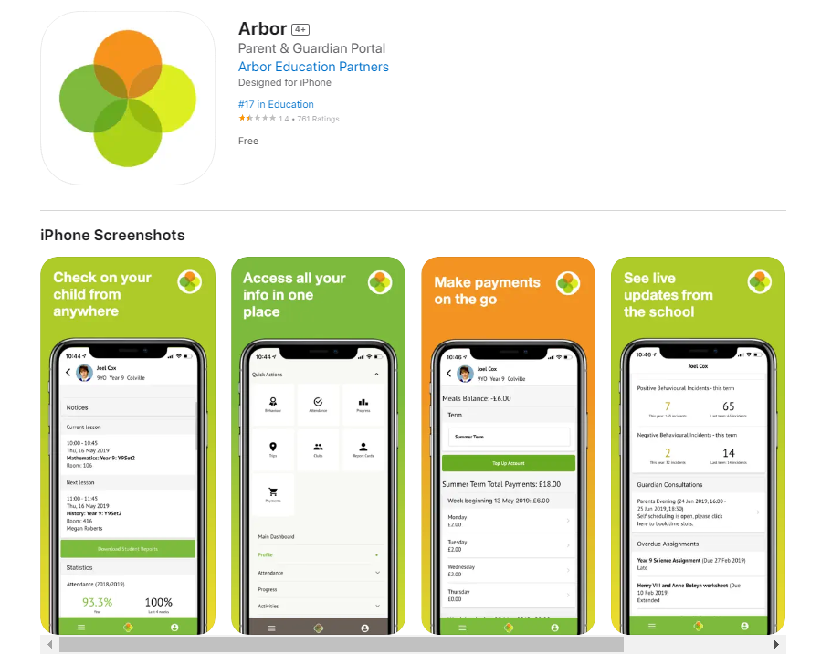
Arbor
All correspondence,
payments, club bookings and consent for trips will be sent electronically through Arbor.

Slide 17

Dates for your diary
Parents’ Evenings: Tuesday 17th and Thursday 19th October
Half term: Monday 23rd - Friday 27th October
INSET Day: Monday 30th October (school closed to pupils)
Individual and sibling photos: Thursday 2nd November
Odd socks day for Anti-Bullying Week: Monday 13th November
EYFS Nativity: Wednesday 13th December, afternoon
End of term: Wednesday 20th December at 1:30pm

Slide 18



Come and join us!
Mrs Foley (community involvement lead) recently held our first meeting for the Friends of St. Thomas of Canterbury.
If you would like to be a part of this parent support group, who come together to help raise much-needed money for our school, you can contact our email address:
friendsofstoc@stthomasofcanterbury.thurrock.sch.uk
We will come together to organise fetes,
discos, non-uniform days and other
fundraising events.
If you would like to join our Parent Heritage Group - leave your email address and telephone number with the office and Miss Paul will contact you.

Slide 19
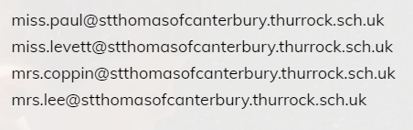
Questions?
Should you have any questions, please do not hesitate to speak to your child’s class teacher or email your child’s class teacher directly.

