Slide 1
Year 6 Parents’ Meeting 20th September 2017
At St. Thomas’ we are learning to follow Jesus, showing respect and consideration for ourselves and others.
We all have the opportunity to learn and work to the best of our ability in a safe and loving environment.

Slide 2
Welcome
Phones to silent please
Sign in beside child’s name
Take a letter for reading/SAT’s Revision Guides
achieve
learn,
and love
Jesus.
following
We

Slide 3
This Evening
Year 6 expectations
Transfer to Secondary School
Key Stage 2 SAT’s
achieve
learn,
and love
Jesus.
following
We

Slide 4
School Journey payments
£75 End of September
£75 End of November
£75 End of January
£75 End of March
achieve
learn,
and love
Jesus.
following
We

Slide 6
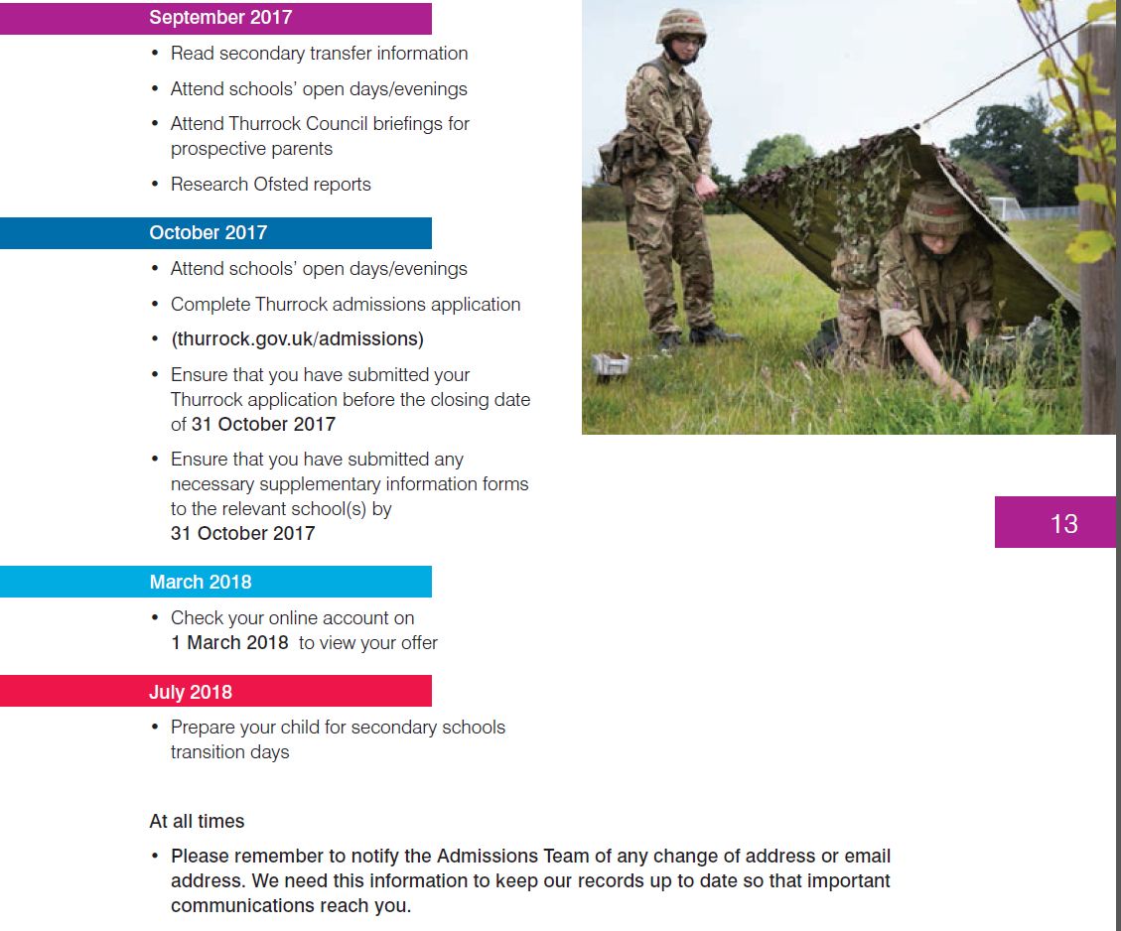
To Do List

Slide 7
achieve
learn,
and love
Jesus.
following
We

Slide 8
achieve
learn,
and love
Jesus.
following
We

Slide 9
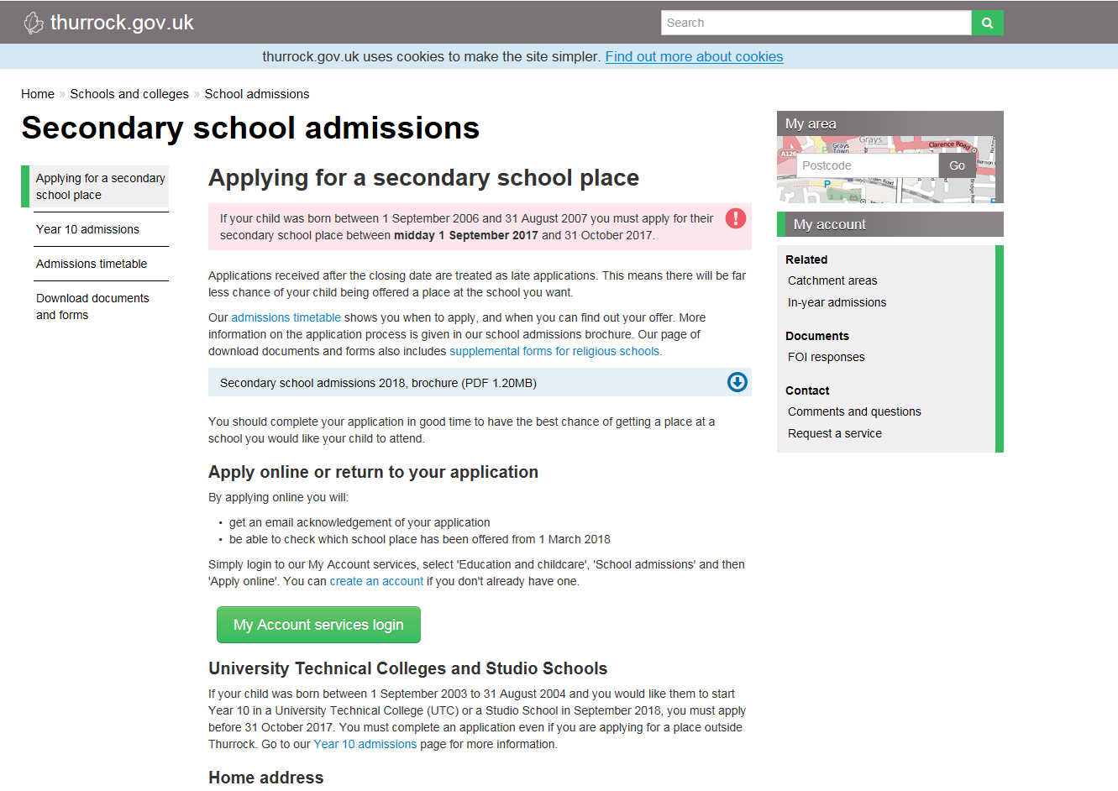
Transfer to Secondary School 2017

Slide 10
Catholic School?
Girls:
Brentwood Ursuline Convent High School
Grays Convent High School
Sacred Heart of Mary Girls School Upminster
Boys:
The Campion School Hornchurch
Mixed:
De La Salle Secondary School Basildon
Do you meet the criteria?
achieve
learn,
and love
Jesus.
following
We
Notes:
Inclusion Agenda – for staff no cliques

Slide 11
To Consider
Supplementary Information Form
Transport costs?
achieve
learn,
and love
Jesus.
following
We

Slide 12
What next?
Read Admissions information
Visit schools
Talk to your child
Fill in your preferences
Complete Supplementary Information Forms
Ensure that you meet the deadline:
Tuesday 31st October 2017
achieve
learn,
and love
Jesus.
following
We

Slide 13
Wait until 1st March 2018
Questions?
achieve
learn,
and love
Jesus.
following
We
Notes:
Inclusion Agenda – for staff no cliques

Slide 14
Key Stage 2 SAT’s
Government expectation for all Year 6 pupils is to be ‘Secondary ready’
No levels…………Scaled Score 100
Expected - 100
Greater depth - 110
achieve
learn,
and love
Jesus.
following
We
Notes:
Easy when everything is going well - but what happened when we are tired , when things go wrong?

Slide 15
Key Stage 2 SAT’s
Week beginning Monday 14th May 2018
Whole week in Hall
No test = no mark
Results contribute to judgement on standards at the school
achieve
learn,
and love
Jesus.
following
We
Notes:
Easy when everything is going well - but what happened when we are tired , when things go wrong?

Slide 16
What?
3 Maths papers:
1x30 minute Arithmetic paper
2x40 minute Reasoning papers
3 English papers:
1x 60 minute Reading test
1x 45 minute Grammar and punctuation test
1x Spelling test
2 Science papers
achieve
learn,
and love
Jesus.
following
We

Slide 17
achieve
learn,
and love
Jesus.
following
We

Slide 18
achieve
learn,
and love
Jesus.
following
We

Slide 19
Reading Paper
In KS2 English SATs your child will be assessed on a range of reading skills, such as the ability to interpret information and comment on writers' use of language, and they’ll have to demonstrate accurate punctuation and an extensive vocabulary in a piece of writing.
The reading test will be a single paper with questions based on three passages of text.
Children will have one hour, including reading time, to complete the test.
Types of questions:
Ranking/ordering, e.g. ‘Number the events below to show the order in which they happen in the story’
Labelling, e.g. ‘Label the text to show the title of the story’
Find and copy, e.g. ‘Find and copy one word that suggests what the weather is like in the story’
Short constructed response, e.g. ‘What does the bear eat?’
Open-ended response, e.g. ‘Look at the sentence that begins Once upon a time. How does the writer increase the tension throughout this paragraph? Explain fully, referring to the text in your answer.’
achieve
learn,
and love
Jesus.
following
We

Slide 20
achieve
learn,
and love
Jesus.
following
We

Slide 22
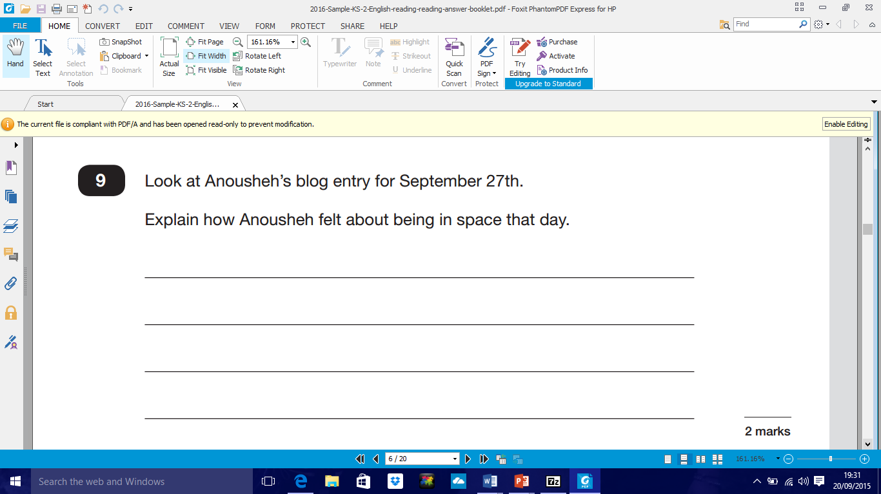

Slide 25
Homework
Our spelling and handwriting homework will be based on the spelling patterns in the new National Curriculum for Year 5 and 6.
The children should learn the words and look up the meanings if necessary so that they can use the words in their writing.
GPS activities to practise what we have been learning in school.
achieve
learn,
and love
Jesus.
following
We

Slide 26
Homework continued
Maths – arithmetic to practise. Times tables should be embedded.
Maths concepts we have been learning. Problem solving and reasoning skills.
Reading every day and discussions about books and what the children have read.
achieve
learn,
and love
Jesus.
following
We

Slide 27
100 books to read
100 suggested books for primary children.
Some are already used in school.
Year 6 have books in class libraries for them to borrow.
Borrow from libraries.
achieve
learn,
and love
Jesus.
following
We

Slide 28
What to do now…....
Learn all the time tables up to 12 x 12
Learn all the division facts up to 12 x 12
Practice standard methods of addition, subtraction, multiplication and division
Learn different grammatical terminology
Answer questions about reading books
achieve
learn,
and love
Jesus.
following
We

Slide 29
Ways to learn the times tables
Write them out – look, cover, write check
Put them on posters
Play games online
Sing them
Play ‘ping pong’ with them
See who can write them the quickest
Quiz them in the car
Learn them forward, backwards and inside out!
achieve
learn,
and love
Jesus.
following
We
Notes:
Inclusion Agenda – for staff no cliques

Slide 30
And finally …..
Pressure on pupils- eased by good preparation Revision: method maths, BBC Revisewise – links on the Year 6 webpage. Study Books used in school belong to you All 5 for £10.90: Return slip asap
Please work with us- we need you to support us and your child Questions?
achieve
learn,
and love
Jesus.
following
We

