Slide 1

Year 6 Parents’ Meeting
18th September 2019
At St. Thomas’ we are learning to follow Jesus, showing respect and consideration for ourselves and others.
We all have the opportunity to learn and work to the best of our ability in a safe and loving environment.

Slide 2
Welcome
Phones to silent please
Sign in beside child’s name
Take a letter for reading/SATs Revision Guides and Grosvenor Hall
achieve
learn,
and love
Jesus.
following
We

Slide 3
This Evening
Transfer to Secondary School
Key Stage 2 SATs and Year 6 expectations
School journey to Grosvenor Hall
achieve
learn,
and love
Jesus.
following
We

Slide 4


Slide 5
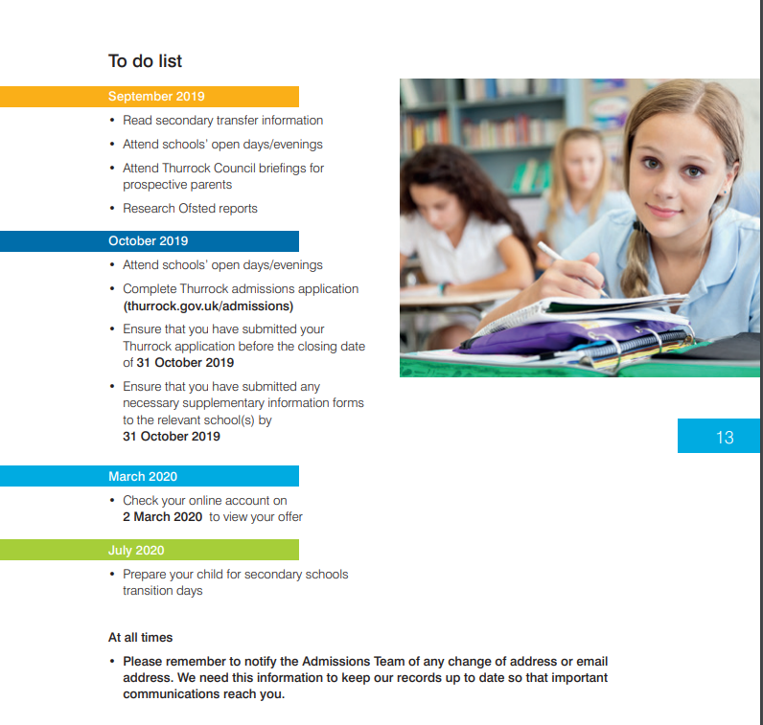

Slide 6
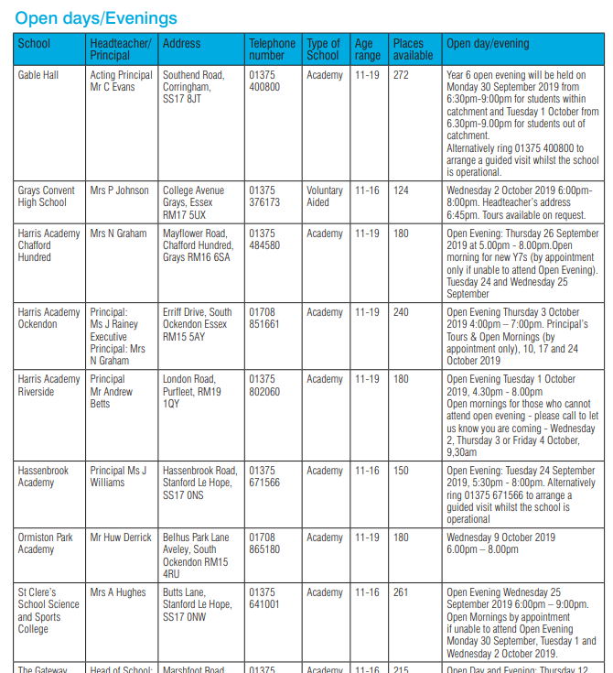
achieve
learn,
and love
Jesus.
following
We

Slide 7
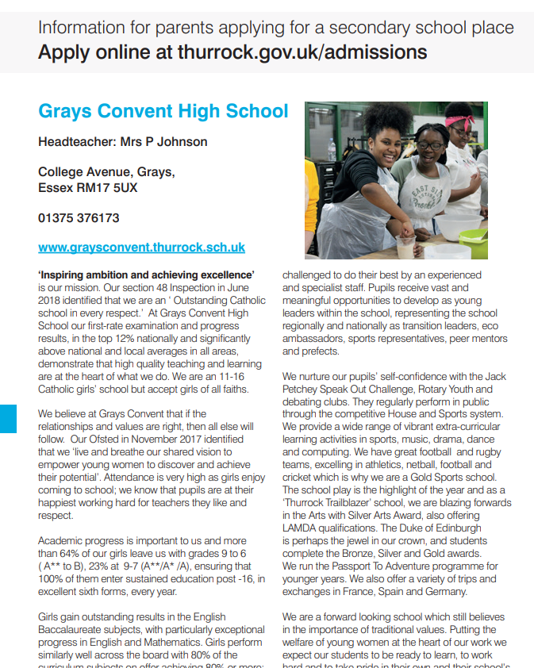
achieve
learn,
and love
Jesus.
following
We

Slide 8
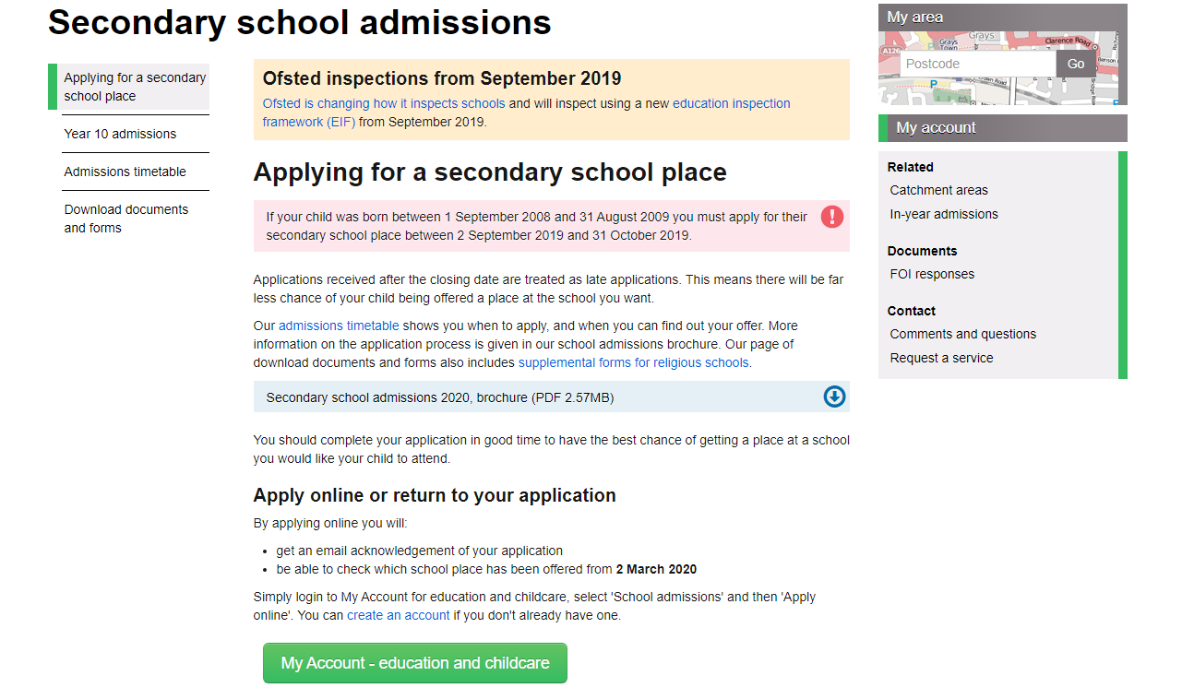
Transfer to Secondary School 2020

Slide 9
Catholic School?
Girls:
Grays Convent High School
Brentwood Ursuline Convent High School
Sacred Heart of Mary Girls School Upminster
Boys:
The Campion School Hornchurch
Mixed:
De La Salle Secondary School Basildon
Do you meet the criteria?
achieve
learn,
and love
Jesus.
following
We
Notes:
Inclusion Agenda – for staff no cliques

Slide 10
To Consider
Supplementary Information Form
Transport costs?
achieve
learn,
and love
Jesus.
following
We

Slide 11
What next?
Read Admissions information
Visit schools
Talk to your child
Fill in your preferences
Complete Supplementary Information Forms
Ensure that you meet the deadline:
Thursday 31st October 2019
achieve
learn,
and love
Jesus.
following
We

Slide 12
Wait until 2nd March 2020
[from 12.30pm onwards]
Questions?
achieve
learn,
and love
Jesus.
following
We
Notes:
Inclusion Agenda – for staff no cliques

Slide 13
Key Stage 2 SATs
Government expectation for all Year 6 pupils is to be ‘Secondary ready’
No levels…………Scaled Score 100
Expected – 100
Maths – 58/110 Reading - 28/50 GPS – 36/70
Greater depth – 110
Maths - 95/110 Reading – 41/50 GPS – 55/70
achieve
learn,
and love
Jesus.
following
We
Notes:
Easy when everything is going well - but what happened when we are tired , when things go wrong?

Slide 14
Key Stage 2 SATs
Week beginning Monday 11th May 2020
Whole week in Hall
No test = no mark
Results contribute to judgement on standards at the school
achieve
learn,
and love
Jesus.
following
We
Notes:
Easy when everything is going well - but what happened when we are tired , when things go wrong?

Slide 15
What?
3 Maths papers:
1x30 minute Arithmetic paper
2x40 minute Reasoning papers
3 English papers:
1x 60 minute Reading test
1x 45 minute Grammar and punctuation test
1x Spelling test
achieve
learn,
and love
Jesus.
following
We

Slide 16
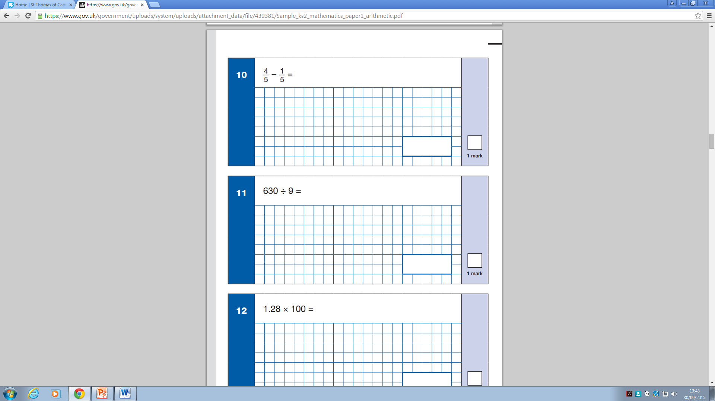
achieve
learn,
and love
Jesus.
following
We

Slide 17
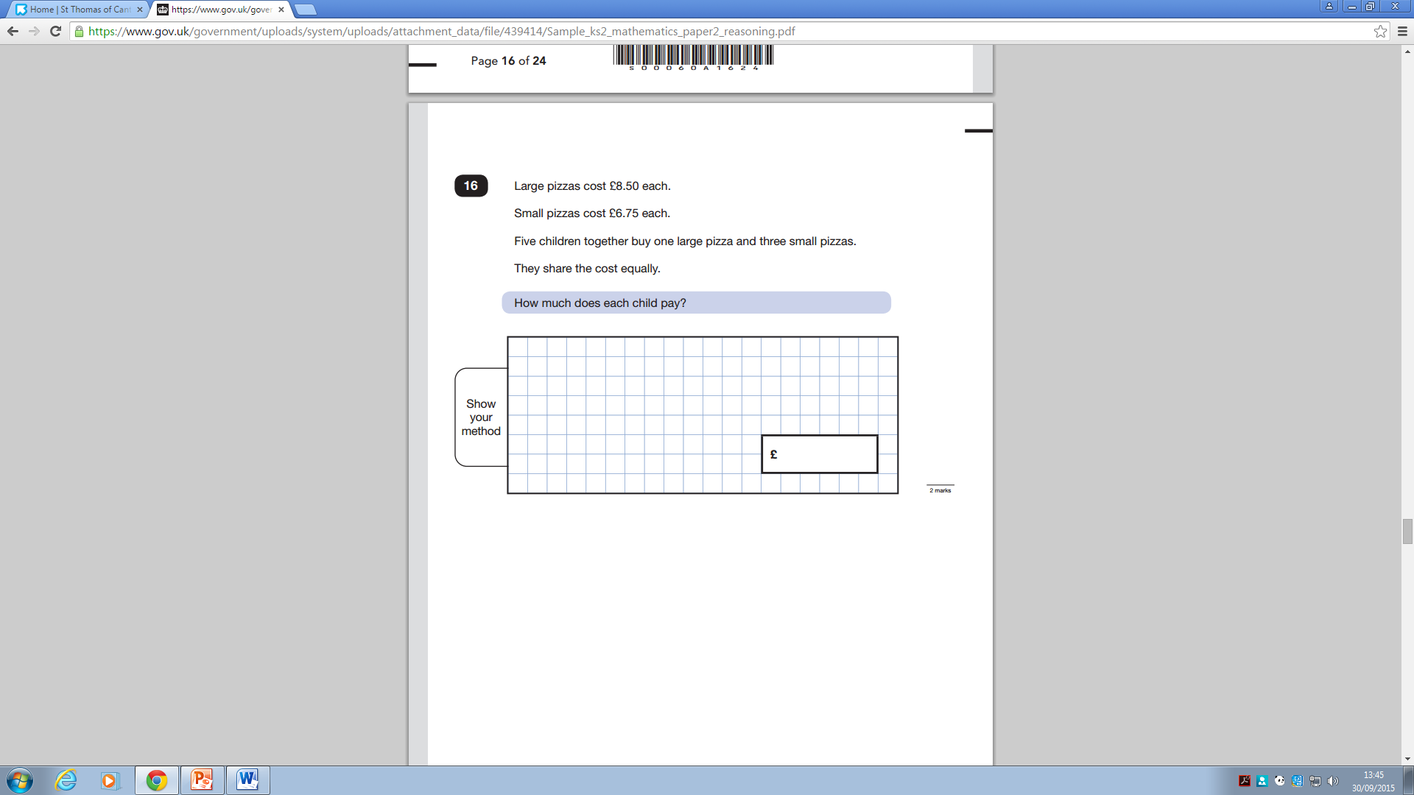
achieve
learn,
and love
Jesus.
following
We

Slide 18
Reading Paper
In KS2 English SATs your child will be assessed on a range of reading skills, such as the ability to interpret information and comment on writers' use of language, and they’ll have to demonstrate accurate punctuation and an extensive vocabulary in a piece of writing.
The reading test will be a single paper with questions based on three passages of text.
Children will have one hour, including reading time, to complete the test.
Types of questions:
Ranking/ordering, e.g. ‘Number the events below to show the order in which they happen in the story’
Labelling, e.g. ‘Label the text to show the title of the story’
Find and copy, e.g. ‘Find and copy one word that suggests what the weather is like in the story’
Short constructed response, e.g. ‘What does the bear eat?’
Open-ended response, e.g. ‘Look at the sentence that begins Once upon a time. How does the writer increase the tension throughout this paragraph? Explain fully, referring to the text in your answer.’
achieve
learn,
and love
Jesus.
following
We

Slide 19
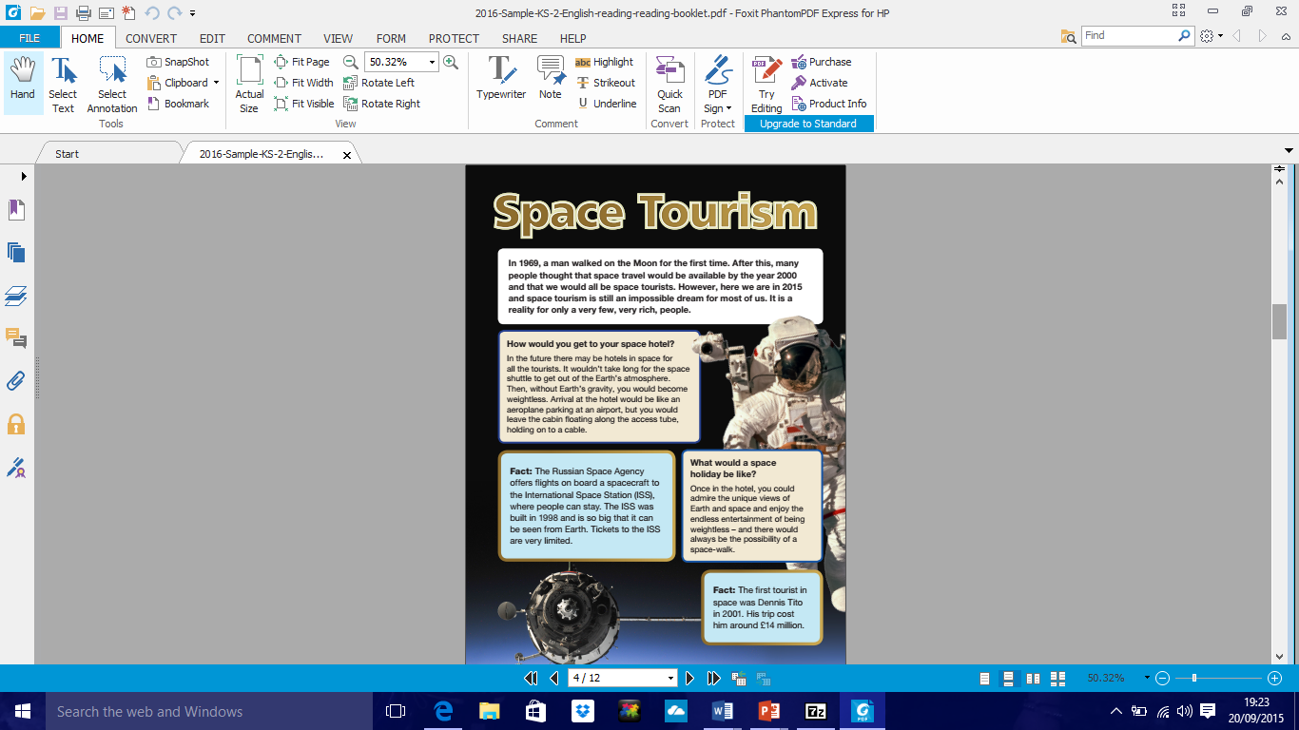
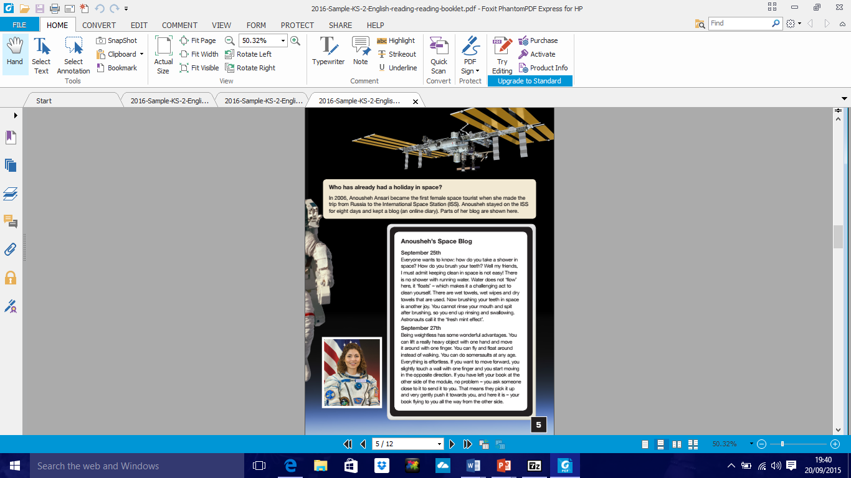
achieve
learn,
and love
Jesus.
following
We

Slide 20
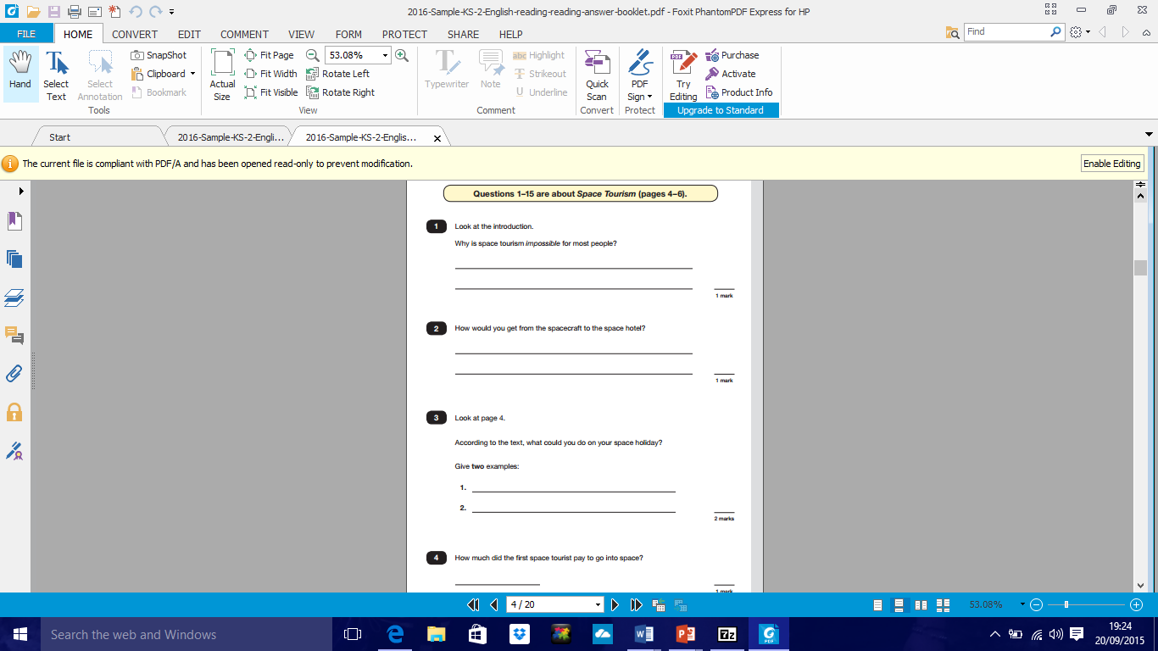
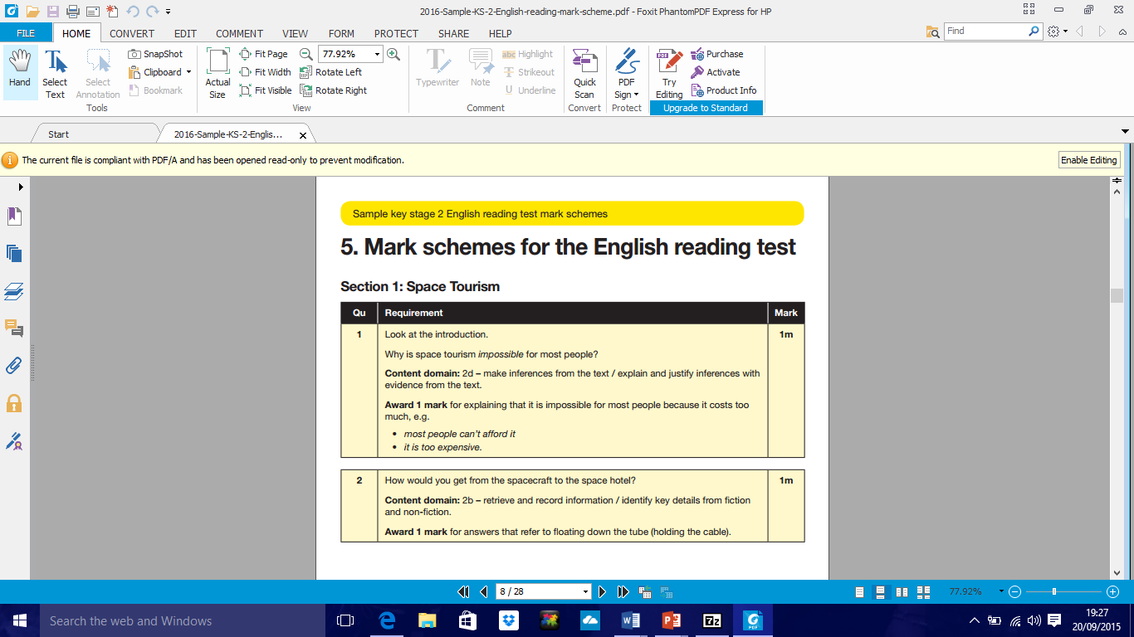

Slide 21
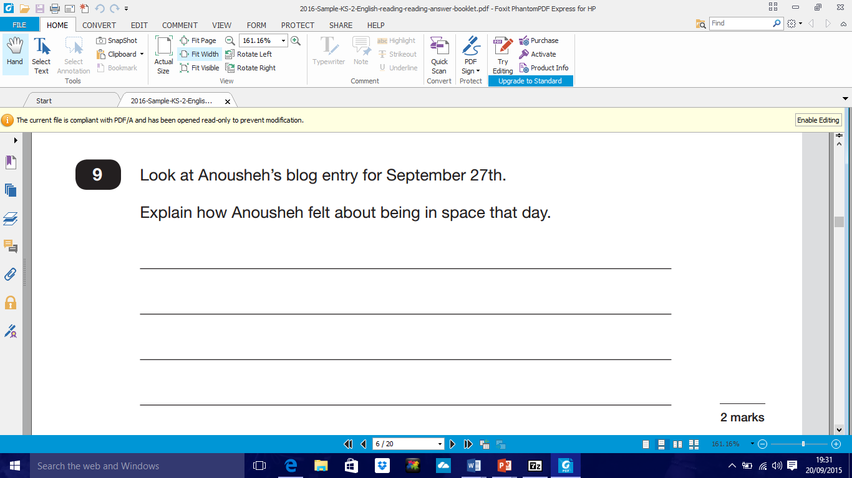
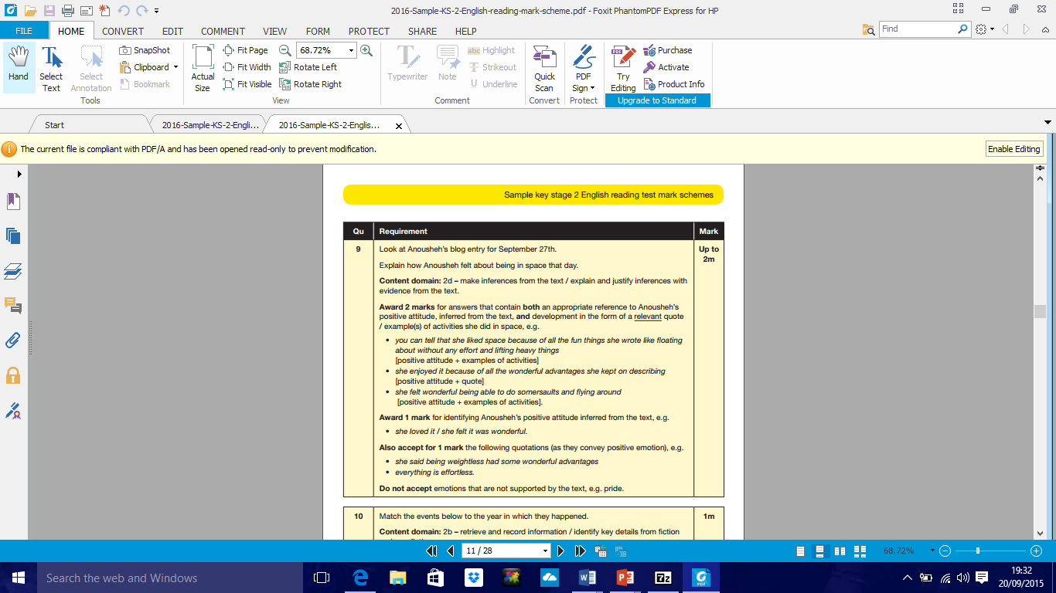

Slide 22
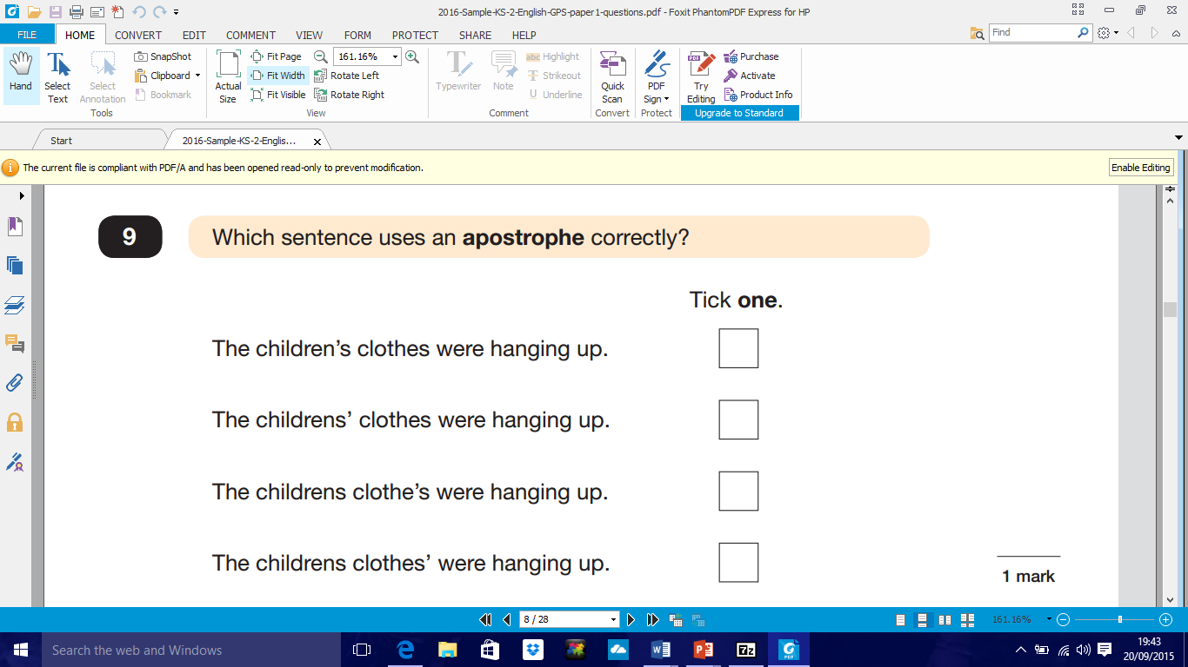
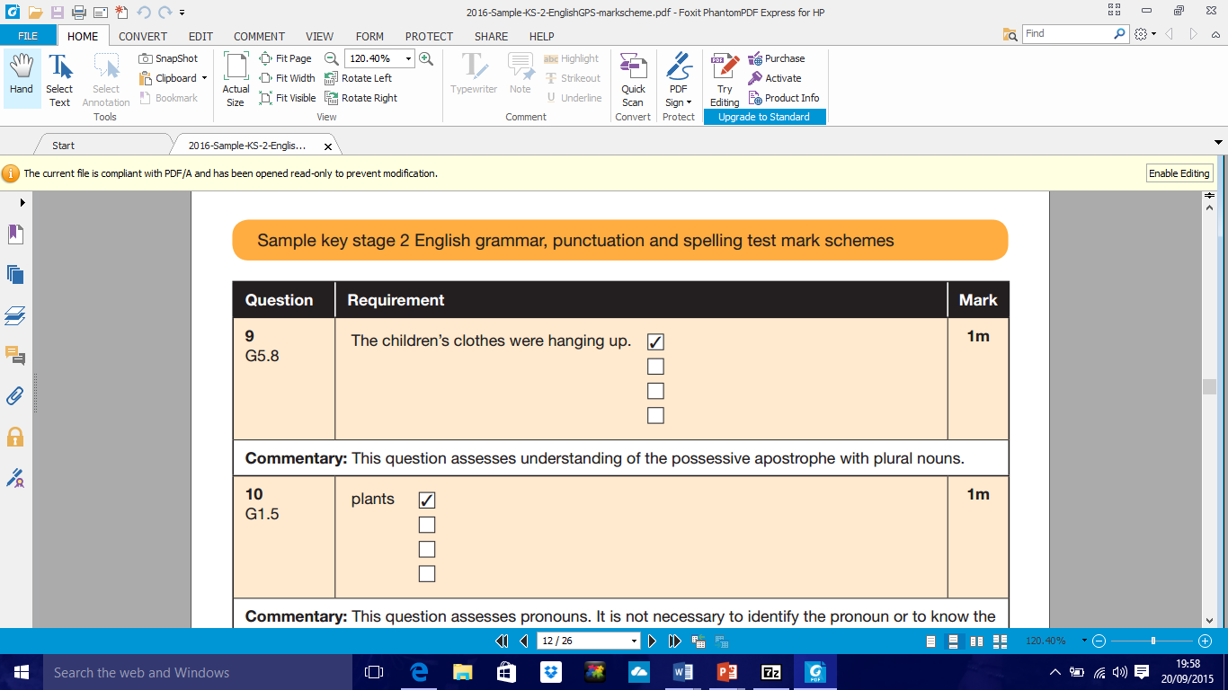

Slide 23
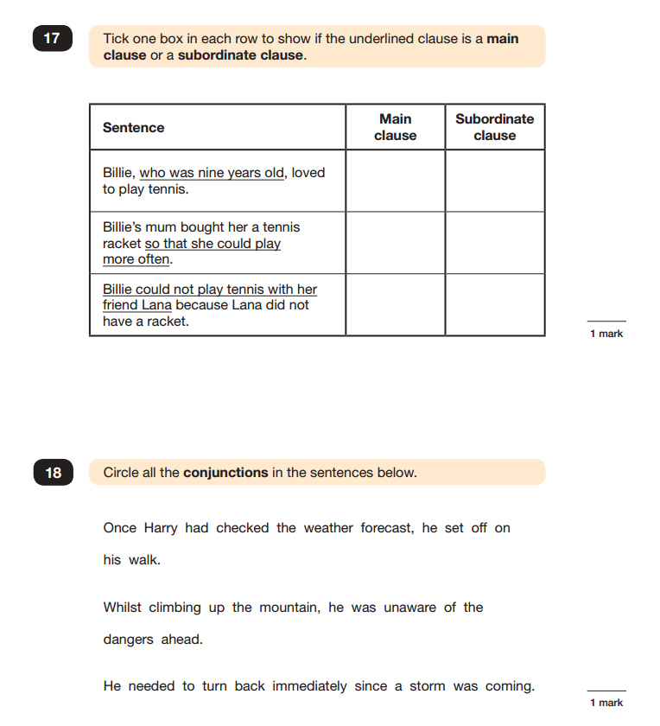

Slide 24
Homework
Our spelling and handwriting homework will be based on the spelling patterns in the new National Curriculum for Year 5 and 6.
The children should learn the words and look up the meanings if necessary so that they can use the words in their writing.
GPS activities to practise what we have been learning in school. Please sign child’s homework books.
achieve
learn,
and love
Jesus.
following
We

Slide 25
Homework continued
Maths – arithmetic to practise. Times tables should be embedded.
Maths concepts we have been learning. Problem solving and reasoning skills.
Reading every day and discussions about books and what the children have read.
achieve
learn,
and love
Jesus.
following
We

Slide 26
100 books to read
100 suggested books for primary children.
Some are already used in school.
Year 6 have books in class libraries for them to borrow.
Borrow from libraries.
achieve
learn,
and love
Jesus.
following
We

Slide 27
What to do now…....
Learn all the time tables up to 12 x 12
Learn all the division facts up to 12 x 12
Practise standard methods of addition, subtraction, multiplication and division
Learn different grammatical terminology
Answer questions about reading books
achieve
learn,
and love
Jesus.
following
We

Slide 28
Revision
Pressure on pupils- eased by good preparation
Revision: links on the Year 6 webpage.
Study Books used in school belong to you
Standard level £7.50, optional foundation and advanced level: Return slip asap
Please work with us- we need you to support us and your child
Questions?
achieve
learn,
and love
Jesus.
following
We

Slide 29
Learning Outside the Classroom
Grosvenor Hall
Ashford, Kent
6th – 10th July 2020
achieve
learn,
and love
Jesus.
following
We

Slide 30
Why?
As one of the leading providers of residential trips, we support teachers in bringing learning to life. As holders of the ‘Learning Outside the Classroom’ Quality Badge, we aim to instil self-confidence and a sense of achievement, through a positive experience which is educational, enjoyable, challenging and rewarding.
achieve
learn,
and love
Jesus.
following
We

Slide 31

Safety
All of our activity and learning programmes are operated in accordance with strict operating standards that define the minimum requirements for staff qualifications, supervision arrangements, equipment, facilities and appropriate clothing.
Individual activities follow a defined session plan and all instructors are regularly observed to ensure they are complying with our safety standards and delivering a quality experience to our visitors.
achieve
learn,
and love
Jesus.
following
We

Slide 32
Typical day
 | 9.30-10.40 | 10.50-12.00 | 12.05-13.15 | 13.15-14.25 | 14.30-15.40 | 15.50-17.00 | 17.05-18.15 | 18.15-19.25 | 19.45-21.00
Mon |  |  |  | L | Arrival and tour |  | Aerial runway | D | Scrap heap challenge
Tue | Aeroball | Fencing | Free time | U | 3G swing | Outdoor climb | Nightline | I | Olympic games
Wed | Problem solving | Bushcraft shelter | Free time | N | Volleyball | Swimming | Archery | NN | Campfire
Thur | Crate stack | Field games | Free time | CH | Abseiling | Fire lighters | Team challenge | ER | Quiz
Fri | Jacob’s ladder | Outdoor laser | Lunch | Leave for home
achieve
learn,
and love
Jesus.
following
We

Slide 33
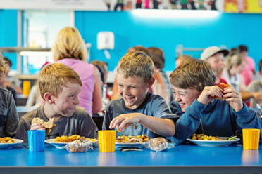
Typical menu
Breakfast – cereals, porridge, toast
Full English, pancakes, pastries (different days)
Lunch – roast chicken, stir fry, pizza, burger, fish-fingers, risotto, bolognaise (different days)
Dinner – Sweet and sour pork, chicken and leek pie, feta and spinach parcels, sausages, chicken tikka masala (different days)
Jacket potato and salad available everyday. Vegetarian option every meal.
achieve
learn,
and love
Jesus.
following
We

Slide 34
Clothes and other kit – preferably not new or expensive.
Long and short sleeve tops
Long and short trousers.
Trainers
Swimming kit and towel
Toiletries
Water bottle and ‘day bag’
Hat or cap, suncream.
Waterproof jacket.
achieve
learn,
and love
Jesus.
following
We

Slide 35
Accommodation
Rooms with 2-8 children. Children will choose some friends, they will be with at least one friend in their room.
Parents can tell Miss Crofton nearer the time if there are children who should not share.
Adults rooms close by.
There will be different groups during activities.
achieve
learn,
and love
Jesus.
following
We

Slide 36
School Journey payments
£70 deposit by Monday 10th October.
£80 End of December
£80 End of January
£80 End of February
£80 End of March
achieve
learn,
and love
Jesus.
following
We

