Slide 1
Welcome to our Year 3 Reading Workshop
Thursday 14th November 2019

Slide 2
What does reading look like in Year 3?
Let’s have a look at a Year 3 reading test paper.

Slide 3
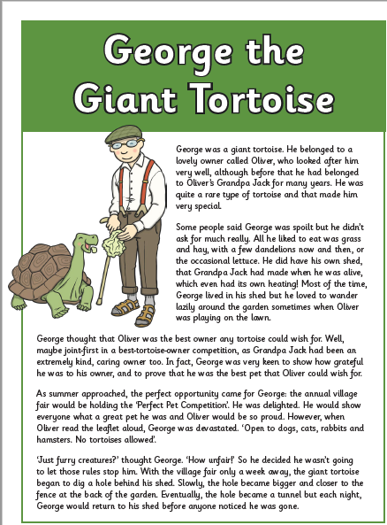
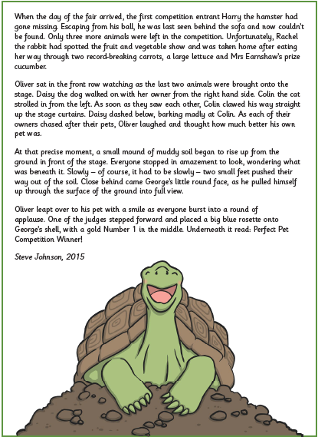
Fiction

Slide 4
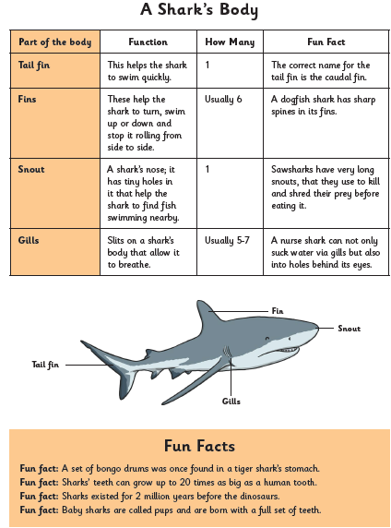
Non-Fiction

Slide 5
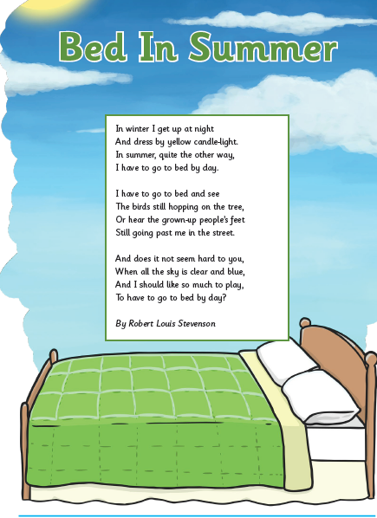
Poetry

Slide 6
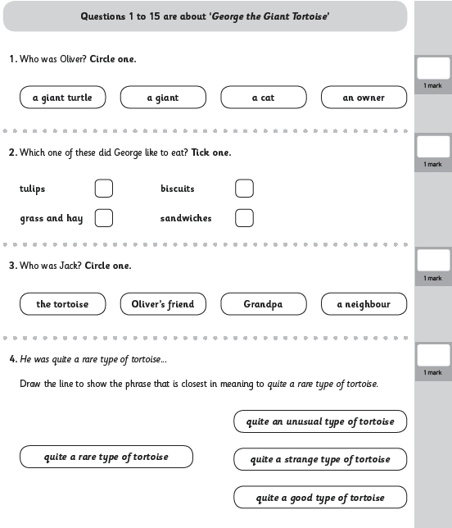
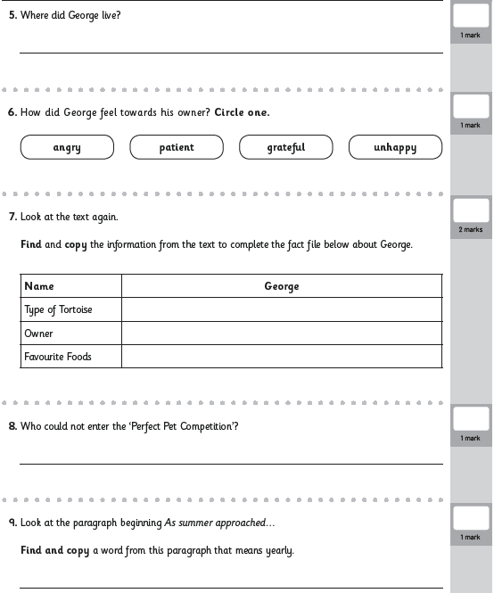

Slide 7
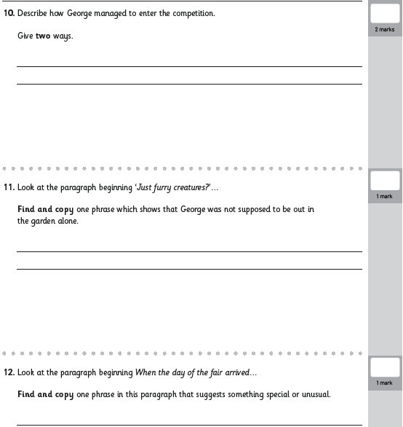
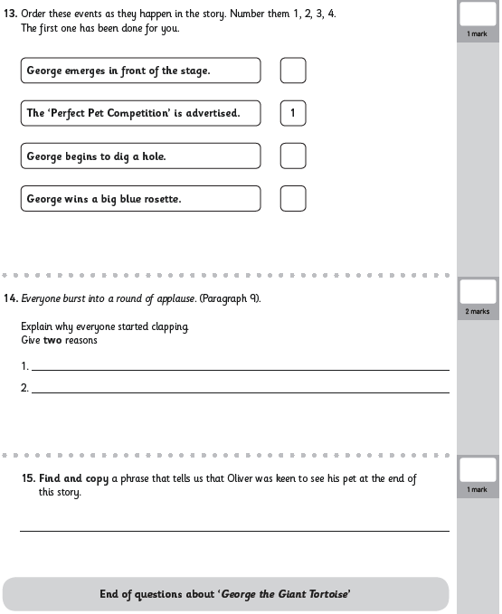

Slide 8
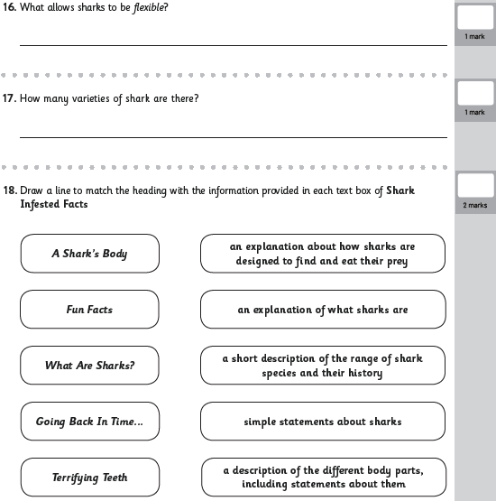
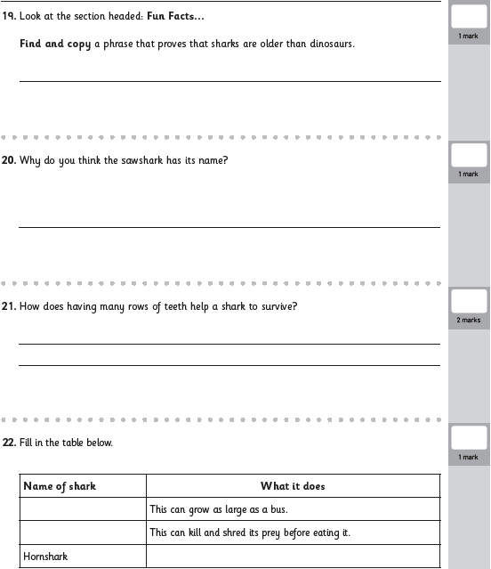

Slide 9
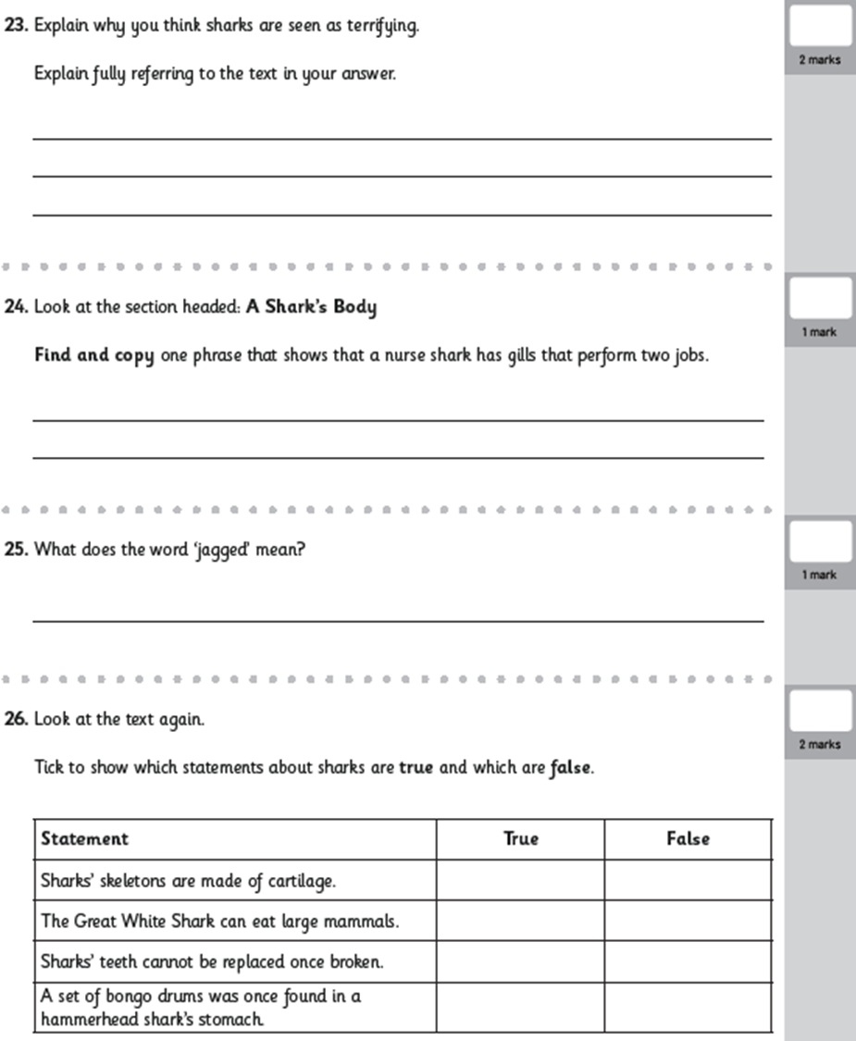

Slide 10
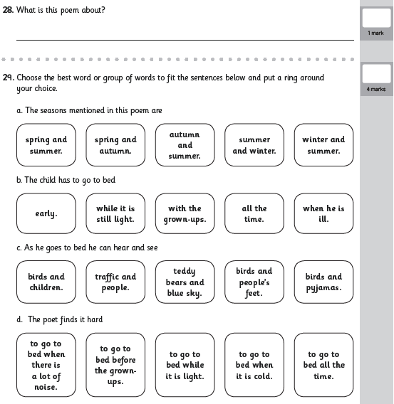
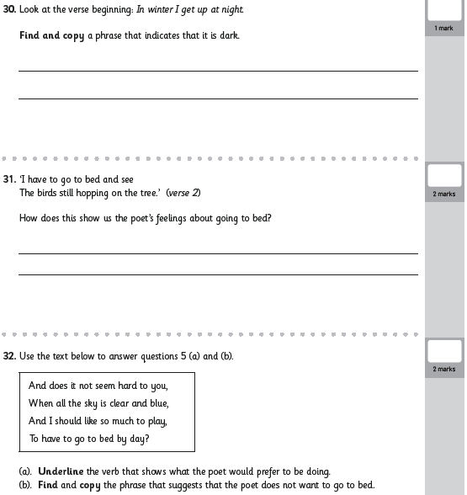

Slide 11
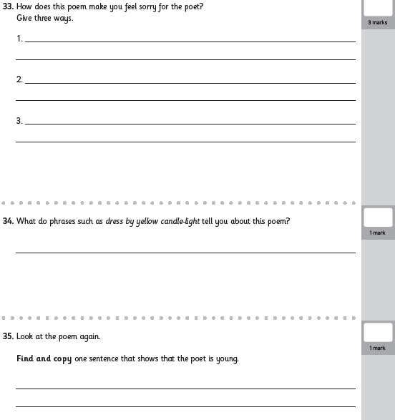

Slide 12
How is reading assessed in Year 3?
Decode
Read age appropriate books aloud with intonation, confidence and fluency for a range of purposes.
Apply their growing knowledge of root words, suffixes and prefixes to read words aloud.
Try out different pronunciations when tackling longer words.
Prepare plays and poems and perform these with intonation, tone, volume and action.

Slide 13
How is reading assessed in Year 3?
Retrieve
Check that the text makes sense to them.
Retrieve information from non-fiction books.

Slide 14
How is reading assessed in Year 3?
Summarise
Increase familiarity of fairy stories, myths and legends and orally retell them.
Identify the main idea of a text from more than one paragraph.
Summarise their understanding of the main idea of more than one paragraph.

Slide 15
How is reading assessed in Year 3?
Infer
Infer characters’ feelings, thoughts and motives from their actions.
Justify inferences with evidence from the text.

Slide 16
How is reading assessed in Year 3?
Predict
Predict what might happen from details stated.
Predict what might happen from details implied.

Slide 17
How is reading assessed in Year 3?
Meaning
Explain the meaning of words in context.
Use a dictionary to check the meaning of words that they have read.
Identify how language, structure and presentation contribute to meaning.

Slide 18
How is reading assessed in Year 3?
Language
Discuss words and phrases that capture their interest and imagination.
Discuss their understanding of the text.

Slide 19
The 5 strands of reading comprehension
Word Meaning
Retrieval
Inference – with evidence
Summary
Prediction

Slide 20
Word Meaning
These questions ask us to work out the meaning of unknown words and phrases using clues in the text.
E.g. Find two words that mean old. Answer: Prehistoric and ancient.

Slide 21
Your turn
You have 5 minutes to complete the word meaning activity.
You need to read the sentences and then decide the meaning of the word in bold.

Slide 22
Let’s look at our answers

Slide 23
Inference with evidence
These questions ask us to hunt for clues in text that tell us how someone might be feeling or why something is happening.
E.g. Why do you think Dan shut the door? Answer: He shut the door because the wind was blowing all of his homework onto the floor.

Slide 24
Your turn
You have 5 minutes to read the text.
Then we will go through the questions as a group.

Slide 25
Let’s look at our answers

