Slide 1
Welcome to Year 1
2020-2021
Your teachers will be:
1F Mrs Foley, Mrs Watras
1O Mrs Obende, Mrs Cantwell & Mrs Lochowska
1G Miss Gander & Mrs Hubbard
achieve
learn,
and love
Jesus.
following
We

Slide 2




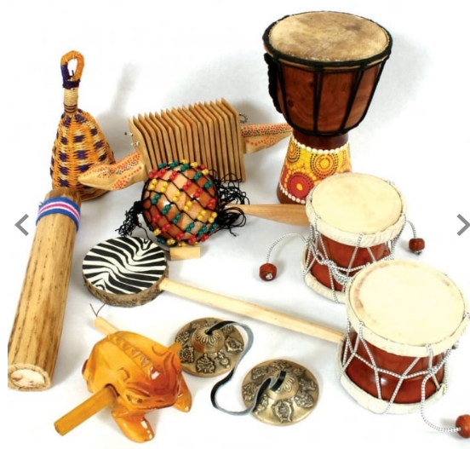
What will you be learning?
Literacy- Exciting Texts-instructions, poetry, non fiction, phonics and stories.
Maths-Number facts, times tables, addition , subtraction, measuring and 2D & 3D shapes.
Humanities-Finding about the history and geography of the world.
And…
Computing, Science, Music, PSHE, Art, R.E, P.E
achieve
learn,
and love
Jesus.
following
We
Notes:
Excellence in ALL aspects of their lives- religious/spiritual, moral , social, cultural, physical, intellectual, emotional

Slide 3
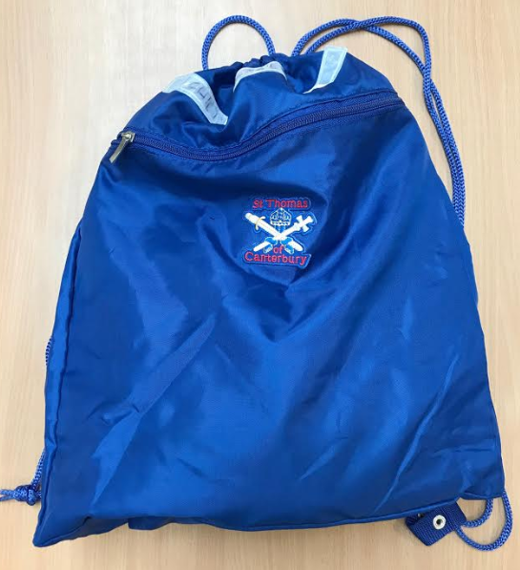
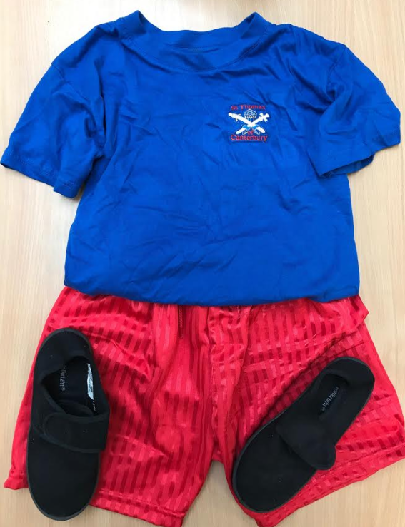
Things you will need
P.E Kit- Shorts, t-shirt, plimsolls (in a named P.E.bag).
Book Bag- Please do not bring in large bags or ruck-sacks to school.
Please put your name and class on everything-especially blazers, jumpers, cardigans, PE Kits and book bags.
achieve
learn,
and love
Jesus.
following
We

Slide 4
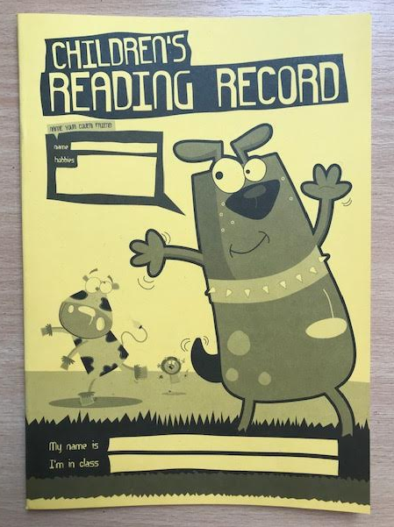
In Year 1 you will be expected to:
Always try your best.
Be kind and considerate to everyone.
Do your homework and make sure that you hand it in every Wednesday morning.
Read to an adult daily at home and change your reading book every Friday.
Bring in your signed Reading record, every day.
Look after your own things.
achieve
learn,
and love
Jesus.
following
We
Notes:
Our BROAD and BALANCED CURRICULUM
SOCIAL and EMOTIONAL LEARNING

Slide 5

Try to do these in the holidays
Enjoy yourself!
Be kind to the rest of the family and your friends.
Look forward to working hard in Year 1.
Bring back some holiday memories to share with us.
Practise your number bonds to 10.
Read or share a book everyday and ensure you can read all your Reception 100 high frequency words.
Draw a picture and write a few sentences about it, as often as you can.
Take part in the library summer reading challenge 2020 (see last slide).
achieve
learn,
and love
Jesus.
following
We
Notes:
Financial priorities are a greater indicator of a school’s mission than the flowery language of a mission statement- Dr John Lydon

Slide 6
For Parents and carers
We want to make the change of class as easy as possible for your child. You can help them by:
Ensuring that all their possessions especially jumpers, cardigans and book bags are named and easily identifiable.
Encourage your child’s growing independence, letting them sort our their own book bag, put on their coat and get dressed. We understand that this takes them time at first.
achieve
learn,
and love
Jesus.
following
We

Slide 7
Listenting to them read, or ask them about their books and encourage them to read for 10 minutes every day. Also,
Practisting Maths skills in a friendly and informal way-number games (board games), mental arithmetic and times tables facts.
Encouraging and supporting them to do their homework by themselves.
achieve
learn,
and love
Jesus.
following
We

Slide 8


Summer reading challenge https://api.readingagency.org.uk/users/sign_up
achieve
learn,
and love
Jesus.
following
We

Slide 9
Please return
Children will need to return their reading records, ready for us to use in Year 1.
Please also return any books that you may have and I will return them to Reception.
Also, please collect any ‘welly’ boots that have been left on the pegs outside your child’s class. Any left after 13th September will be removed, ready for the new children.
achieve
learn,
and love
Jesus.
following
We
Notes:
Those who feel excluded can feel included – pupils and staff

