Slide 1
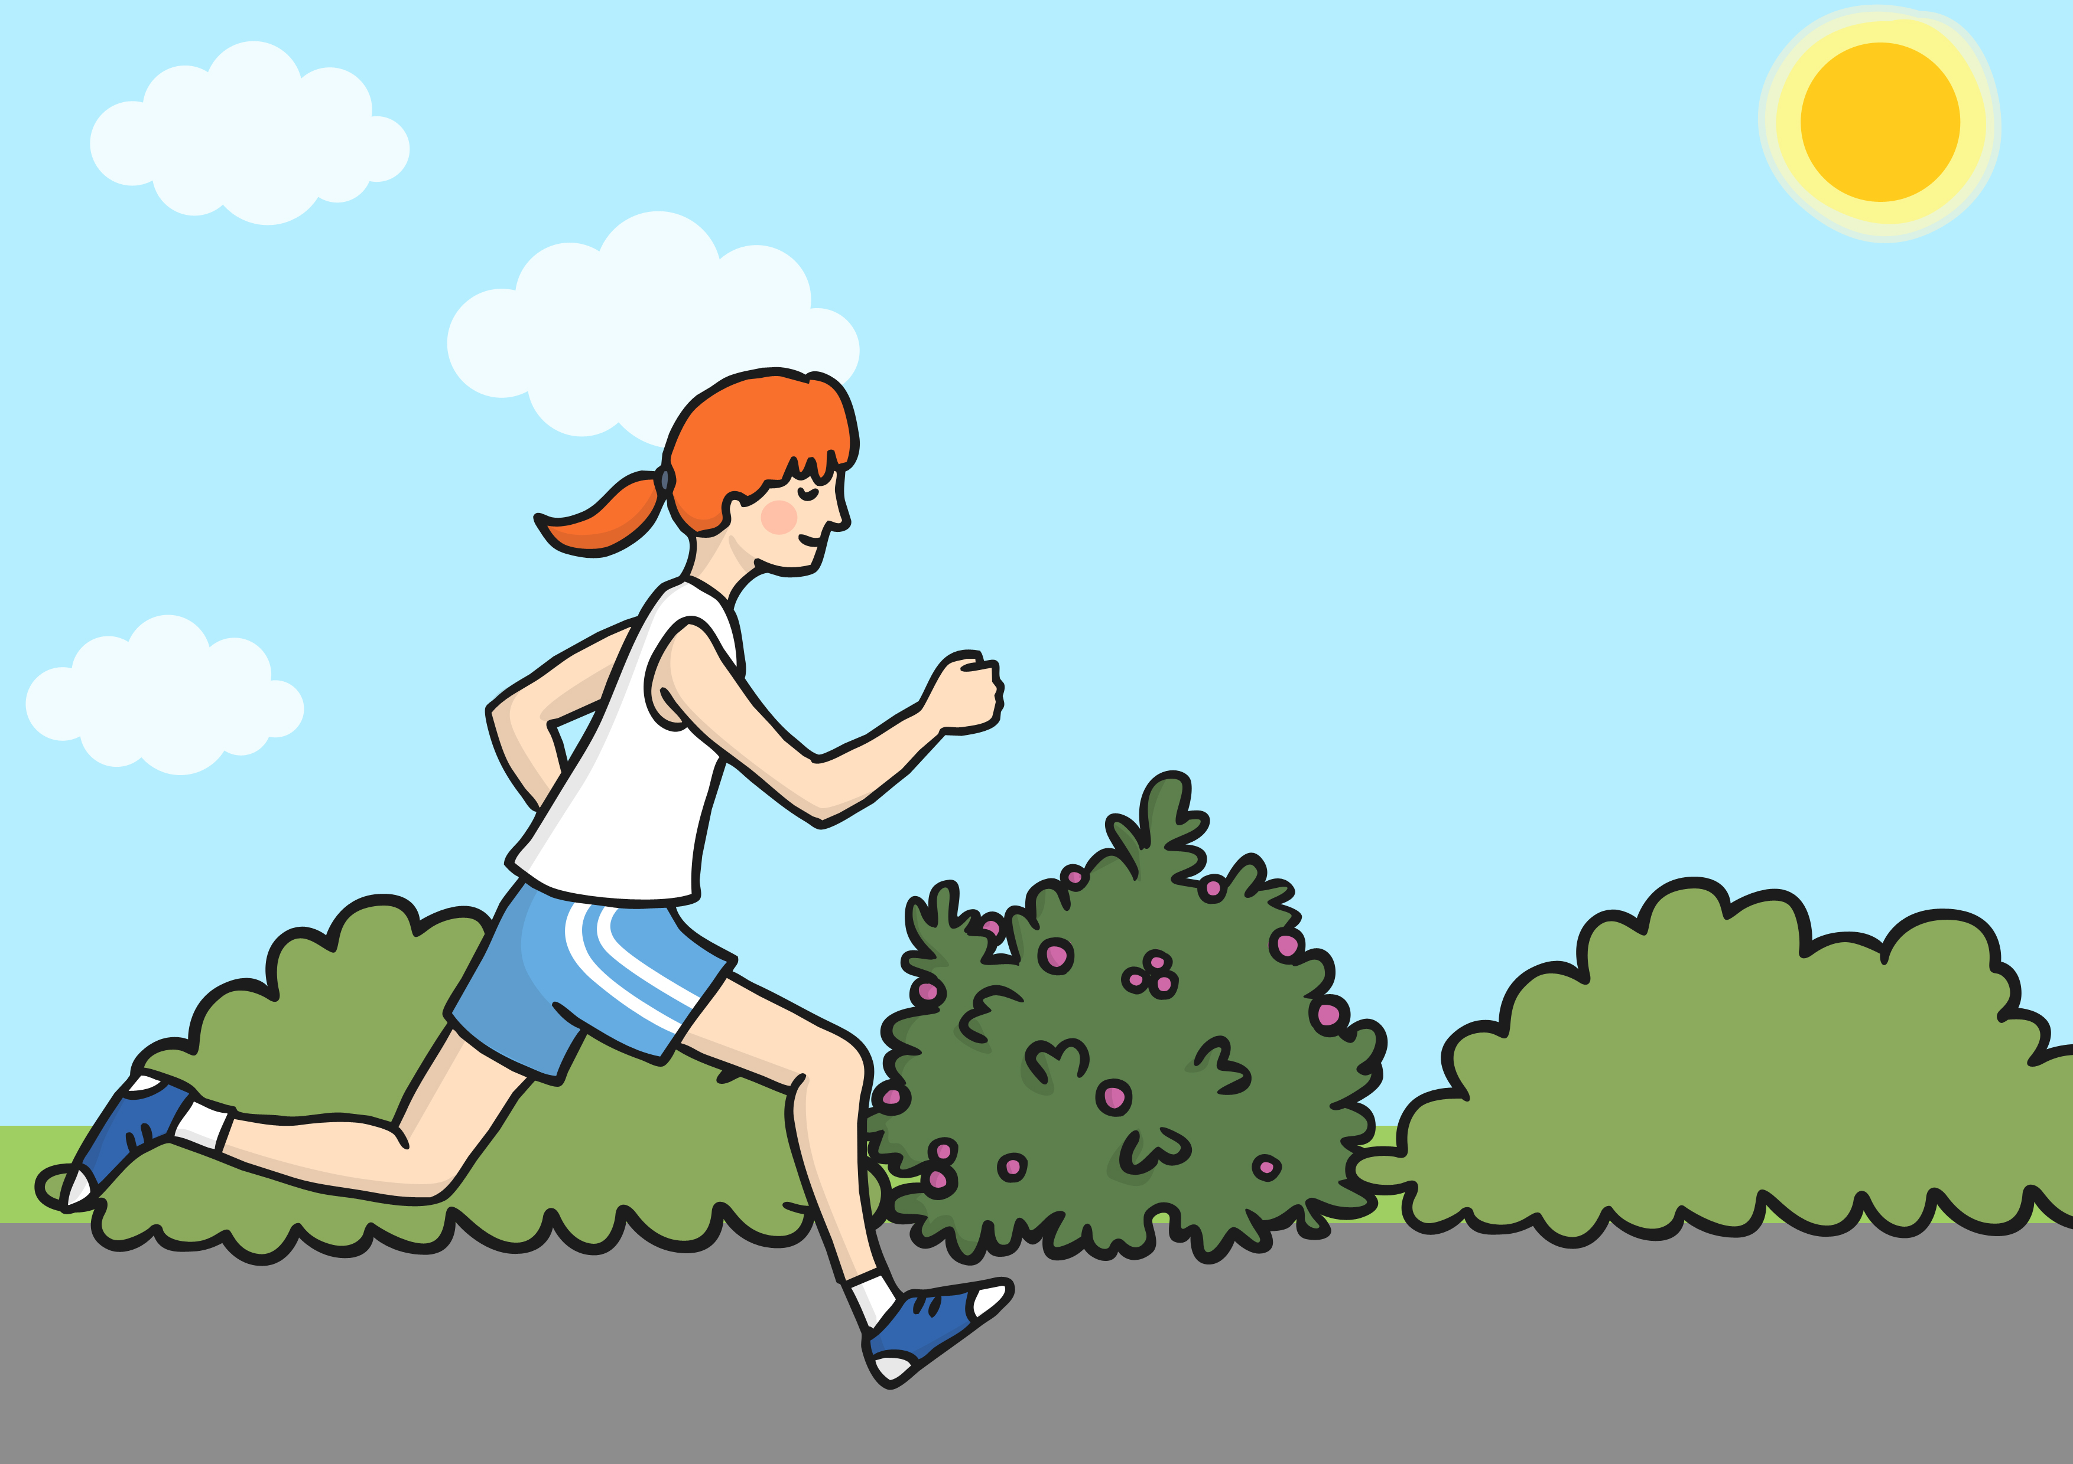


A task setting PowerPoint about the importance of exercise

Slide 2

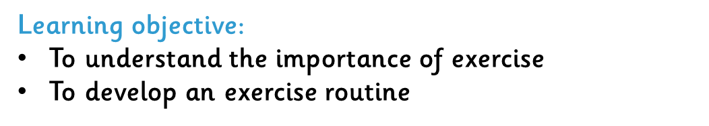
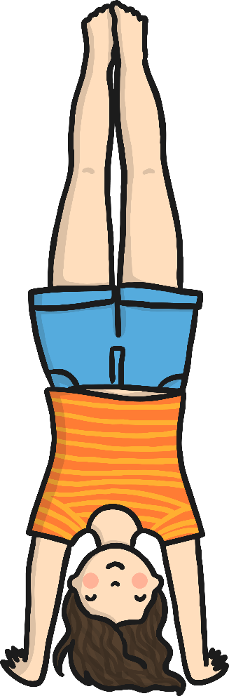
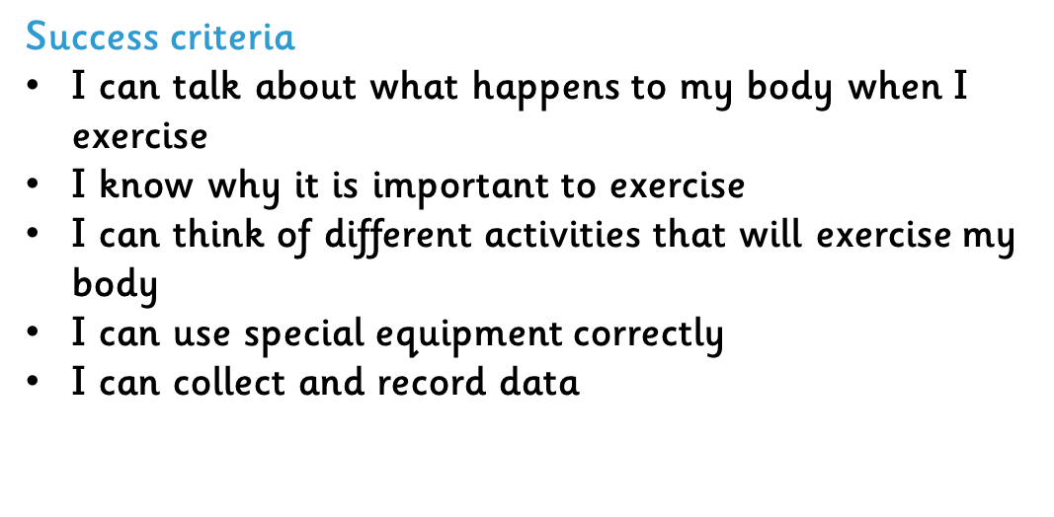

Slide 3
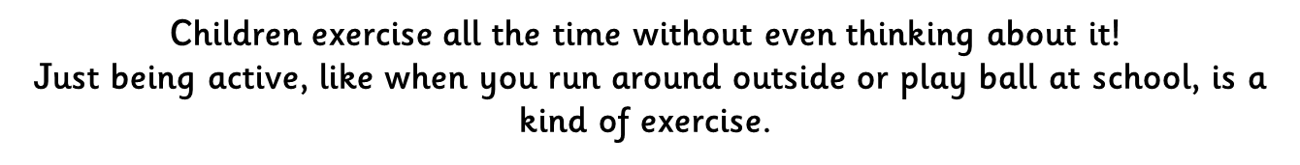
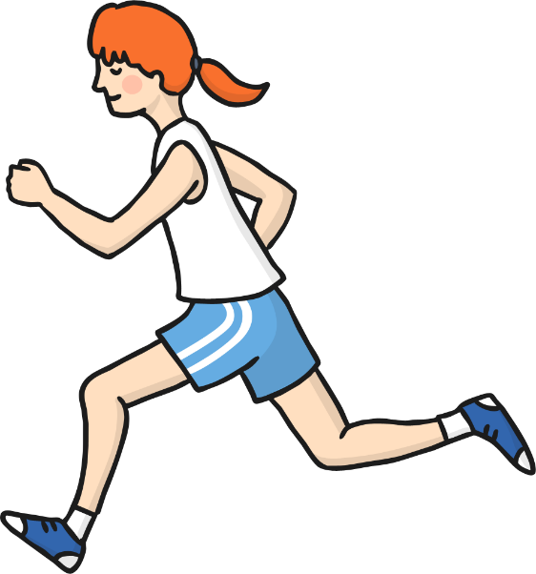
Children exercise all the time without even thinking about it!
Just being active, like when you run around outside or play ball at school, is a kind of exercise.

Slide 4
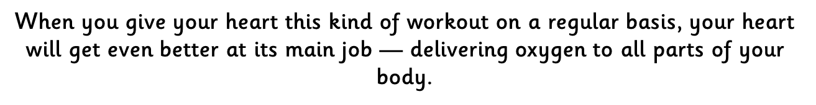
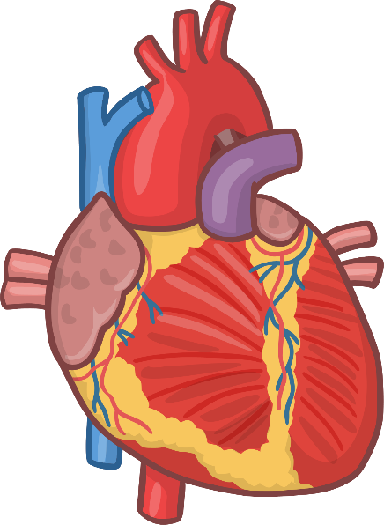

Slide 5
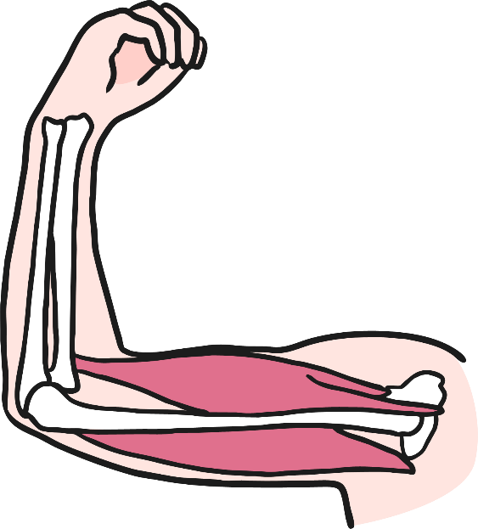
Exercise Strengthens Muscles
Another kind of exercise can help make your muscles stronger. Exercising that can build strength. By using your muscles to do powerful things, you can make them stronger.

Slide 6
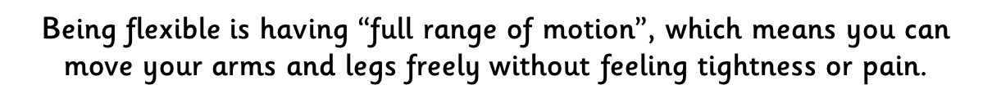
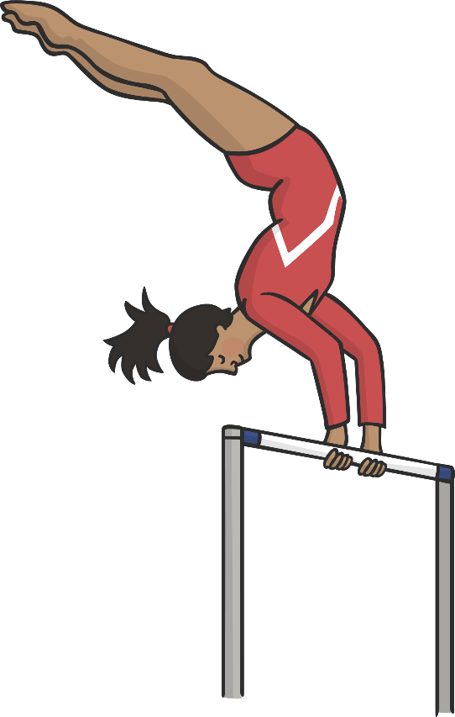
Exercise Strengthens Muscles
Another kind of exercise can help make your muscles stronger. Exercising that can build strength. By using your muscles to do powerful things, you can make them stronger.

Slide 7
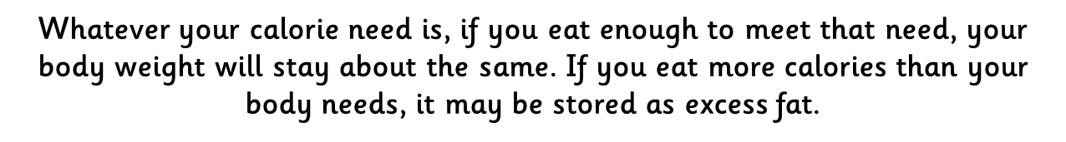
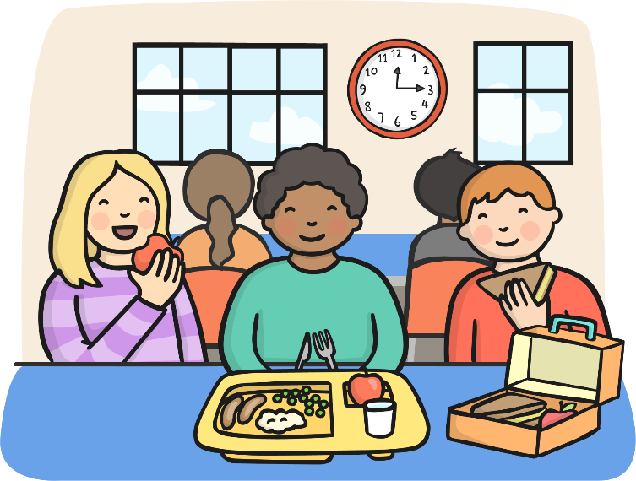

Slide 8
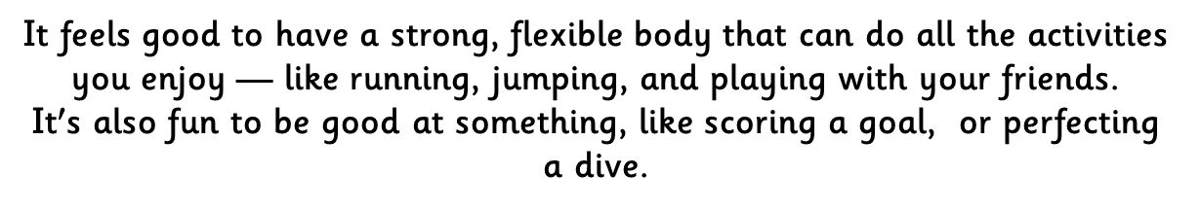
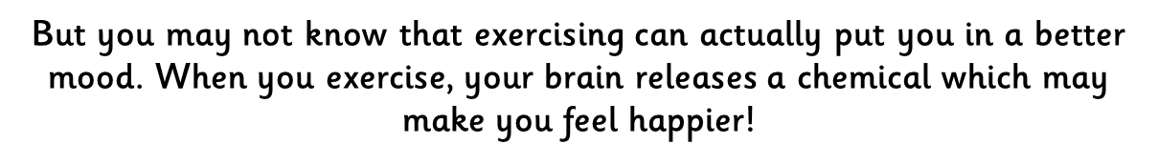



Slide 9


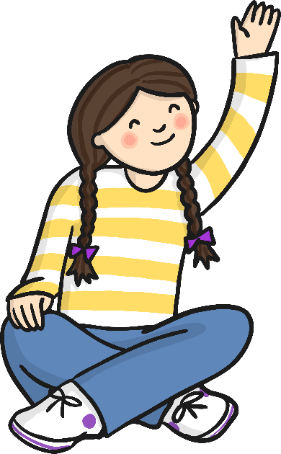

Slide 10
