Slide 1


Year 3 –– Money
Step 1: Pounds and Pence
© Classroom Secrets Limited 2018

Slide 2
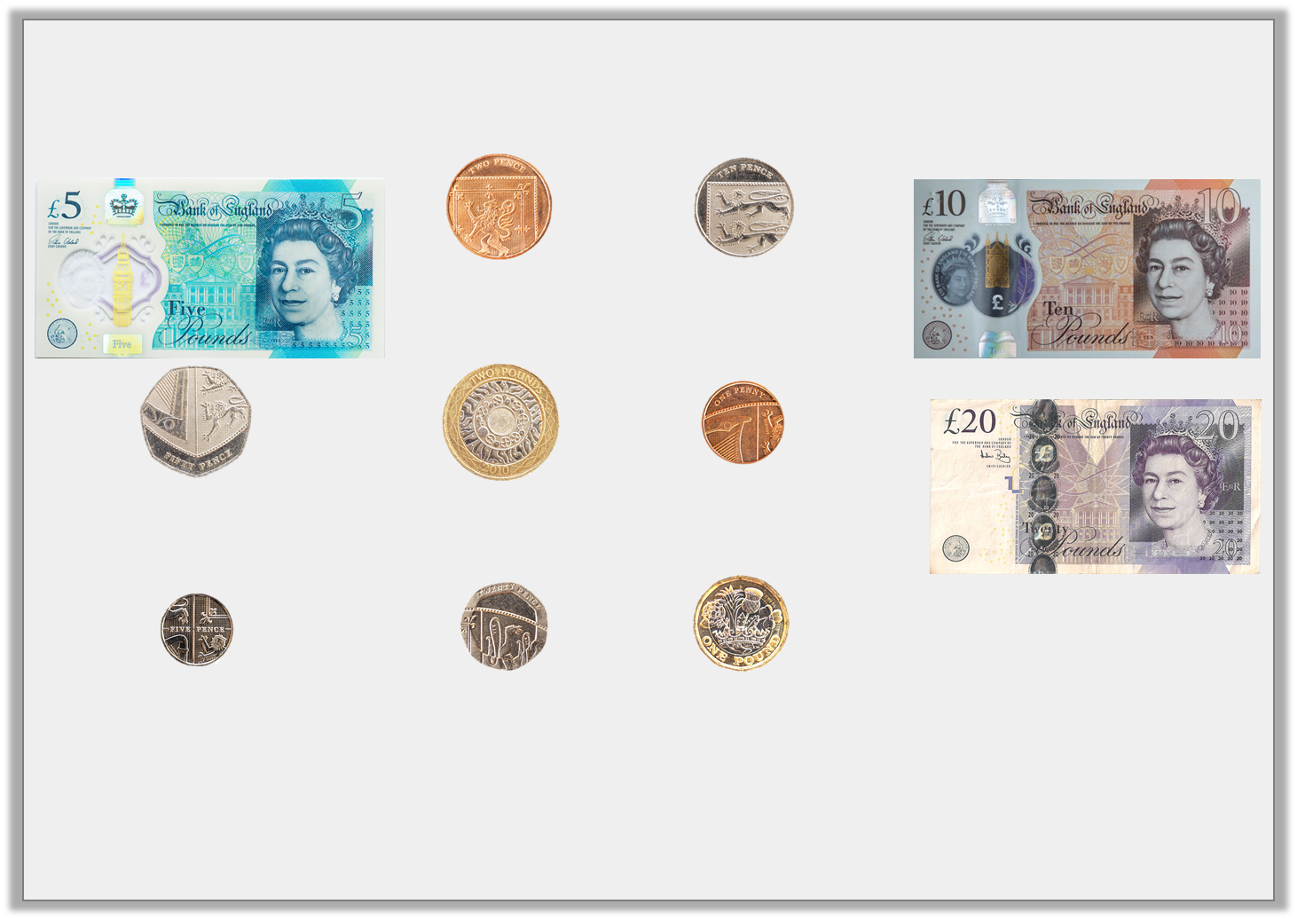
Introduction
Match the coins or notes to their values.
20p
£20
£5
5p
2p
1p
10p
£10
50p
£2
£1
© Classroom Secrets Limited 2018

Slide 3
Introduction
Match the coins or notes to their values.
Now place them in value order, largest at the top left.
£5
2p
10p
£10
50p
£2
1p
£20
5p
20p
£1
© Classroom Secrets Limited 2018

Slide 4
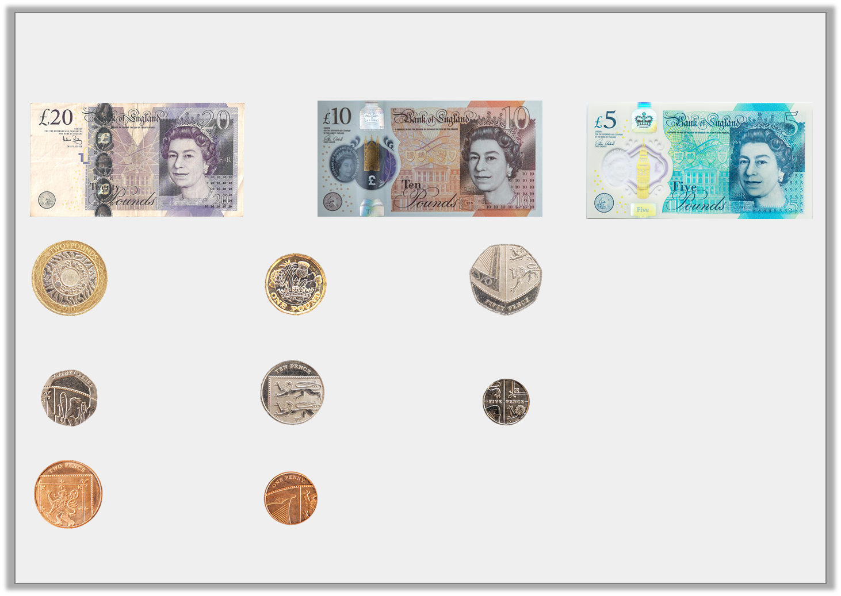
Introduction
Match the coins or notes to their values.
Now place them in value order, largest at the top left.
£20
£10
£5
£2
£1
50p
20p
10p
5p
2p
1p
© Classroom Secrets Limited 2018

Slide 5
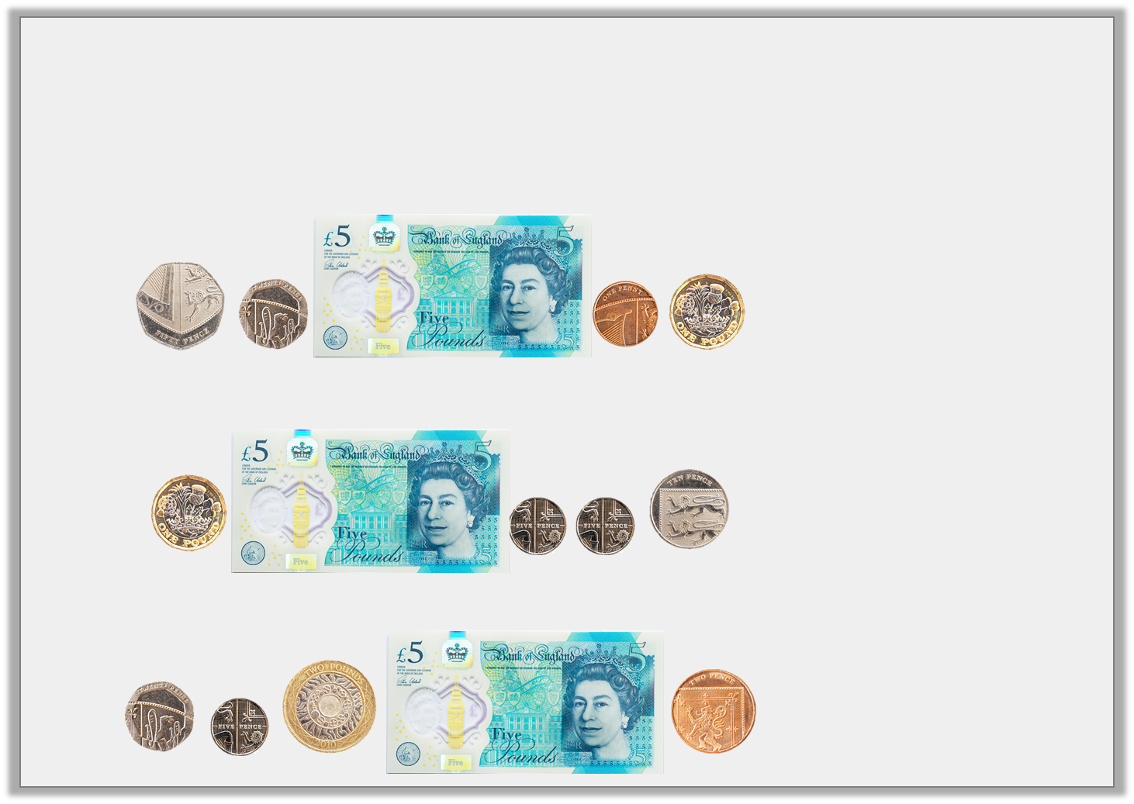
Varied Fluency 1
Match the notes and coins to the correct amounts.
A.
B.
C.
£6 and 20p
£6 and 71p
£7 and 27p
© Classroom Secrets Limited 2018

Slide 6
Varied Fluency 1
Match the notes and coins to the correct amounts.
A.
B.
C.
£6 and 20p
£6 and 71p
£7 and 27p
© Classroom Secrets Limited 2018

Slide 7
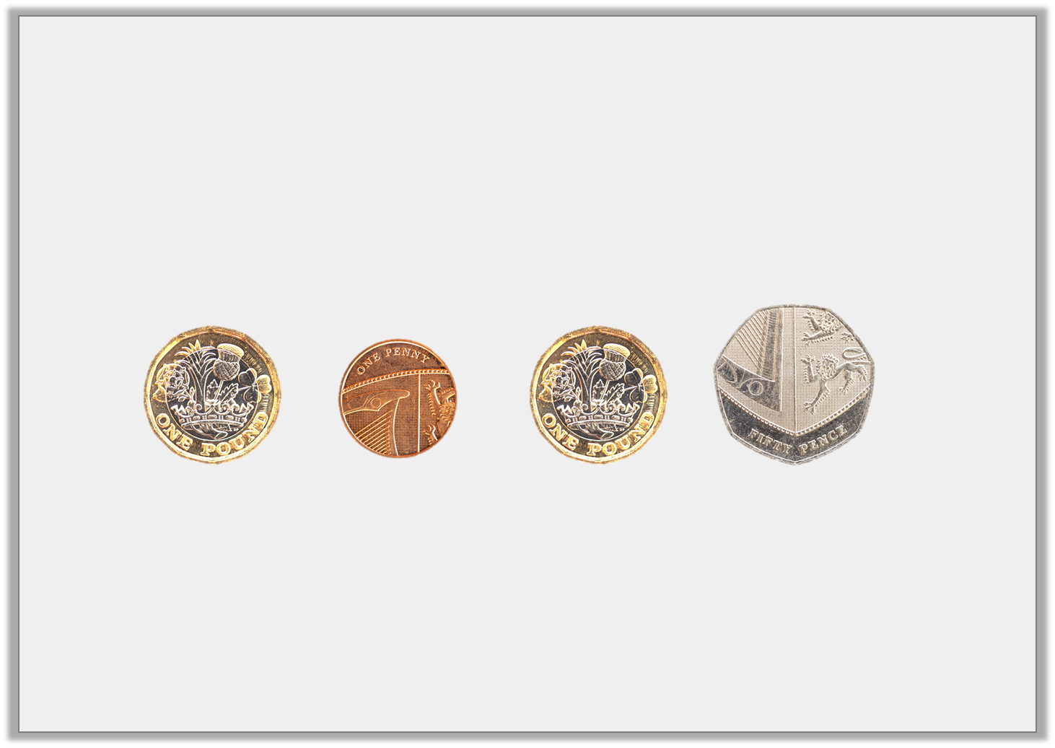
Varied Fluency 2
Identify the total of the coins below.
© Classroom Secrets Limited 2018

Slide 8
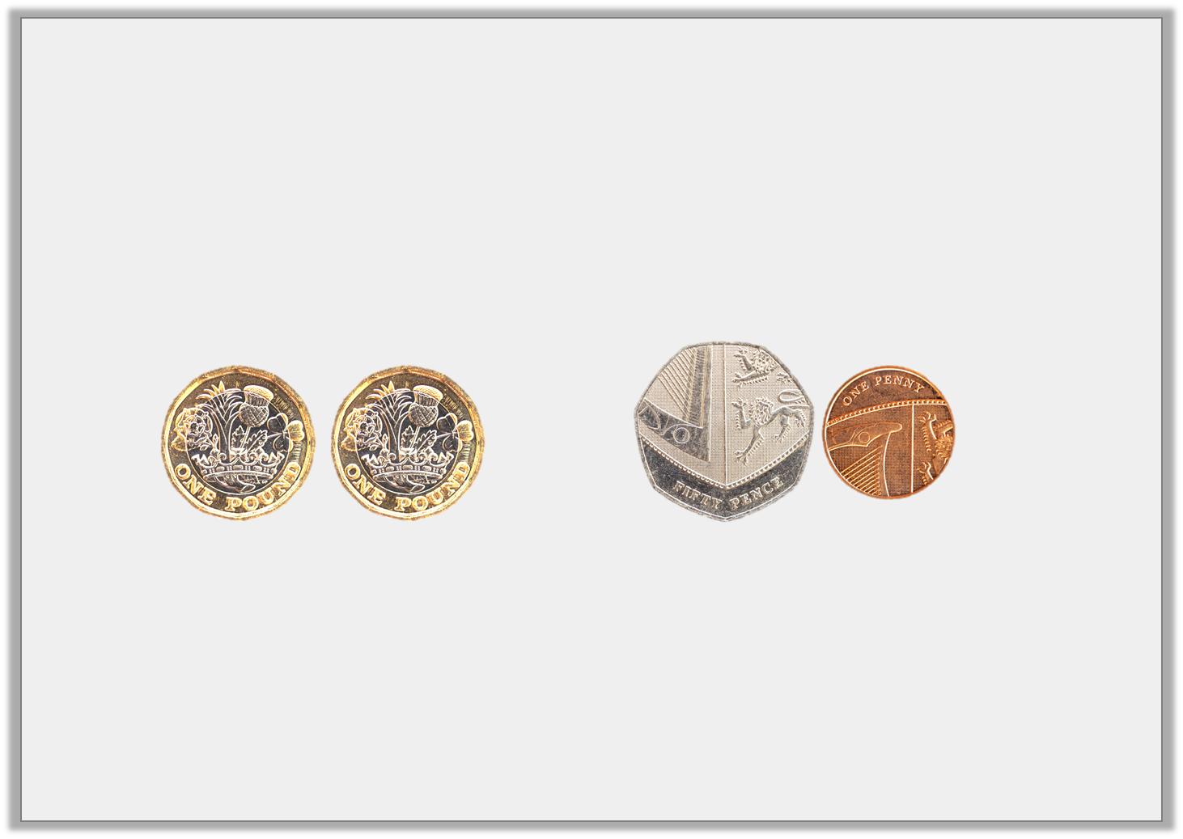
Varied Fluency 2
Identify the total of the coins below.
£2 and 51p
© Classroom Secrets Limited 2018

Slide 9
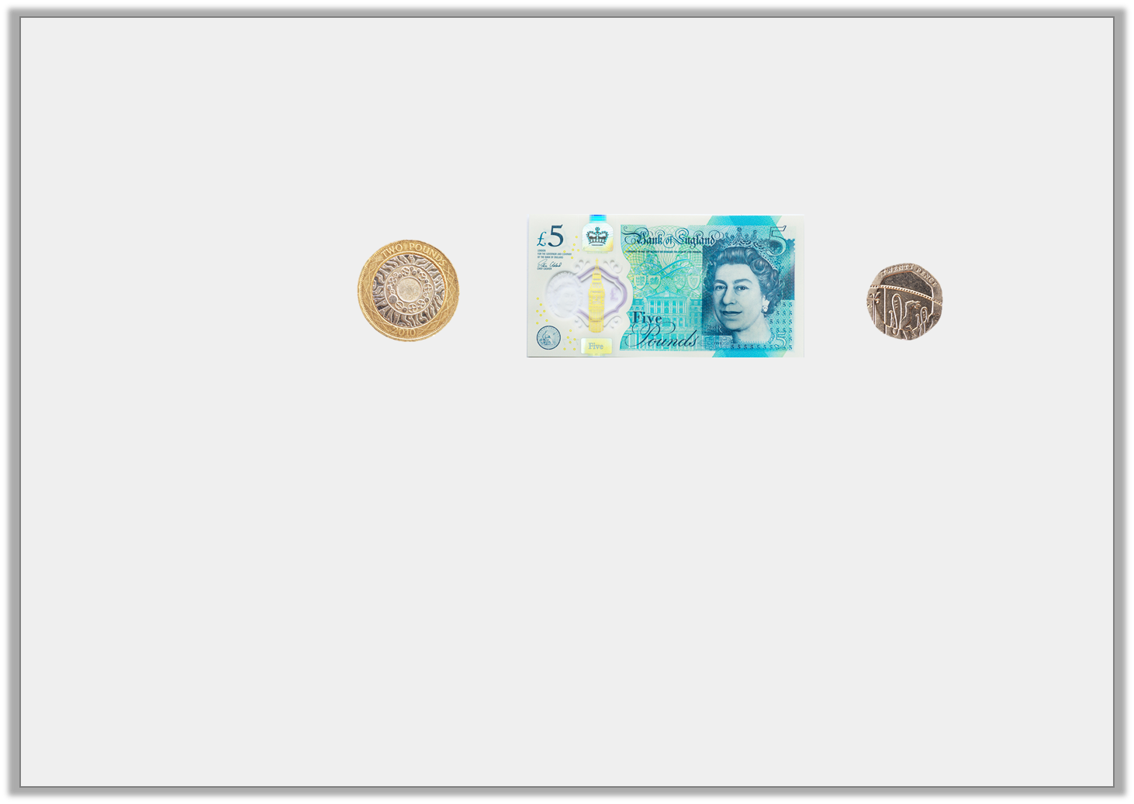
Varied Fluency 3
Which has the greatest value?
A.
B. | £7 and 40p
C. | £8 and 20p
© Classroom Secrets Limited 2018

Slide 10
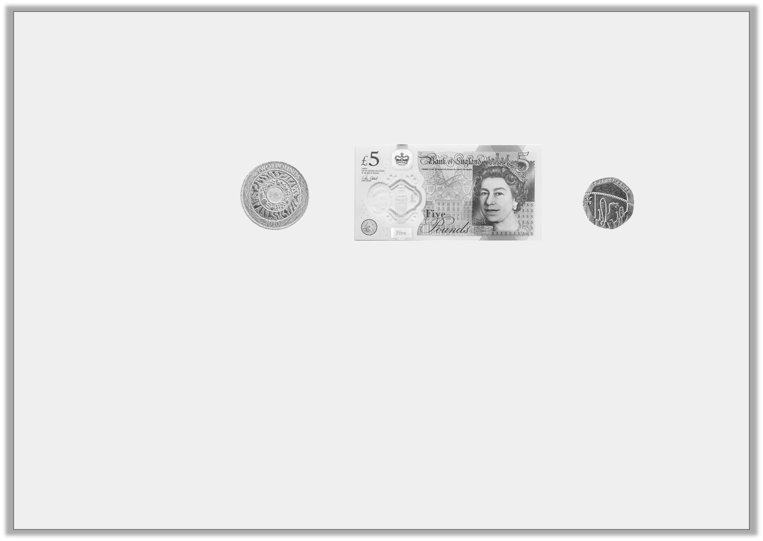
Varied Fluency 3
Which has the greatest value?
A.
B. | £7 and 40p
C. | £8 and 20p
© Classroom Secrets Limited 2018

Slide 11
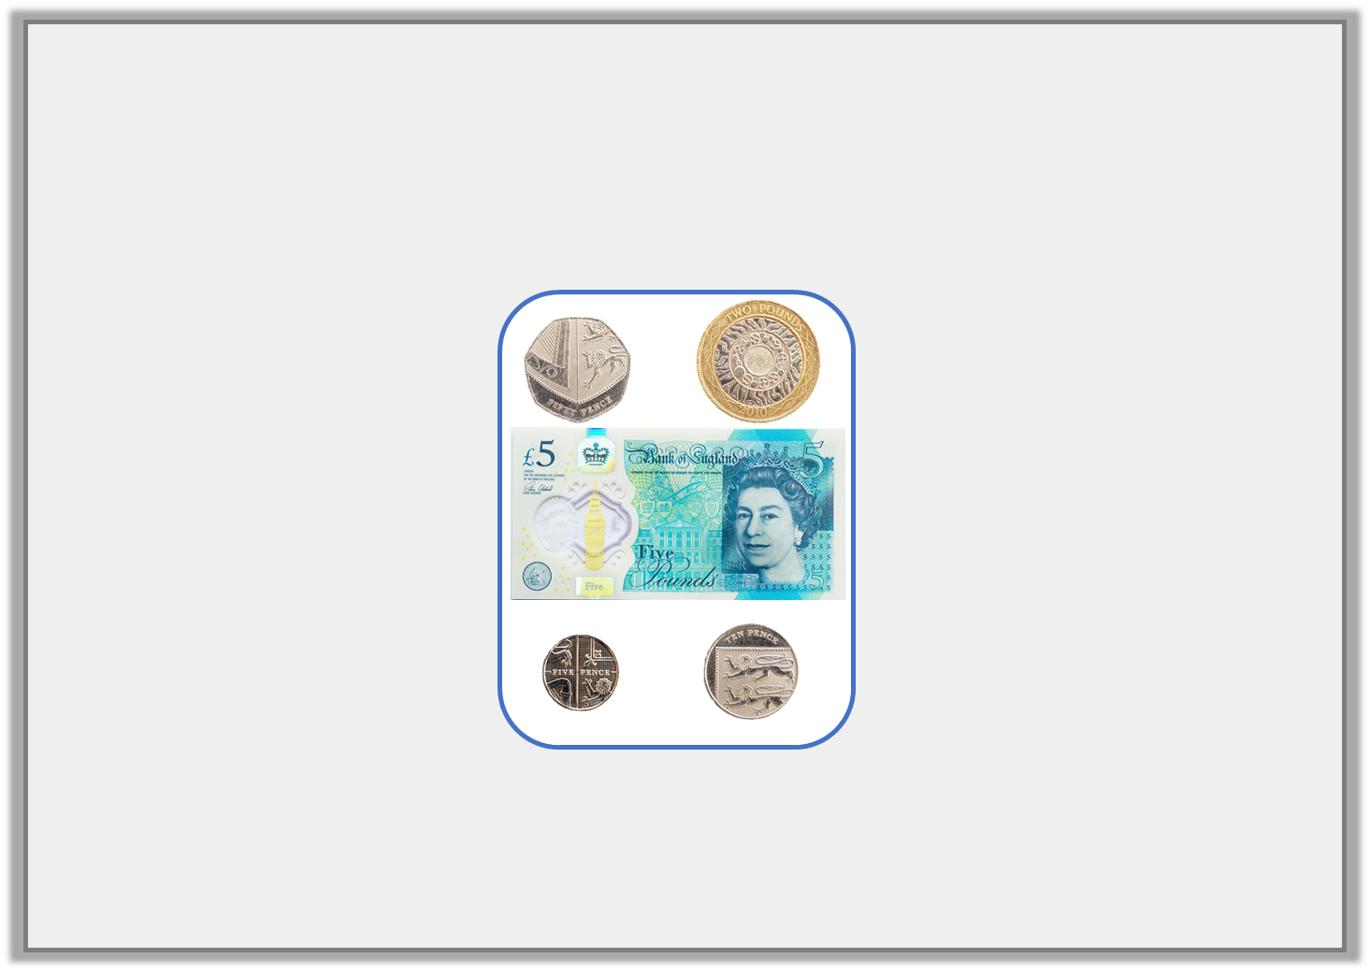
Varied Fluency 4
Tick the odd one out.
A. | B. | C.
£6 and 56p
£7 and 65p
© Classroom Secrets Limited 2018

Slide 12
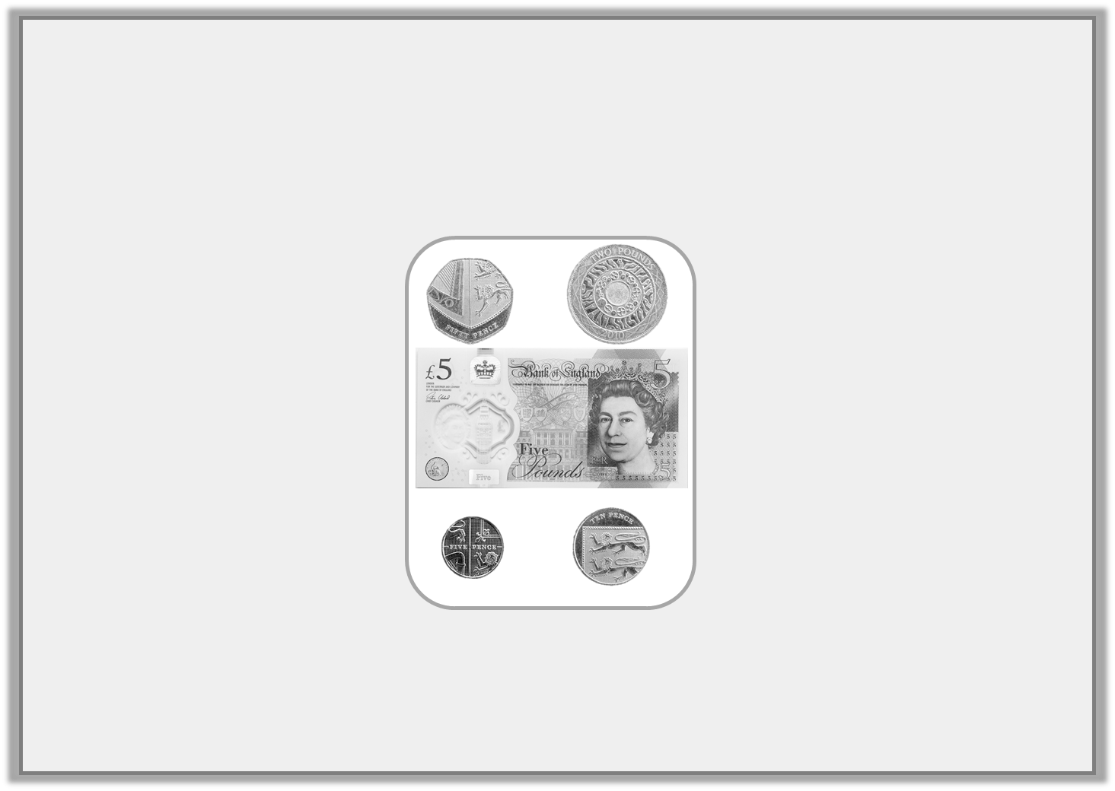
Varied Fluency 4
Tick the odd one out.
A. | B. | C.
£6 and 56p
£7 and 65p
✓
© Classroom Secrets Limited 2018

Slide 13
Problem Solving 1
Look at the pricelist below.
Frank uses 5 coins to buy some flip flops and 1 note and 6 coins to buy some goggles.
Find three possible combinations of notes and coins for each item which total less than £10 for each item.
Flip Flops | £____ and 40p
Goggles | £8 and _____ p
© Classroom Secrets Limited 2018

Slide 14
Problem Solving 1
Look at the pricelist below.
Frank uses 5 coins to buy some flip flops and 1 note and 6 coins to buy some goggles.
Find three possible combinations of notes and coins for each item which total less than £10 for each item.
Various answers, for example: To buy some flip flops he could use one £2 coin, two £1 coins, two 20p coins (£4 and 40p);
To buy some goggles he could use one £5 note, one £2 coin, one £1 coin, one 50p coin, two 10p coins and one 5p coin (£8 and 75p).
Three different combinations given for each.
Flip Flops | £____ and 40p
Goggles | £8 and _____ p
© Classroom Secrets Limited 2018

Slide 15

Problem Solving 2
Draw £9 and 10p in the purse, using one note and up to five coins.
Find one more combination.
© Classroom Secrets Limited 2018

Slide 16
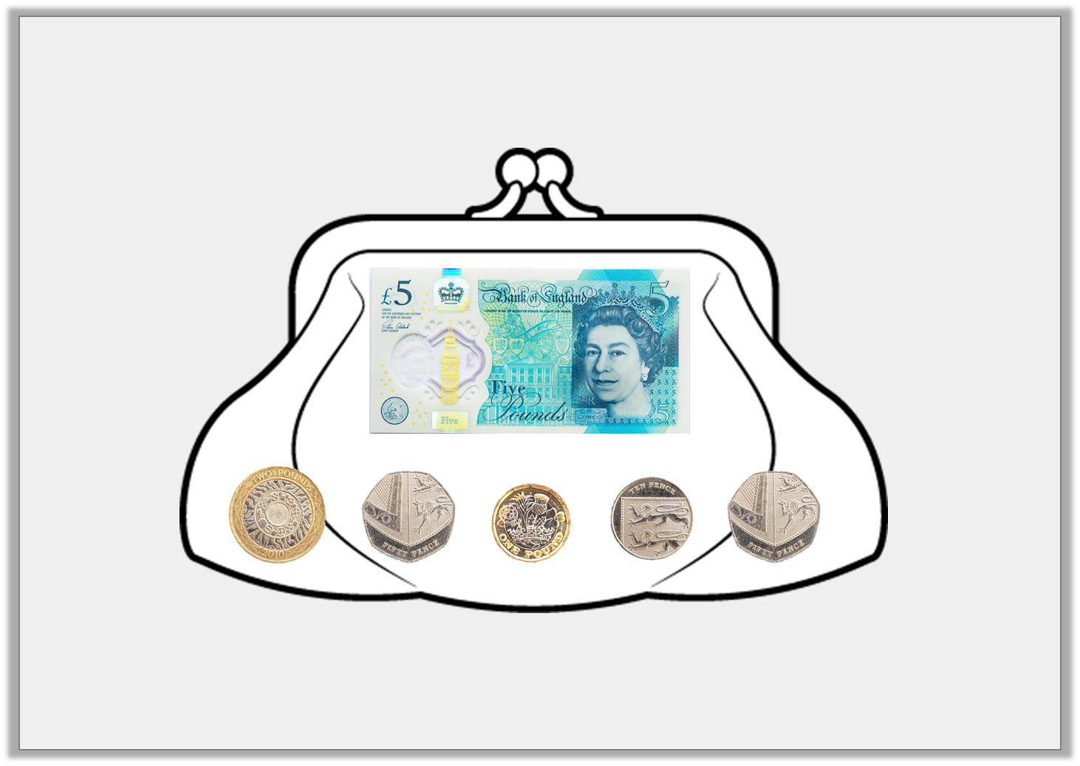
Problem Solving 2
Draw £9 and 10p in the purse, using one note and up to five coins.
Find one more combination.
One £5 note, two £2 coins and two 5p coins.
© Classroom Secrets Limited 2018

Slide 17
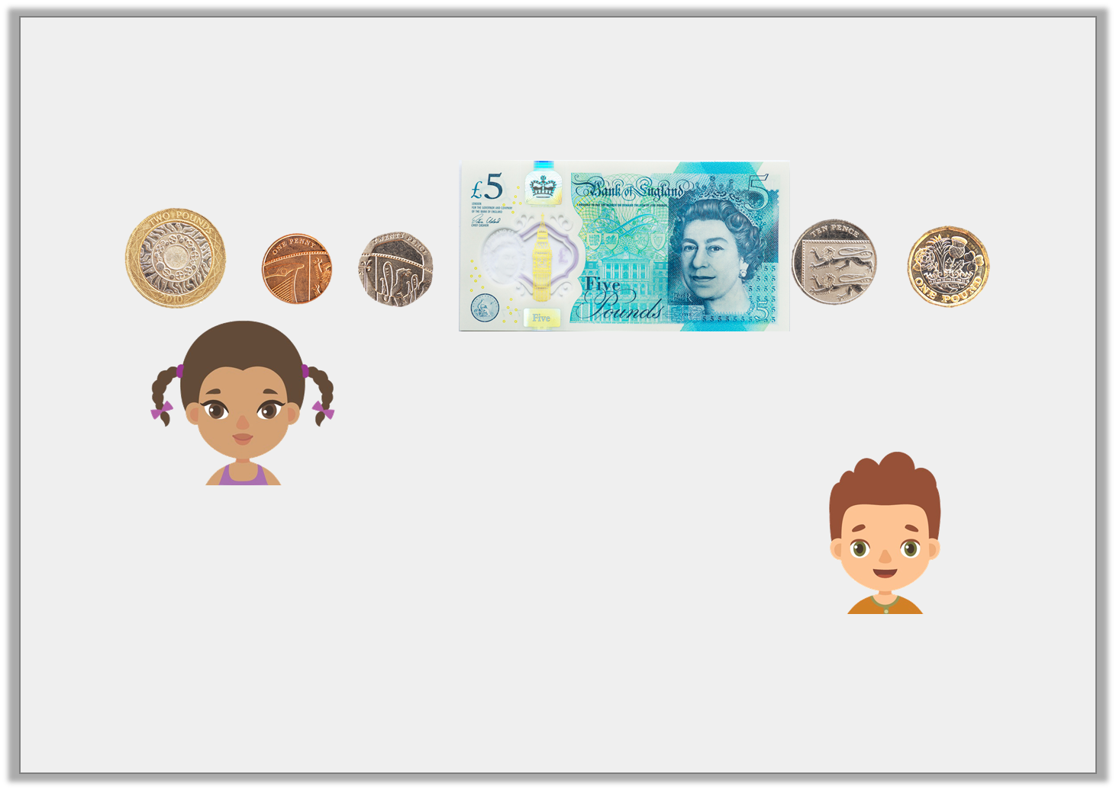
Reasoning 1
Freya and Niles are finding the total of the coins below.
Who is correct? Explain why.
I think the total is £8 and 26p.
Freya
I think the total is £8 and 31p.
Niles
© Classroom Secrets Limited 2018

Slide 18
Reasoning 1
Freya and Niles are finding the total of the coins below.
Who is correct? Explain why.
Niles is correct because...
I think the total is £8 and 26p.
Freya
I think the total is £8 and 31p.
Niles
© Classroom Secrets Limited 2018

Slide 19
Reasoning 1
Freya and Niles are finding the total of the coins below.
Who is correct? Explain why.
Niles is correct because one £5 note + one £2 coin + one 20p coin + one 10p coin + one 1p coin = £8 and 31p.
I think the total is £8 and 26p.
Freya
I think the total is £8 and 31p.
Niles
© Classroom Secrets Limited 2018

