Slide 2
Diving into Mastery Guidance for Educators
Each activity sheet is split into three sections, diving, deeper and deepest, which are represented by the following icons:
Always start with diving. If that is easy, then try deeper. For an extra challenge try deepest (do all three) !
Diving
Deeper
Deepest

Slide 3
Aim
Read, write, order and compare numbers to at least 1 000 000 and determine the value of each digit.

Slide 4
Compare and Order Numbers to 100 000
Diving
Complete the statements using the correct symbol: <, > or =.
<
24 105 24 115
10 000
1000
100
10
10
1
1
12 354
<
1000
100
10
10
10
1
1
10 000
10 000
1000
1000
1
<
=
36 032
10 000
1000
1000
1000
1
100
100
100
100
100
20 000
16 032
10
10
10
10
What number could go in the box?
Any number greater than 89 523
89 023
> 89 523
What number could go in the box?
>

Slide 5
Compare and Order Numbers to 100 000
Diving
You have eight counters. Create four different numbers.
There must be one counter in at least four columns.
Ten Thousands | Thousands | Hundreds | Tens | Ones
Write the numbers down.
Write them in ascending order.
Using your numbers, write at least four statements comparing two or more numbers using the symbols <, > and =.
These could be 30 122 13 121 41 111 22 211
13 121 22 211 30 122 41 111
30 122 > 13 121 22 211 < 41 111 13 121 < 30 122 41 111 > 30 122

Slide 6
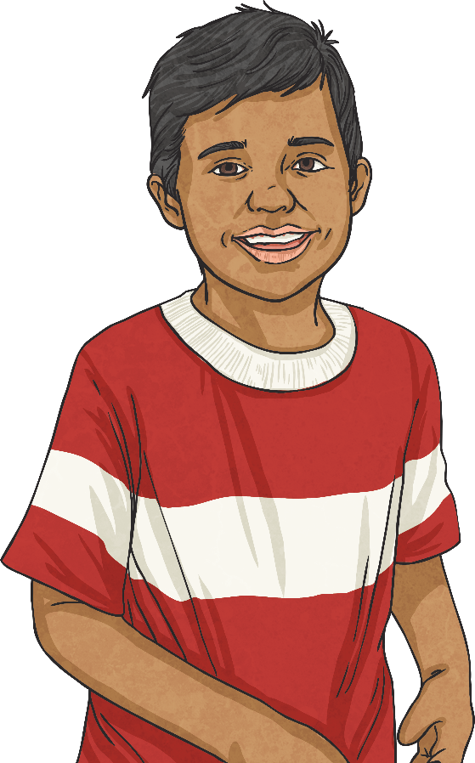
Compare and Order Numbers to 100 000
Deeper
Curtis and Anton are looking at the number 95 124.
Their teacher asks them what digit is in the hundreds place. Curtis writes down 100 and Anton writes down 1.
Anton is correct. The digit in the hundreds place is 1. A digit is any numeral from 0 to 9. If the teacher had asked what is the value of the digit 1, this would have been 100.
Who do you agree with and why?

Slide 7
Compare and Order Numbers to 100 000
Deeper
You have seven counters. There must be a counter in at least four columns.
What is the greatest number you can make? Explain your thinking.
What is the smallest number you can make? Explain your thinking.
41 110
The greatest possible amount of counters need to be in the highest value columns.
1114
The greatest possible amount of counters need to be in the lowest value columns.
Ten Thousands | Thousands | Hundreds | Tens | Ones

Slide 8
Compare and Order Numbers to 100 000
Deepest
Here are 10 digit cards. You can only use each digit once.
1
2
3
4
5
6
7
8
9
0
My number has five digits.
The sum of the digits is 16.
Rounded to the nearest thousand, my number is 56 000.
My tens of thousands digit is one more than the ones digit.
The value of my hundreds is 0.
What is my number?
56 014

Slide 9
Compare and Order Numbers to 100 000
Deepest
1
2
3
4
5
6
7
8
9
0
I have a different five-digit number. All the digits are different.
The hundreds digit is half of the tens digit. The thousands digit is half of the ones digit.
Here are some of the possible answers:
41 362 51 362 71 362 81 362 91 362
12 364 52 364 72 364 82 364 92 364
13 486 53 486 61 482 71 482 93 486
What could my number be? How many different solutions can you find?

Slide 10
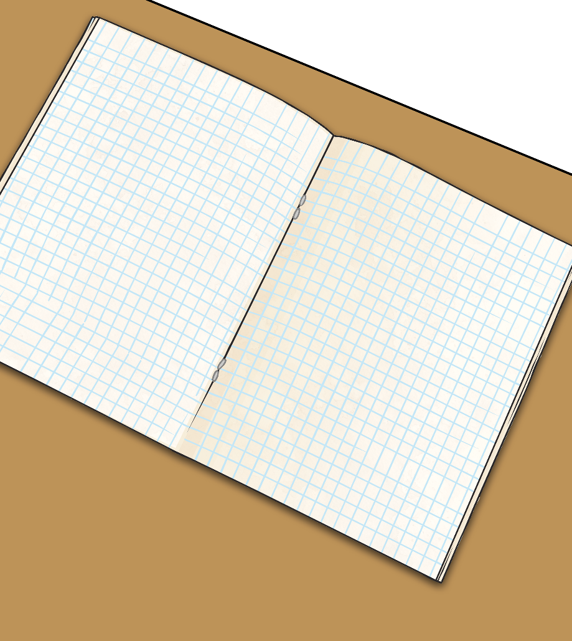
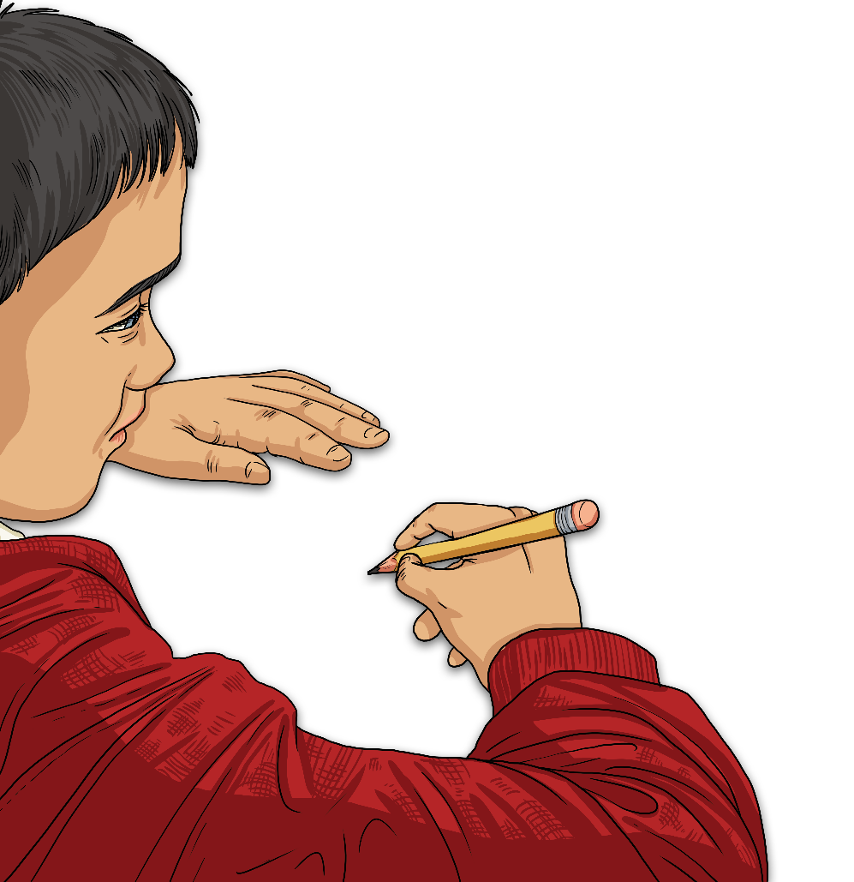
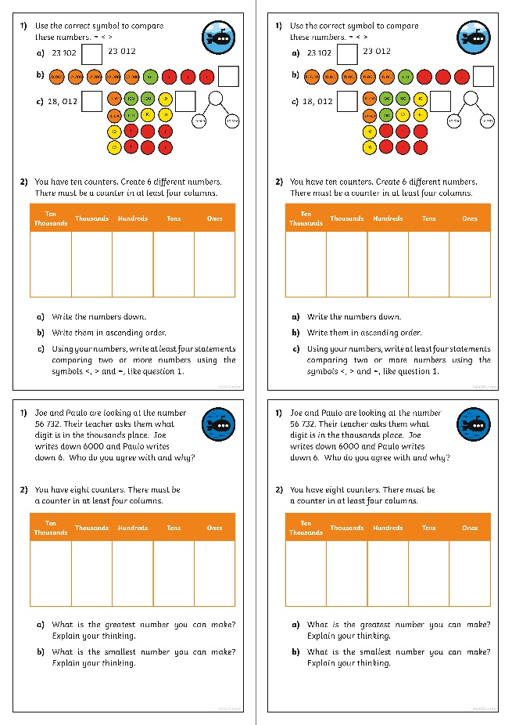
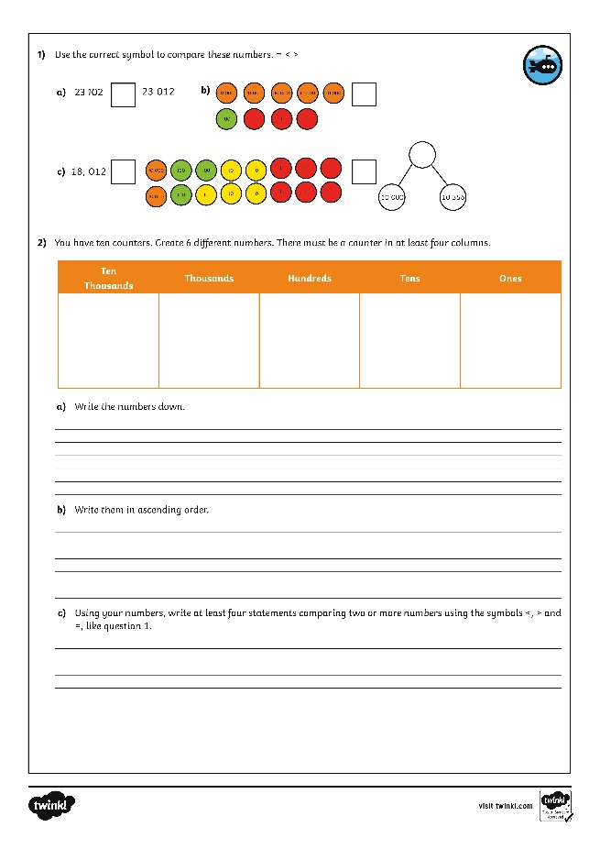
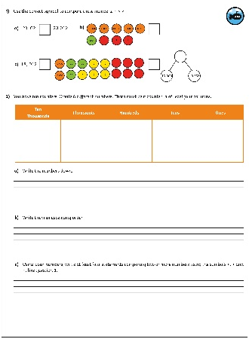
Compare and Order Numbers to 100 000
Dive in by completing your own activity!

