Slide 2
Diving into Mastery Guidance for Educators
Each activity sheet is split into three sections, diving, deeper and deepest, which are represented by the following icons:
Always start with diving. If that is easy, then try deeper. For an extra challenge try deepest (do all three) !
Diving
Deeper
Deepest

Slide 3
Aim
Round any number up to 1 000 000 to the nearest 10, 100, 1000, 10 000 and 100 000.

Slide 4
Round Numbers within 100 000
Diving
Complete this table.
 | Round to the nearest 10 | Round to the nearest 100 | Round to the nearest 1000 | Round to the nearest 10 000
35 342
23 689
67 951
 | Round to the nearest 10 | Round to the nearest 100 | Round to the nearest 1000 | Round to the nearest 10 000
35 342 | 35 340 | 35 300 | 35 000 | 40 000
23 689 | 23 690 | 23 700 | 24 000 | 20 000
67 951 | 67 950 | 68 000 | 68 000 | 70 000

Slide 5
Round Numbers within 100 000
Diving
What could the starting number be for each row?
Possible answers are…
 | Round to the nearest 10 | Round to the nearest 100 | Round to the nearest 1000 | Round to the nearest 10 000
 | 35 860 | 35 900 | 36 000 | 40 000
 | 36 040 | 36 000 | 36 000 | 40 000
 | 35 960 | 36 000 | 36 000 | 40 000
 | Round to the nearest 10 | Round to the nearest 100 | Round to the nearest 1000 | Round to the nearest 10 000
35 859 | 35 860 | 35 900 | 36 000 | 40 000
36 042 | 36 040 | 36 000 | 36 000 | 40 000
35 959 | 35 960 | 36 000 | 36 000 | 40 000
The first number needs to be between 35 855 and 35 864.
The second number needs to be between 36 035 and 36 044.
The third number needs to be between 35 955 and 35 964.

Slide 6
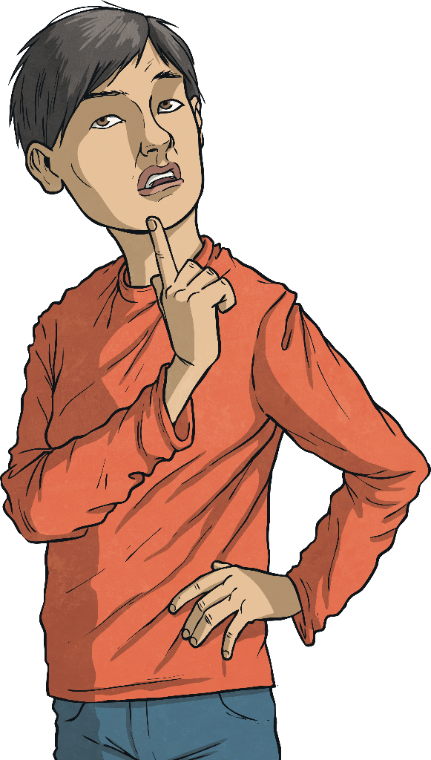
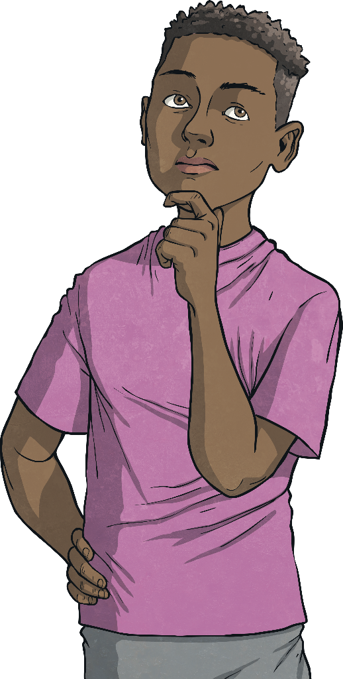
Round Numbers within 100 000
Deeper
Mick says that if he rounds 49 895 to the nearest 10, 100, 1000 and 10 000, he will get the same answer. Brodie disagrees.
Who do you agree with? Explain your answer and prove it!
Brodie is correct.
49 895 to the nearest 10 is 49 900.
To the nearest 100, it is 49 900.
To the nearest 1000, it is 50 000.
To the nearest 10 000, it is 50 000.
Mick
Brodie

Slide 7
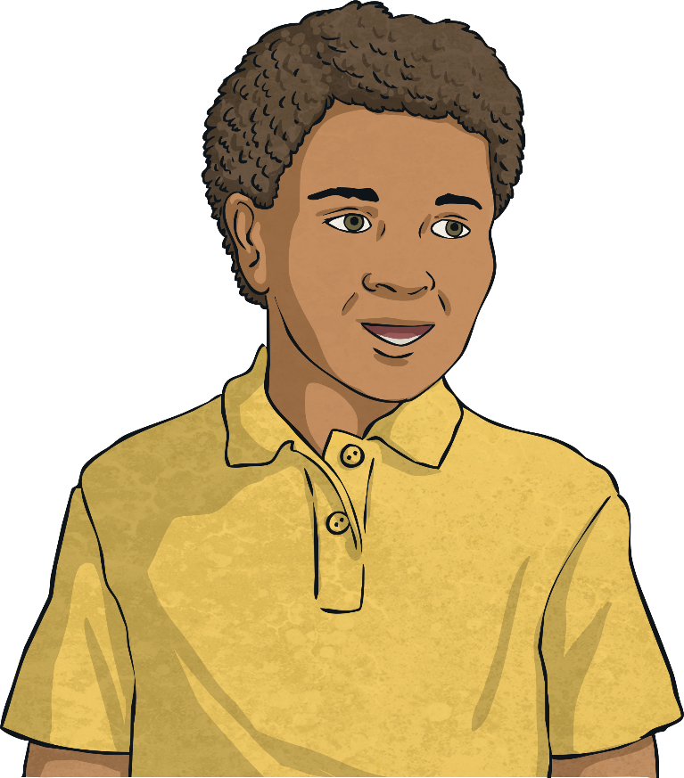
Round Numbers within 100 000
Deeper
Eli is looking at how many people went to see a concert.
He says that rounded to the nearest 10 000, 120 000 people went.
How many people could have attended? Can you give three different possible answers?
Any answers between 115 000 and 124 999 are correct.
What are the fewest and greatest numbers of people that could have attended? How do you know?
115 000. This is the lowest number that still rounds to 120 000 to the nearest 10 000.
124 999. This is the greatest number that still rounds to 120 000 to the nearest 10 000.

Slide 8
Round Numbers within 100 000
Deepest
Bryan has some 0-9 digit cards. Using each digit card only once, he says that he can make two numbers that, when rounded to the nearest 1000, are the same number. What could these numbers be?
1
2
3
4
5
6
7
8
9
0

Slide 9
Round Numbers within 100 000
Deepest
Bryan has some 0-9 digit cards. Using each digit card only once, he says that he can make two numbers that, when rounded to the nearest 1000, are the same number. What could these numbers be?
1
2
3
4
5
6
7
8
9
0
There are many possible answers, for example,
4012 and 3956 – both round to 4000
5932 and 6048 – both round to 6000
9037 and 8541 – both round to 9000

Slide 10
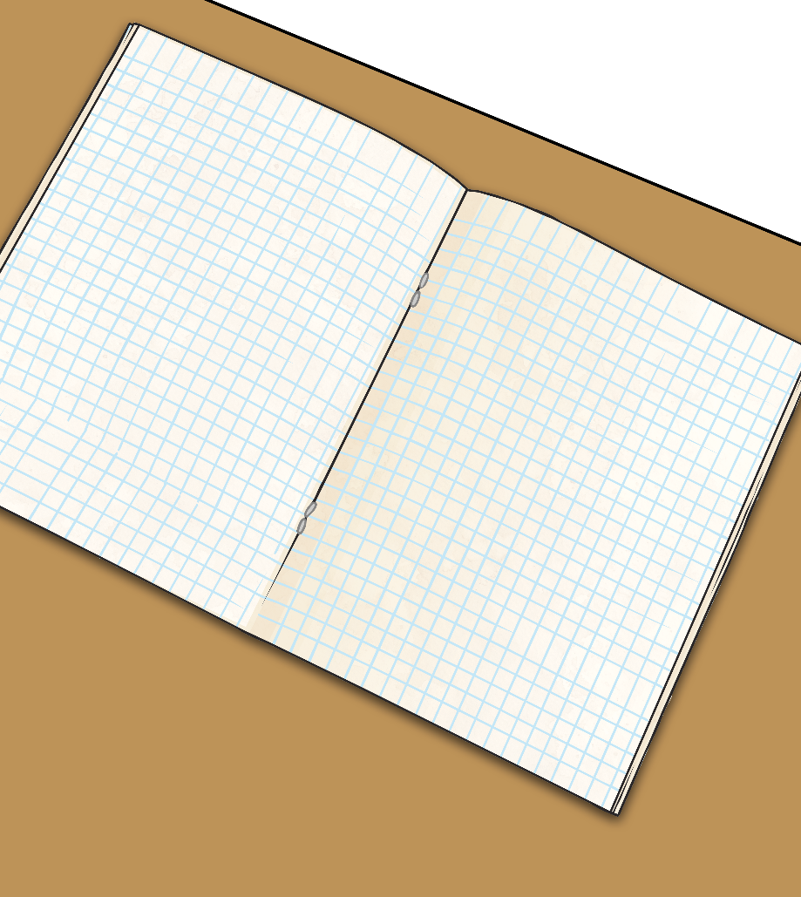
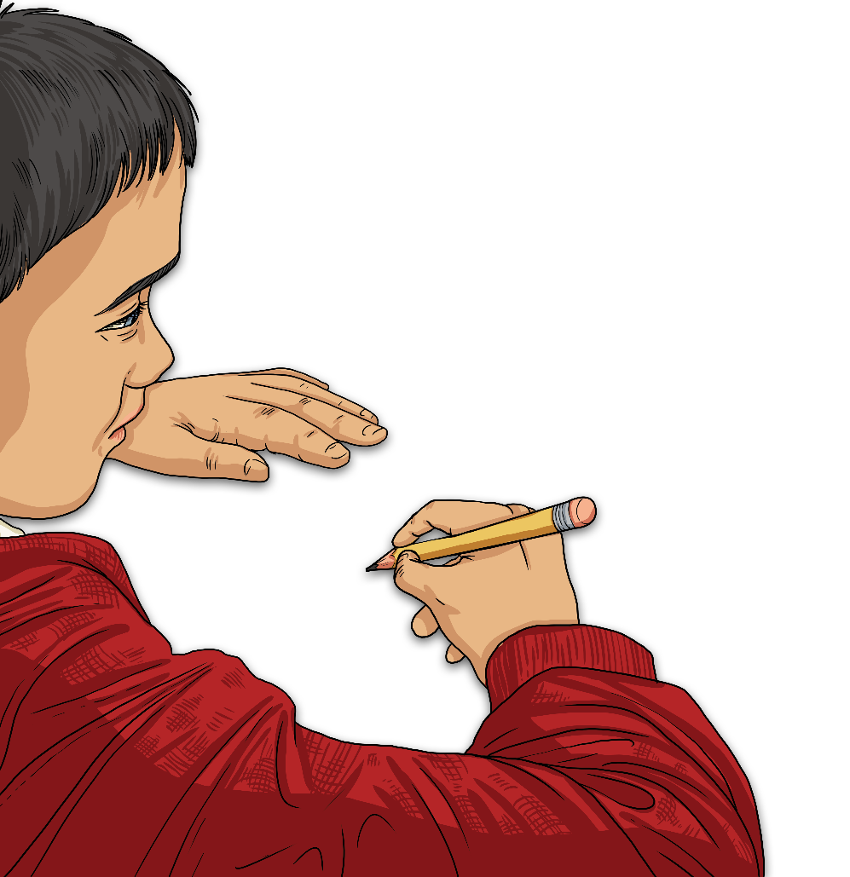
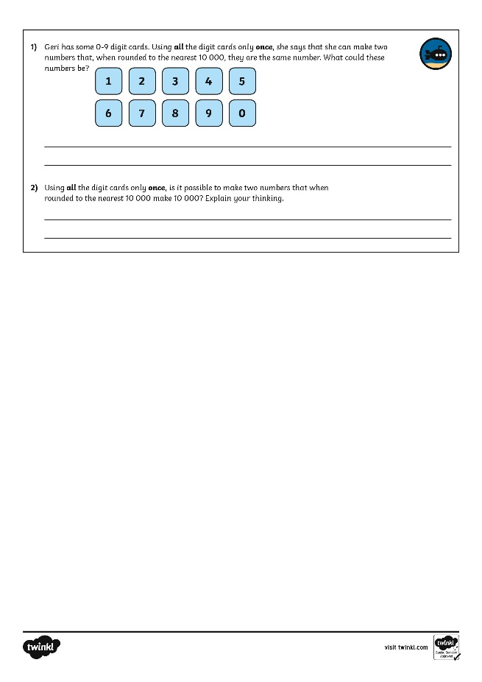
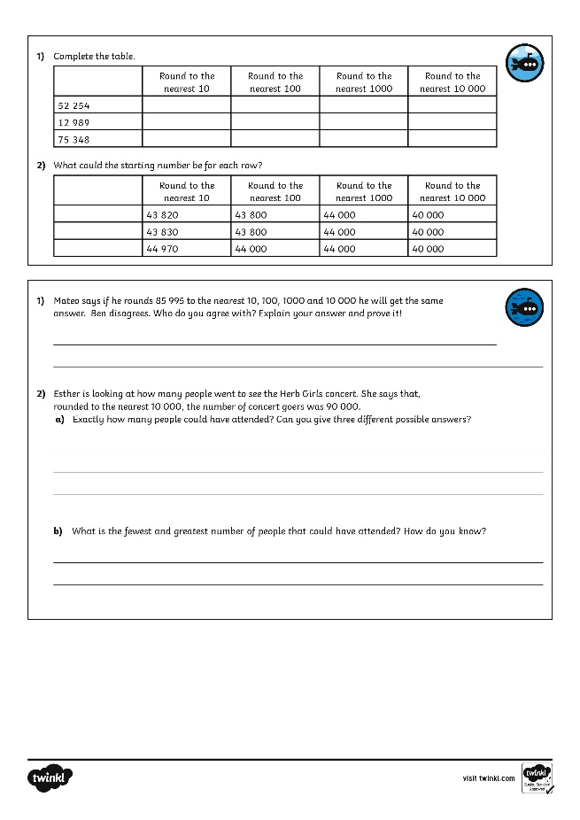
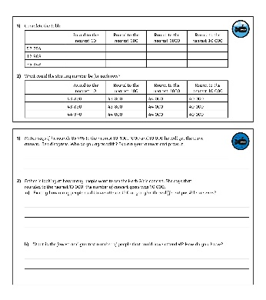
Round Numbers within 100 000
Dive in by completing your own activity!

