Slide 2



Diving into Mastery Guidance for Educators
Each activity sheet is split into three sections, diving, deeper and deepest, which are represented by the following icons:
Always start with diving. If that is easy, then try deeper. For an extra challenge try deepest (do all three) !
Diving
Deeper
Deepest

Slide 3
Aims
Read, write, order and compare numbers to at least 1 000 000 and determine the value of each digit.
Count forwards or backwards in steps of powers of 10 for any given number up to 1 000 000.

Slide 4





Numbers to 10 000
Diving
Complete the table by identifying what is missing from each representation of the following three numbers.
You could use the resources shown to make each number to help you.
 |  |  | 8105
 |  |  | 3075
 |  |  | 5535
 |  |  | 8105
 |  |  | 3075
 |  |  | 5535
8105
1000
8105
1000
1000
1000
1000
1000
1000
1000
100
100
1000
1000
1000
1000
1
1
1
6005
2100
1
1
2100
1000
1000
1000
1000
10
10
10
10
1
1
1
10
1
3075
10
1000
10
10
10
10
1
1
1075
2000
1
2000
1000
1000
1000
1000
1000
100
100
Accept any correct model, such as:
5535
100
100
100
10
10
10
1
1
1
1
1
4000
1535

Slide 5

Numbers to 10 000
Deeper
Complete the table.
 | +10 | -100 | +100 | +1000
5109
3260
 |  | 7019
 |  | 9520
 | +10 | -100 | +100 | +1000
5109 | 5119 | 5009 | 5209 | 6109
3260 | 3270 | 3160 | 3360 | 4260
7119 | 7129 | 7019 | 7219 | 8119
9620 | 9630 | 9520 | 9720 | 10 620

Slide 6
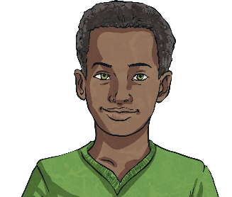
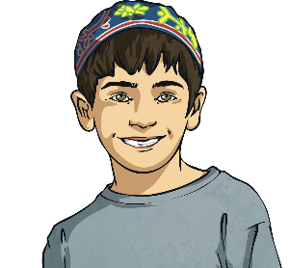
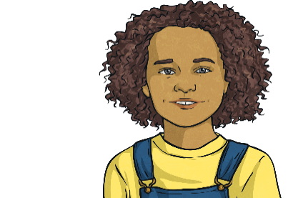
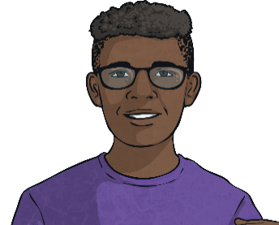
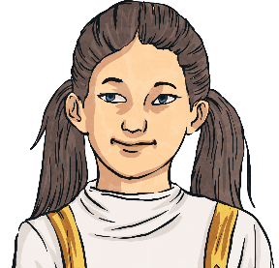
Numbers to 10 000
Deeper
Use the clues to correctly match the number card to the child.
12 030
3325
9030
5549
10 527
Callum
My number is divisible by 5.
Tommy
The digit sum of my number
is 23.
Alesha
My number is 3000 more than Moira’s number.
Zuli
My number has five digits.
Moira
My number is a multiple of 10.

Slide 7
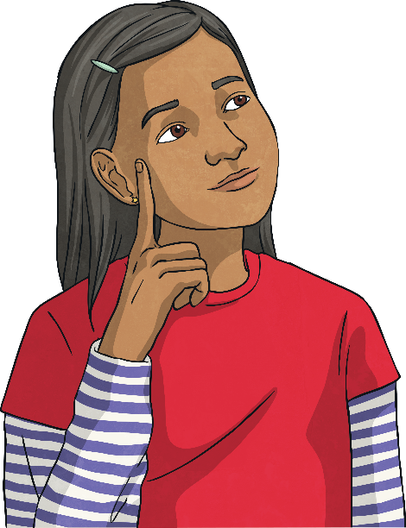
Numbers to 10 000
Deeper
Amara is counting in steps of 100 from 9105. She thinks that she will say the number 10 005.
Do you agree with her?
Discuss this with a partner to make sure you can explain your thinking clearly.
Amara is correct. She will count up
to 9905 and then the next number will
be 10 005.
Can you and your partner think of three other numbers that she would say?

Slide 8

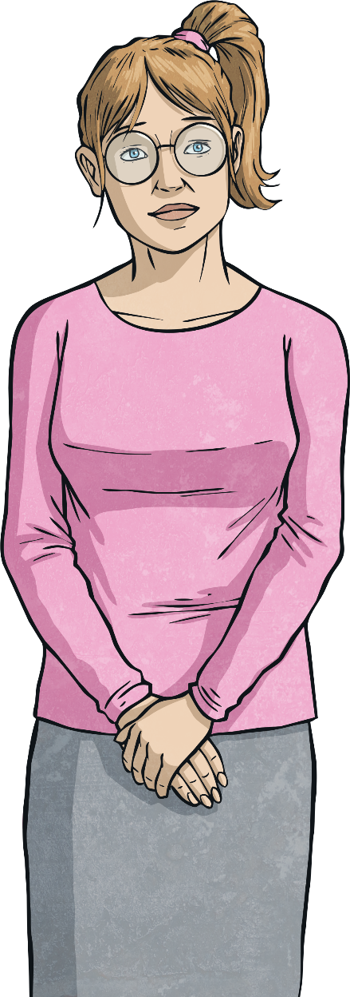
Numbers to 10 000
Deepest
I am counting forwards in steps of 1000.
I have just said 8106.
If I started counting backwards, what would be the first negative number I would say? Prove it!
I am counting forwards in steps of 1000.
I have just said 8106.
Can you identify three numbers that are less than 4000 that I have already said?
I am counting forwards in steps of 1000.
I have just said 8106.
Can you identify three other numbers
that I will say?
There are endless possible answers, such as 9106, 15 106 or 39 106. As long as your positive number ends in 106, you are correct!
-894. 106 is the last positive number that I would say; if I subtracted 1000 from this, I would
get -894.
3106, 2106, 1106, 106

Slide 9
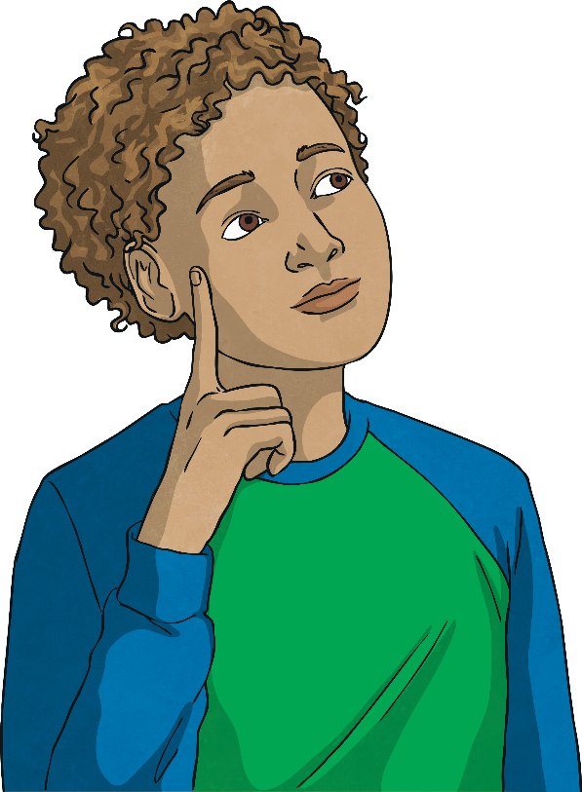
Numbers to 10 000
Deepest
Mustafa started with the number 8503. After following four instructions from the cards below, he now has the number 8593.
Which four instructions could he have followed from the cards below?
He can only use each card once in each set of instructions.
Is there more than one possibility?
+10
+100
+1000
-10
-100
-1000
There is more than one possibility. Here is one example:
- 1000, + 100, - 10, + 1000
Did you find
a different possibility?

Slide 10
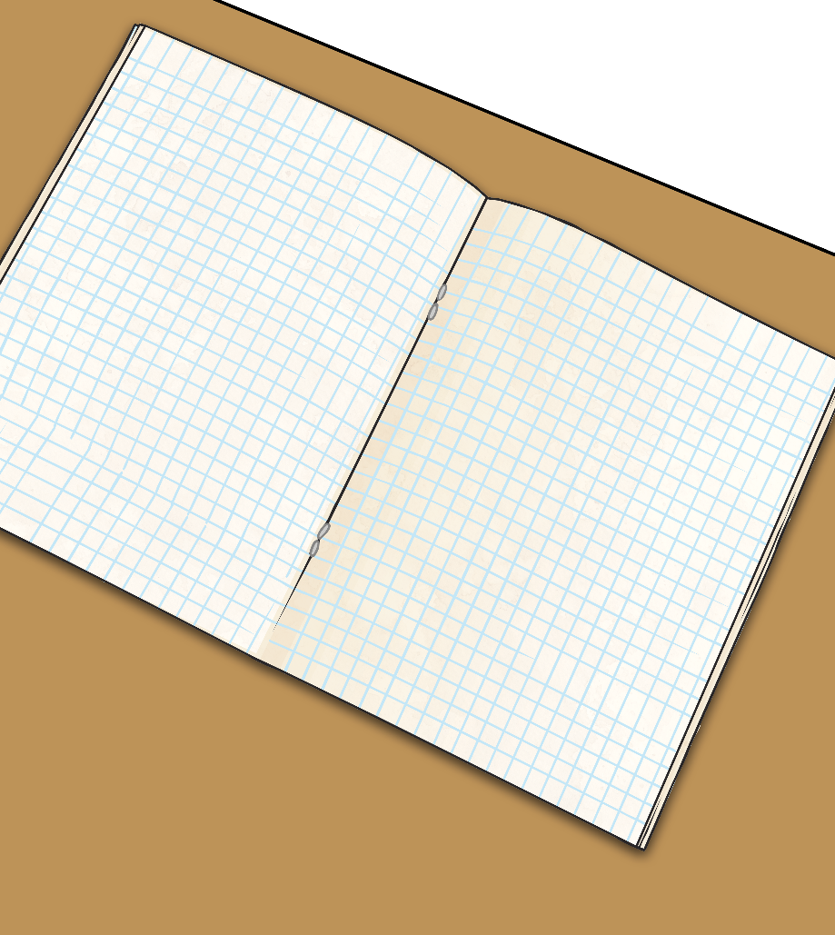
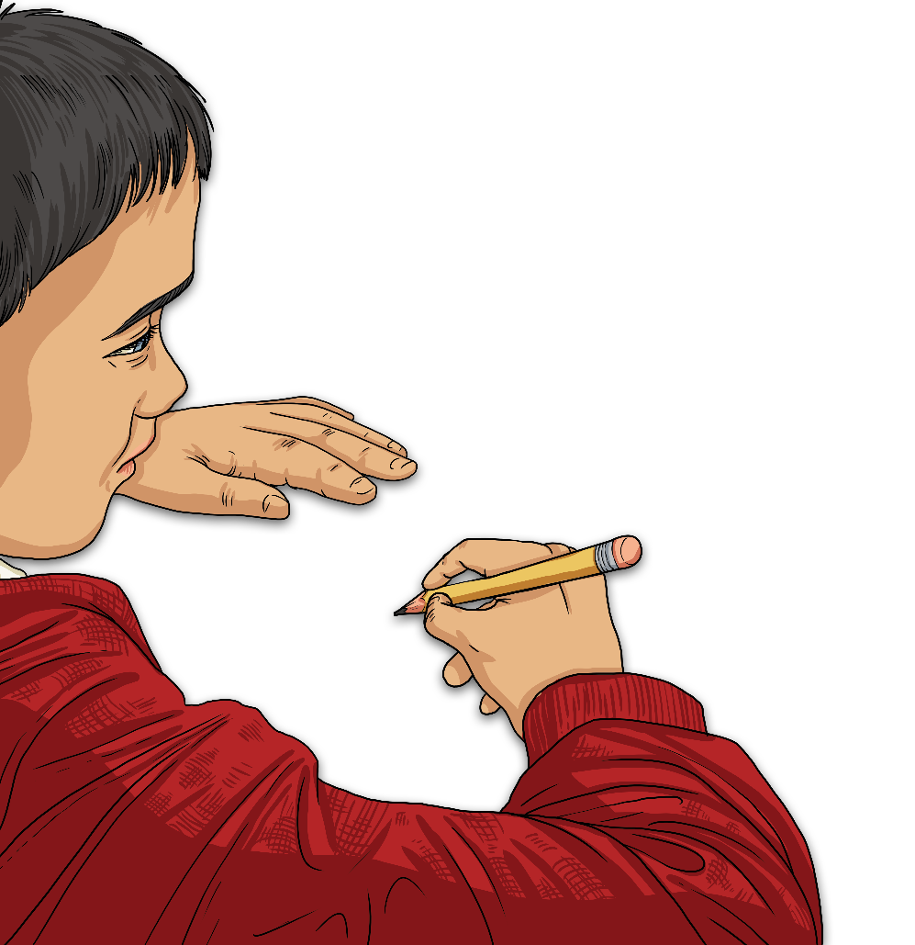
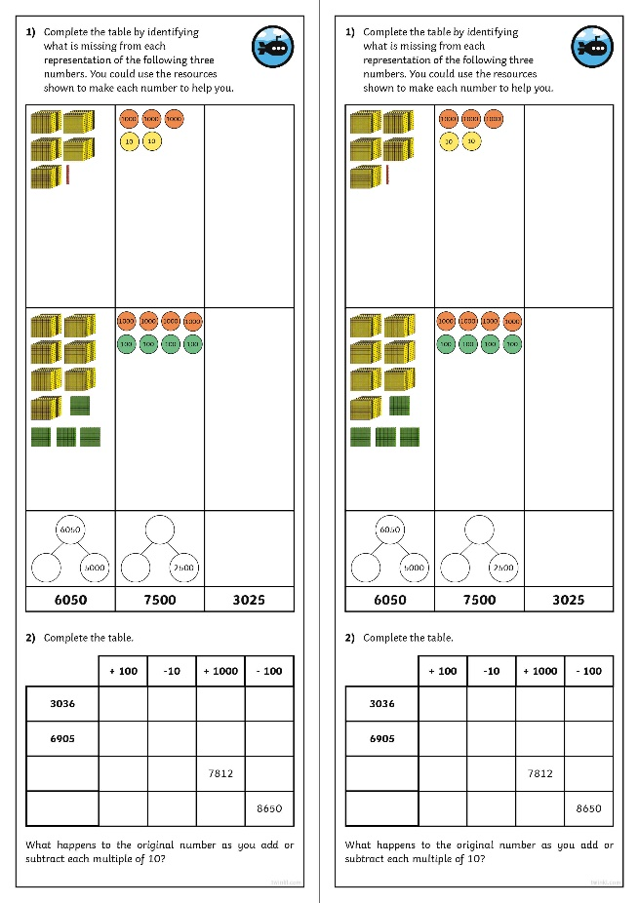
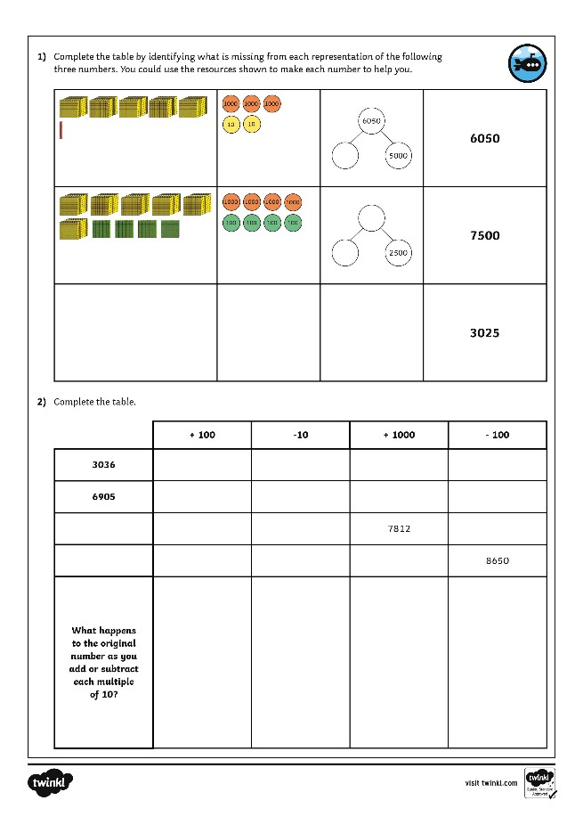
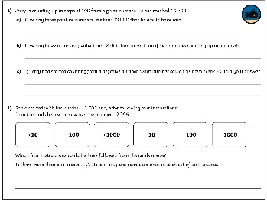
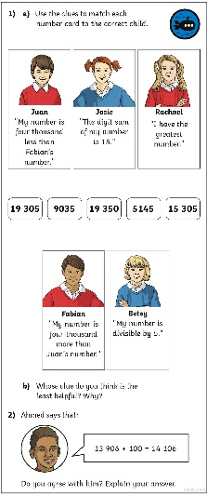
Numbers to 10 000
Dive in by completing your own activity!

