Slide 1
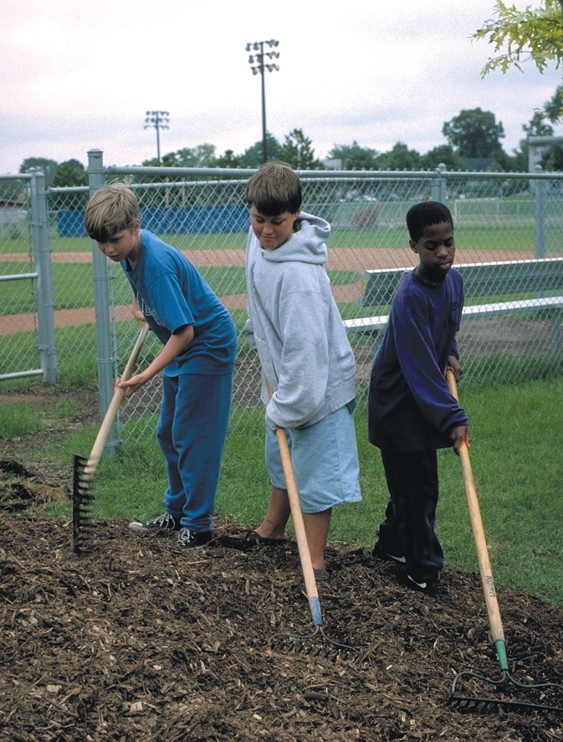
There was once a man who had two sons. He went to the older one and said, ‘Son, go and work in the vineyard today.’
Now Jesus was in the Temple teaching when he told this story, so he said to the people who were listening,
“What do you think? Which of the two sons did what his father wanted?”
‘I don’t want to,’ he answered, but later he changed his mind and went.
And they all said, “The first.”
Then the father went to the other son and said the same thing.
‘Yes, sir,’ he answered, but he did not go.
Which one of the two did what his father wanted?
Based on Matthew 21: 28-31
(Come and See)

