Slide 1



LO: To learn about the gifts of the Holy Spirit.

Slide 2
LO: To learn about the gifts of the Holy Spirit.
We first find the gifts of the Holy Spirit in the Old Testament book of Isaiah, who was looking forward to the coming of Jesus, the Chosen One. He recognised that the one who was to come, the Messiah, would have these special gifts given by the Spirit of God.
The spirit of the Lord shall rest on him, the spirit of wisdom and understanding, the spirit of counsel and might, the spirit of knowledge and the fear of the Lord.
Isaiah 11:2

Slide 3
LO: To learn about the gifts of the Holy Spirit.
The gifts of the Holy Spirit enable people to live as Christians. There are seven particular gifts, which are linked together and help people to lead good lives and make use of the gifts they have. These gifts should be used to help others.

Slide 4

LO: To learn about the gifts of the Holy Spirit.
Wisdom – that is the gift to be sensible and not to jump to conclusions but be thoughtful.

Slide 5


LO: To learn about the gifts of the Holy Spirit.
Understanding – enables people to be compassionate and to take time to find out and be able to appreciate what is happening.

Slide 6
LO: To learn about the gifts of the Holy Spirit.
Counsel – means using wisdom and understanding to come to a good decision about something.
Finding out what is right and wrong and discovering answers to questions and difficulties.
Finding the truth.

Slide 7
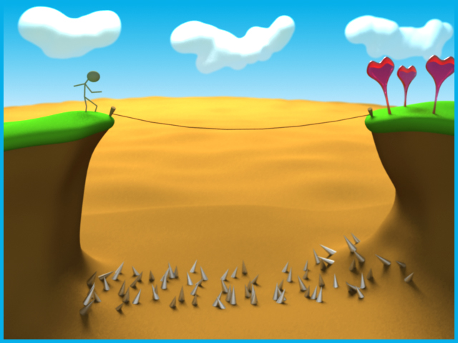
LO: To learn about the gifts of the Holy Spirit.
Fortitude – there are times when everyone needs to be brave in standing up for what they believe to be right and holy.
Overcome problems and be brave to solve it.

Slide 8


LO: To learn about the gifts of the Holy Spirit.
Knowledge – without knowledge you cannot make right judgements or have an understanding. It takes practice to have true knowledge. READING and LISTENING

Slide 9

LO: To learn about the gifts of the Holy Spirit.
Piety – this is about reverence and respect for God, for one another and for oneself.
GOD

Slide 10

LO: To learn about the gifts of the Holy Spirit.
Fear of the Lord - this gift enables people to recognise the awe and wonder of God and be amazed by the love and goodness of God.
GOD

Slide 11
Key questions to reflect on (think about):
You do not have to record the answers. Discuss it with someone at home.
Which of the gifts of the Holy Spirit do you think is the most important to you? Why?
How do the gifts of the Holy Spirit help people to live Christian lives in serving others?
Where might you experience the gifts of the Holy Spirit in action at home, school and in the local community? E.g. wisdom helps us to be thoughtful and think of the needs of others first.

Slide 12
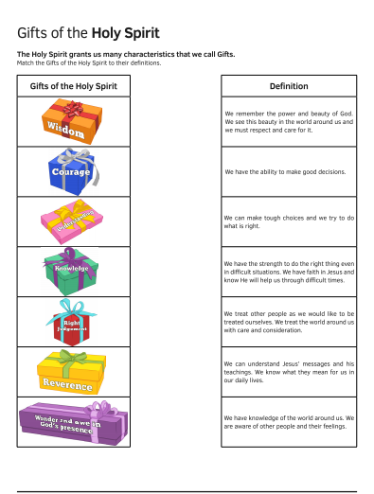
Your Task - Challenge 1
Cut out the definition and match it to the correct gift.

Slide 13
YOUR TASK – Challenge 2/3
Choose ONE of the gifts of the Holy Spirit. Put it in the centre of your page. Think about where these are practised by believers at home, in school or parish. Give reasons why (2 points) believers act in these ways. For example:
Home School
Parish
Extension: Can you think of other places and ways these might be lived out?
WISDOM

