Slide 1
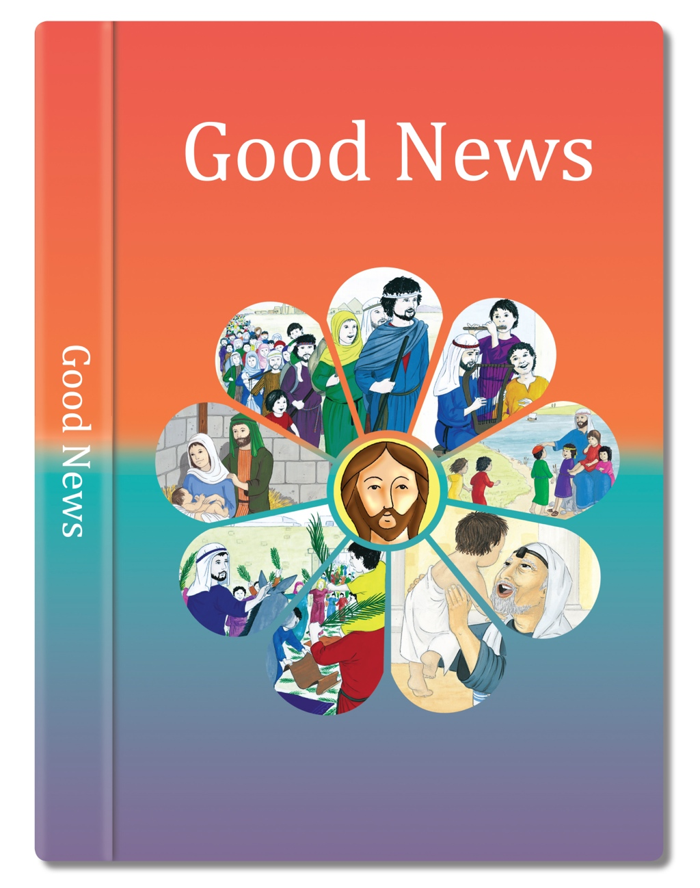

Slide 2
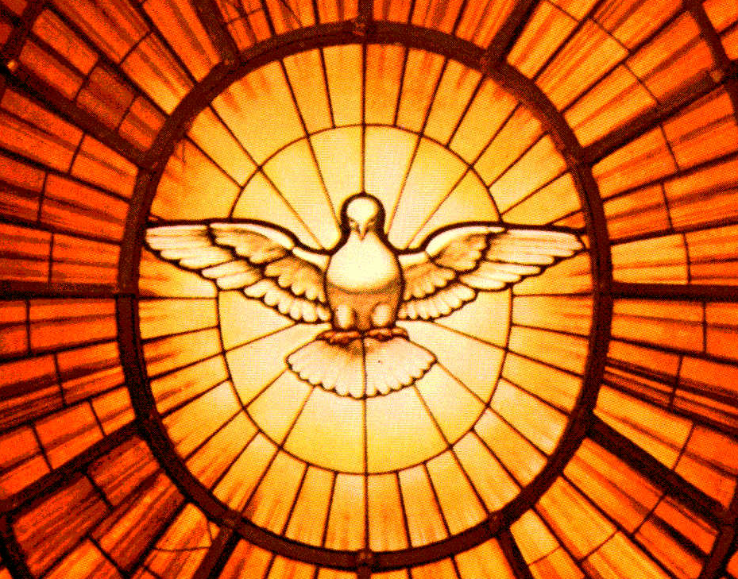
God has given each of us different gifts. But he has given us the same Spirit in our hearts.
to some the skill of nursing and healing;
to some the power to do wonderful things;
There are many different ways of caring for ourselves and for one another. But it is the same Spirit who gives us the energy (power) to care for one another in these different ways.
to some the power to know God and to help others to know him;
to some the power to distinguish clearly between right and wrong.
The Holy Spirit gives to some the power to speak wisely; to some the power to work out difficult problems and to explain them; to some the power to believe in and trust God;
All different gifts, all different forms of energy, but all given by the same Holy Spirit who is at work in our hearts.
Based on I Corinthians 12: 4-8, 11
(Come and See)

