Slide 1

We are a part of history!
By: Antonina Krystek
Year 6
Class: 6C

Slide 2
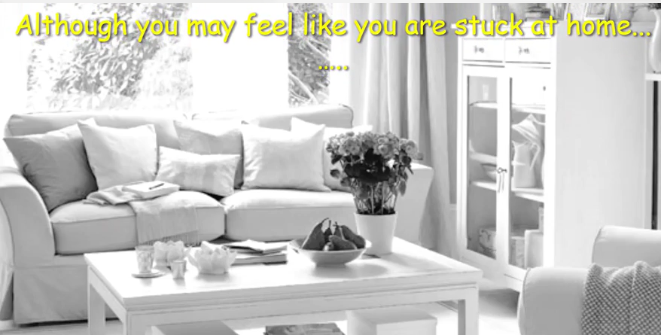
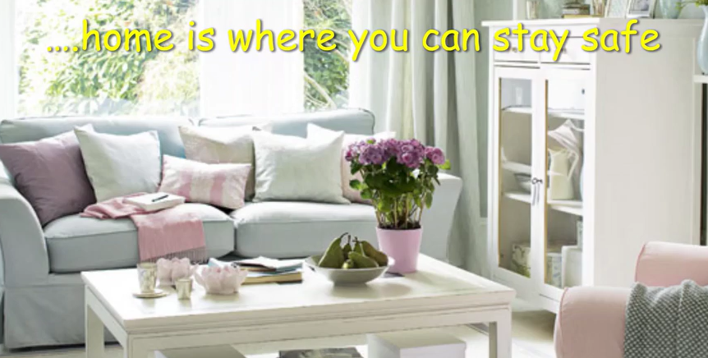
Our health, especially during this time, is very important. Doctors and government officials are working hard to make sure families stay safe. That's why they tell people to cancel activities, like sports events. They closed schools to stop the virus from spreading. They tell us all to keep our distance from other people when we’re out. All these tricks make it hard for the virus to jump from one person to the next. If the virus can't spread, fewer people get sick.

Slide 3

Please watch the video to learn more about Covid-19
https://www.youtube.com/watch?v=IX3dpN91E1I

Slide 4
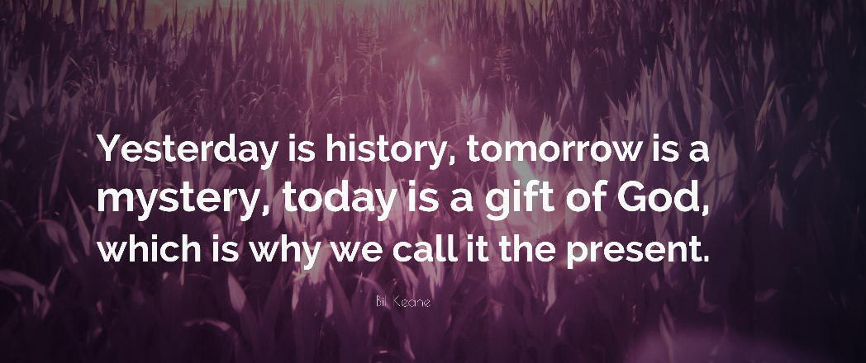

Slide 5
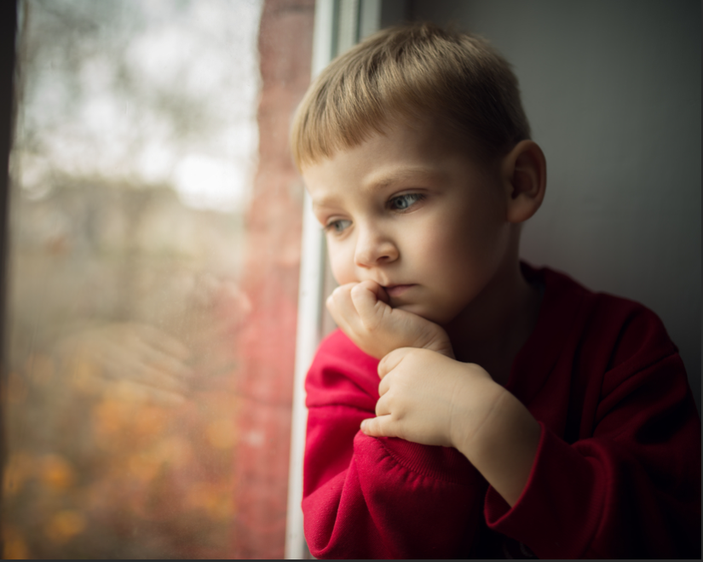
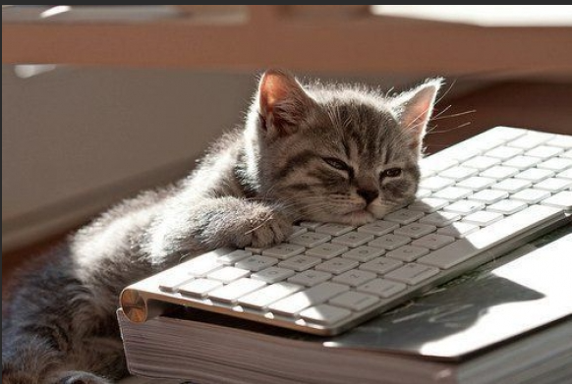
We might feel bored…
We might feel sad because we cant go out and play with our friends…
But…

Slide 6
There are many things we can do at home!
Do art.
Talk over the internet to your family that doesn’t live with you.
Talk to your friends over the internet.
Read loads of your favourite books.
Do more school work.
Have fun in your garden or on your balcony.
Watch television.

Slide 7
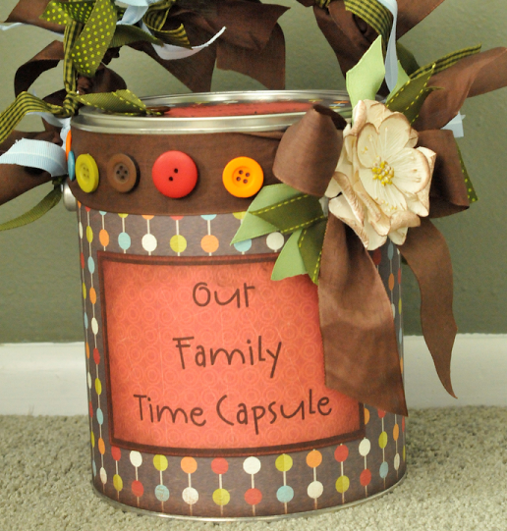
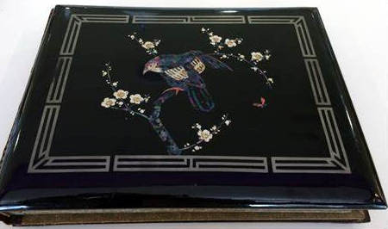

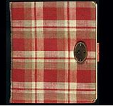
What can we do to remember the times during Covid-19?
Create a family time capsule
Keep a photo album.
Write a Diary just like Anne Frank during WW2.
Film this time

Slide 8

Remember! We are a part of history!
Don’t forget that

Slide 9
Hope this was helpful.
Thank you for listening! Stay at home. Stay safe and have fun.

