Slide 1
ww2 veterans
By: Antonina Krystek

Slide 2
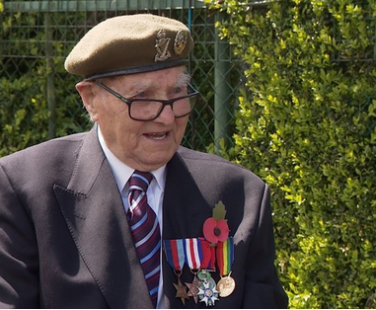
Albert Evans
A World War 2 veteran from Dudley has been recalling some of his memories from the war and VE Day, 75 years ago.
Albert Evans tells us he had been serving in France and was in Bremen in Germany on the 8th of May 1945, when the news of victory finally arrived.

Slide 3
Albert Evans
After hearing that the war was won, Albert assumed he would be sent home. However, unlike the majority of Europe, he and his fellow soldiers had no time to celebrate.
Instead they were sent directly to the trouble in Palestine and Egypt, meaning Albert could not return home for over 3 years.
Remembering VE Day Albert said: "Naturally, we thought we were coming back on leave to England, because we hadn't had a leave for 3 years, but what did they do... They sent us to the trouble in Palestine. I couldn't believe it."

Slide 4
Josepha jankowska
Josepha Jankowska was my Great Grandmother who lived through WW1 and WW2.
She had to take a steam train from Poland to England. She stayed in England for a few years and then after the second WW, she moved back to Poland, where she lived the rest of her life.
(Born – 13 June 1931)(Died 11 June 2018)
I have no picture of her at home.

