Slide 1
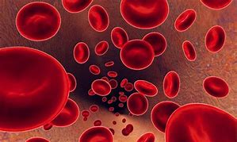
Science ☺
By Charlie

Slide 2
1) How many chambers does the heart have?
Six
Five
Four
Three

Slide 3
2) The beating sound your heart makes comes from?
Blood going in the wrong direction
Valves closing
Your heart skipping beats
Your ears playing tricks on you

Slide 4
3) Which blood vessels have valves and thin walls?
Veins
Capillaries
Lymph
Arteries

Slide 5
4) From which chamber of the heart does blood leave to go to the lungs?
Right ventricle
Right atrium
Left ventricle
Right ventricle
Right atrium
Left ventricle

Slide 6
5) Which type of blood vessel has a pulse?
Arteries
Vein
Capillary

Slide 7
well done on making it this far

Slide 8
6) Why is blood that flows from the lungs to the heart bright red rather than dark red?
Oxygen makes it red.
Carbon dioxide makes it red.
The lungs add a dye to blood as it flows through them.
Eaten too much beetroot

Slide 9
7) What is the name of the blood vessel which carries blood to the right atrium?
vena cava
pulmonary artery
pulmonary vein
aorta

Slide 10
8) which are the thinnest and smallest blood vessels?
Arteries
Veins
Capillaries
None of the above

Slide 11
9) Where does the heart pump oxygenated to?
to the brain only
to the lungs only
to the digestive system only
to the whole body

Slide 12
10) which animal has only one lung
ant
snake
monkey
horse

Slide 13
answers
question 1, c: four
question 2, b: valves closing
question 3 a: veins
question 4 b: right atrium
question 5 a: arteries
question 6 a: oxygen makes it red
question 7 a: vena cava
question 8 b: veins
question 9 d: to the whole body
question 10 b: snake

