Slide 1

Mother Teresa
By: Antonina Krystek 6C

Slide 2
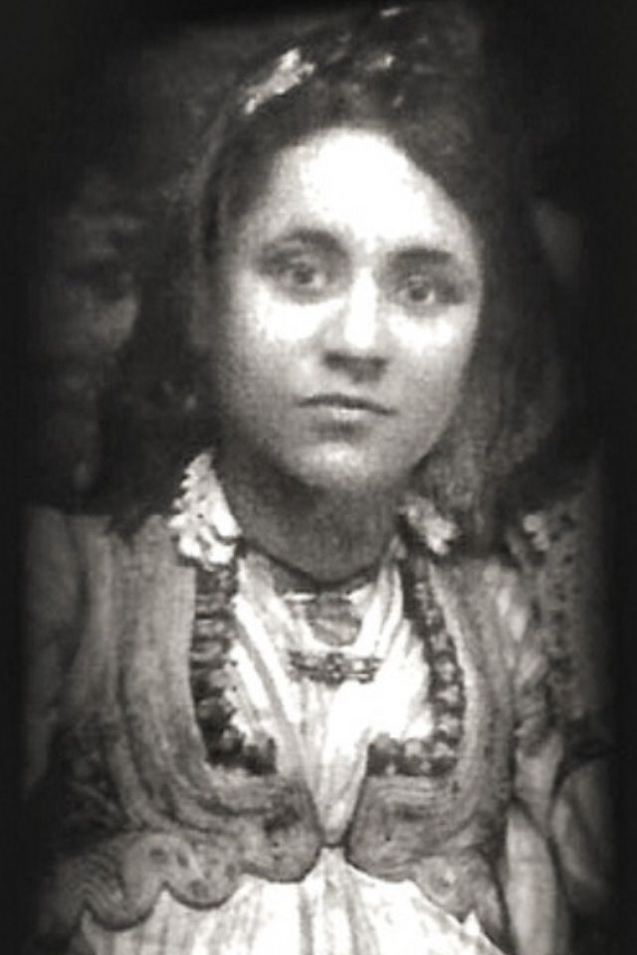
ABOUT MOTHER TERESA
Mother Teresa was born in Uskub, Ottoman Empire on August 26, 1910. This city is now called Skopje and is the capital of the Republic of Macedonia. Her birth name was Agnes Gonxha Bojaxhiu. Her father died when she was eight and she was raised by her mother. Agnes grew up in the Roman Catholic Church and decided to devote her life to God at an early age. When she turned 18, Agnes joined the Sisters of Loreto to become a missionary to India. Before she could go to India, she had to learn English. She spent a year in Ireland learning to speak English at the Loreto Abby. A year later, Agnes began her missionary work in Darjeeling, India. She learned the local language, Bengali, and taught at the local school. In 1931, she took her vows as a nun and chose the name Teresa. She taught for many years in India becoming the headmistress at a school in eastern Calcutta.

Slide 3
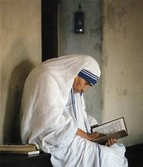
How is mother Teresa a witness?
While the twentieth century was a time of turbulence, selfishness, godlessness, and violence, Mother Teresa of Calcutta was a witness to love. She was a clear reminder of the goodness within human nature and the beauty of being truly open to God.

Slide 4
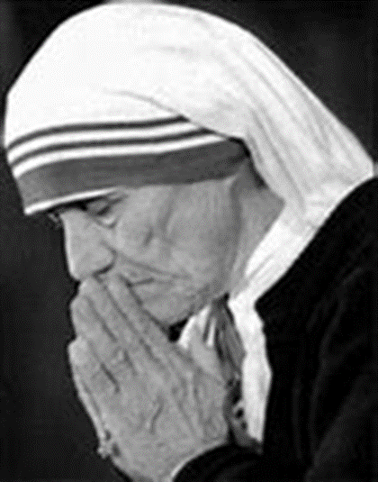
What’s most impressive about Mother Teresa?
IT’S IMPRESSIVE HOW Mother Teresa decided to leave her family and just move to a different country to help people, even when she knew she would never see her family again. I really admire that about her.

Slide 5
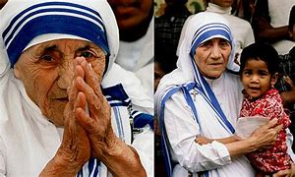
What do you think gave mother Teresa her courage?
Mother Teresa got her courage from believing in herself and believing that with her and people’s help they could help the humans in need.
She reached out in a hostile area, breaking all the rules of social acceptance while trusting god and caring for her inferiors.

Slide 6
