Slide 2



Diving into Mastery Guidance for Educators
Each activity sheet is split into three sections, diving, deeper and deepest, which are represented by the following icons:
Always start with diving. If that is easy, then try deeper. For an extra challenge try deepest (do all three) !
Diving
Deeper
Deepest

Slide 3
Aim
Add and subtract whole numbers with more than 4 digits, including using formal written methods.

Slide 4



Subtract Whole Numbers with More Than 4 Digits (Column Method)
Diving
Complete these subtraction calculations. You may want to use place value counters to help you.
 | 9 | 6 | 3 | 4
– | 3 | 5 | 6 | 5
 | 2 | 8 | 5 | 3 | 2
– |  | 7 | 3 | 1 | 5
 | 8 | 5 | 6 | 7 | 8
– | 1 | 8 | 4 | 3 | 7
6
0
6
9
2
1
2
1
7
6
7
2
4
1
65 149 – 36 547 =
28 602
52 697 – 32 588 =
20 109

Slide 5



Subtract Whole Numbers with More Than 4 Digits (Column Method)
Diving
Here are five teams’ flight times, given in seconds.
Number One | Fantastic Fliers | Sea Beast | Air Warrior | Plane Sailing
61 035 | 79 541 | 82 658 | 71 982 | 75 608
Which two teams have a difference of exactly 10 676?
Sea Beast and Air Warrior
Which two teams have a difference of exactly 21 623?
Number One and Sea Beast

Slide 6



Subtract Whole Numbers with More Than 4 Digits (Column Method)
Deeper
Jamila has been practising column subtraction but she has made some mistakes.
Can you identify all the mistakes and explain her errors?
Then carry out the calculations yourself to find the correct totals.
 | 4 | 7 | 8 | 3 | 2
– |  | 6 | 4 | 0 | 8
 | 4 | 1 | 4 | 3 | 6
 | 8 | 7 | 7 | 6 | 1
– | 2 | 6 | 0 | 5 | 3
 | 6 | 1 | 7 | 1 | 8

Slide 7

Subtract Whole Numbers with More Than 4 Digits (Column Method)
Deeper
Jamila has not recorded the exchange of taking 1 ten from 6 tens to create 11 ones, which leaves 5 tens.
The correct total is 61 708.
Jamila has done 8 - 2 rather than 2 - 8 and exchanging.
The correct total is 41 424.
 | 4 | 7 | 8 | 3 | 2
– |  | 6 | 4 | 0 | 8
 | 4 | 1 | 4 | 3 | 6
 | 8 | 7 | 7 | 6 | 1
– | 2 | 6 | 0 | 5 | 3
 | 6 | 1 | 7 | 1 | 8

Slide 8




Subtract Whole Numbers with More Than 4 Digits (Column Method)
Deeper
Is this statement always, sometimes or never true? Explain your thinking.
This is never true.
An odd number subtract another odd number will always give an even number.
For example, 12 561 – 8537 = 4024.
The difference between two odd numbers is odd.

Slide 9


Subtract Whole Numbers with More Than 4 Digits (Column Method)
Deepest
Can you identify the missing digits in these two calculations?
 | 5 | 5 |  | 3 | 9
– |  |  | 6 | 5
 |  | 9 | 3 | 8 | 7
 |  |  | 3 | 0 | 6
– | 3 | 5 |  |  | 4
 | 4 | 8 | 6 | 0 | 2
0
8
4
5
2
7
0
4

Slide 10

Subtract Whole Numbers with More Than 4 Digits (Column Method)
Deepest
I have 3 whole numbers: A, B and C.
Each has 5 digits.
The difference between A and B is 18 304
and the difference between B and C is 35 782.
What could my numbers be? Find three different possibilities and show the working for each.
One example of possible answers:
A = 75 123 B = 56 819 C = 92 601 | A = 66 032 B = 47 728 C = 11 946 | A = 97 325 B = 79 021 C = 43 239

Slide 11
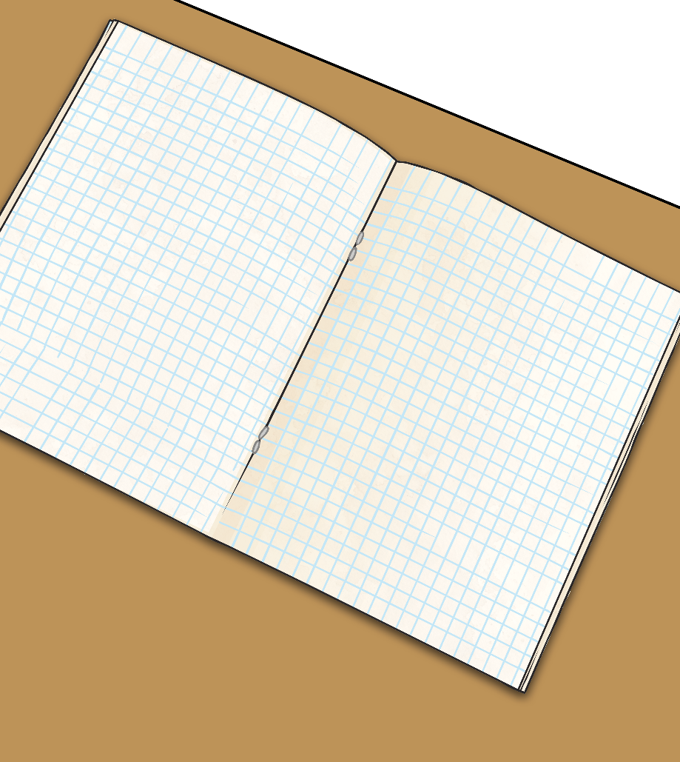

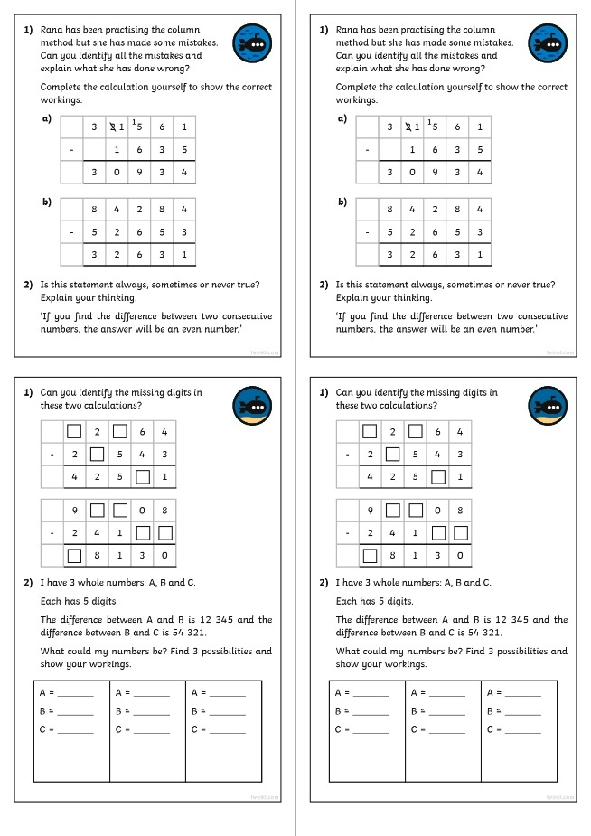
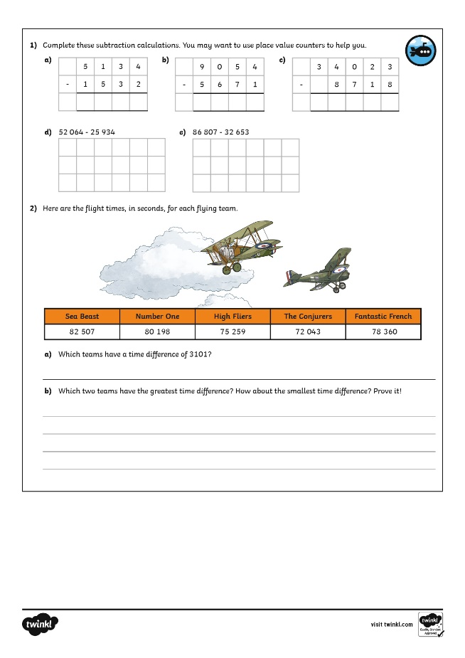
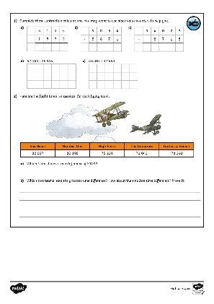
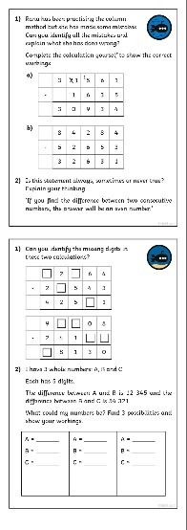
Subtract Whole Numbers with More Than 4 Digits (Column Method)
Dive in by completing your own activity!

