Slide 2



Diving into Mastery Guidance for Educators
Each activity sheet is split into three sections, diving, deeper and deepest, which are represented by the following icons:
Always start with diving. If that is easy, then try deeper. For an extra challenge try deepest (do all three) !
Diving
Deeper
Deepest

Slide 3
Aim
Read, write, order and compare numbers to at least 1 000 000 and determine the value of each digit.

Slide 4

Numbers to 100 000
Diving
Use counters and a place value chart to represent these numbers.
42 105
10 741
24 324
38 502
Ten Thousands | Thousands | Hundreds | Tens | Ones
Ten Thousands | Thousands | Hundreds | Tens | Ones
Click each number to reveal the answer.

Slide 5

Numbers to 100 000
Diving
What number is being represented on the place value chart?
Ten Thousands | Thousands | Hundreds | Tens | Ones
16 604
22 153
30 265

Slide 6
Numbers to 100 000
Deeper
Match the correct numerals to the words.
10 350
ten thousand, three hundred and fifty
10 030
ten thousand, three hundred and five
10 305
ten thousand and thirty

Slide 7
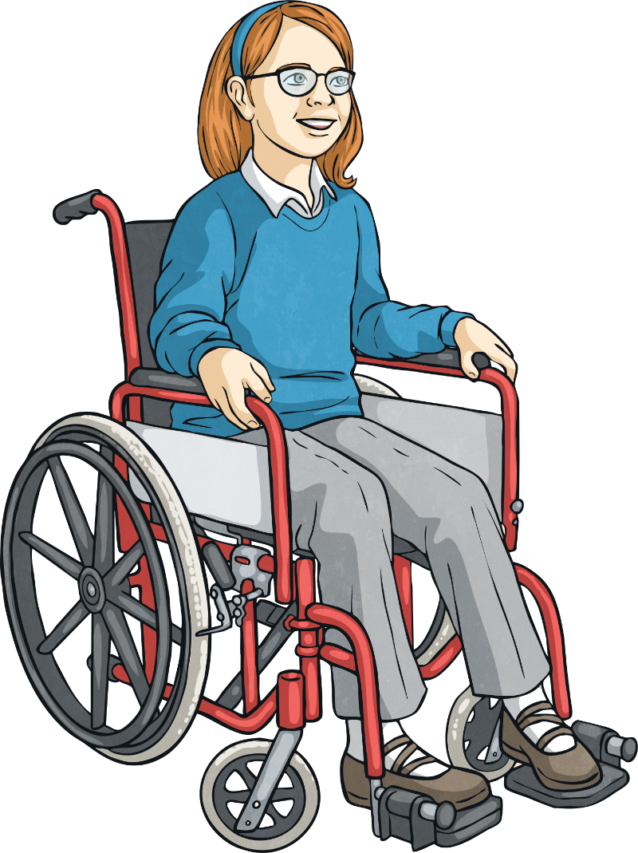
Numbers to 100 000
Deeper
Eliza is counting backwards and forwards in thousands from 5046.
Which of the statements is true and which are false?
Explain your thinking.
A
B
C
Eliza will say the number 15 146.
When counting forwards from 5046, the fifth number will
be 10 046.
Eliza will say the number -5604.
False
All positive numbers greater than 1000 will end with 046.
True
6046, 7046, 8046,
9046, 10 046.
False
The smallest positive number will be 46, then counting backwards
-954. All negative numbers will end 954.

Slide 8
Numbers to 100 000
Deeper
16 321 is being partitioned in different ways.
Which representation is incorrect?
Explain your thinking.
A
16 thousands + 321 ones
B
10 thousands + 63 hundreds + 21 ones
C
C
1600 hundreds + 3 hundreds + 2 tens + 1 ones
1600 hundreds + 3 hundreds + 2 tens + 1 ones
The value of this is 160 321. It should be 160 hundreds.

Slide 9

Numbers to 100 000
Deepest
Here is a number line.
A
B
C
D
There are many possible answers, for example,
Can you write a set of numbers that would fit on this line and that no one in your class has thought of?
is 5600 less than B.
is less than 10 000 and is a multiple of 5.
is halfway between B and D.
is double the value of B.
3000
8600
12 900
17 200
4300
9900
14 850
19 800
2400
8000
12 000
16 000
What could the values of A, B, C and D be?
Give three possible sets of numbers.
A
A
A
A
B
B
B
B
C
C
C
C
D
D
D
D

Slide 10
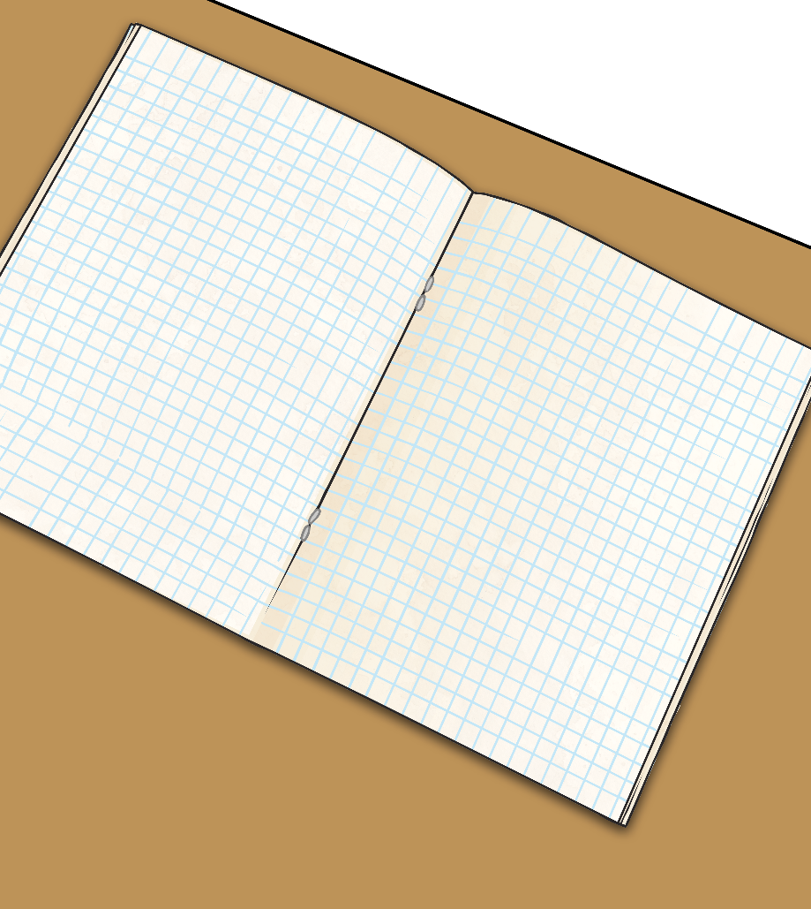
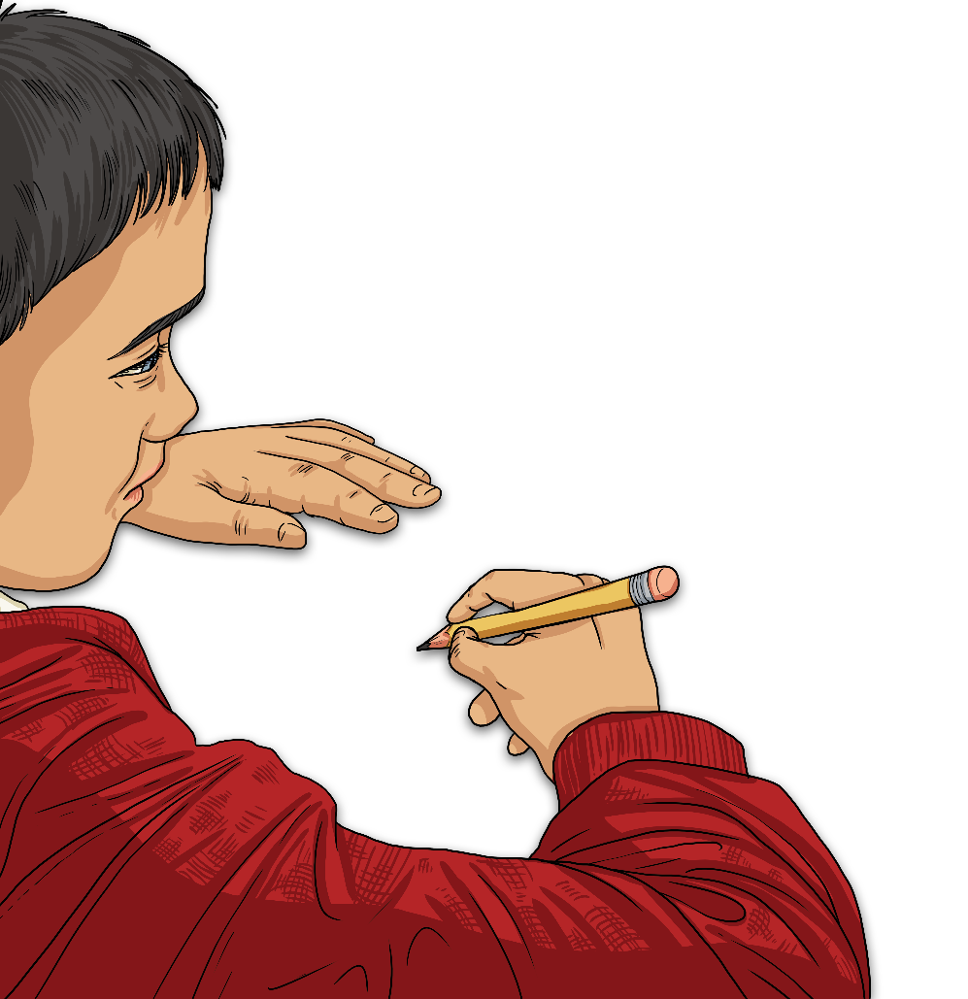
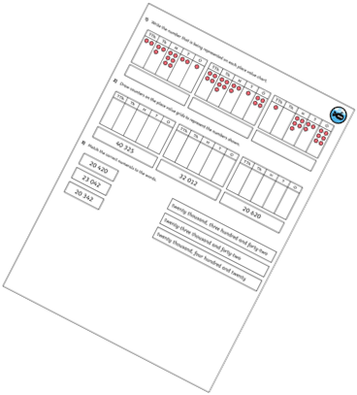
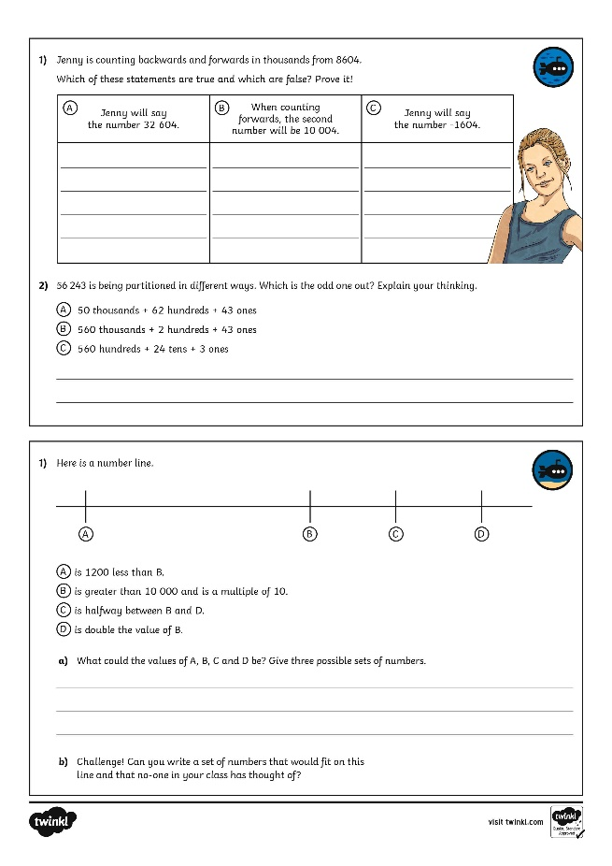
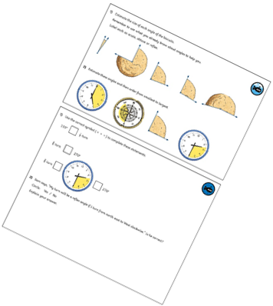
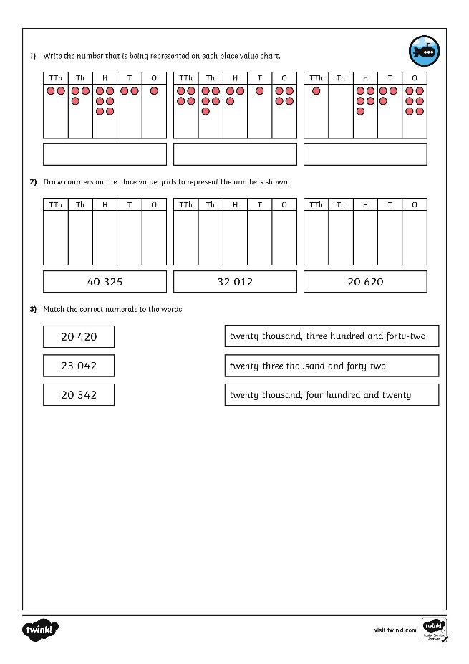
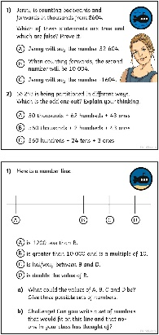
Numbers to 100 000
Dive in by completing your own activity!

