Slide 2



Diving into Mastery Guidance for Educators
Each activity sheet is split into three sections, diving, deeper and deepest, which are represented by the following icons:
Always start with diving. If that is easy, then try deeper. For an extra challenge try deepest (do all three) !
Diving
Deeper
Deepest

Slide 3
Aim
Add and subtract whole numbers with more than 4 digits, including using formal written methods.

Slide 4



Add Whole Numbers with More Than 4 Digits (Column Method)
Diving
Complete these addition calculations. You may want to use place value counters to help you.
 | 3 | 6 | 3 | 4
+ | 5 | 5 | 6 | 5
 |  | 8 | 5 | 3 | 2
+ |  | 7 | 3 | 1 | 5
 | 2 | 5 | 6 | 7 | 8
+ |  | 8 | 4 | 3 | 7
9
1
9
9
1
5
8
4
7
3
4
1
1
5
1
1
1
1
1
1
65 149 + 6547 =
71 686
2698 + 25 704 =
28 402

Slide 5

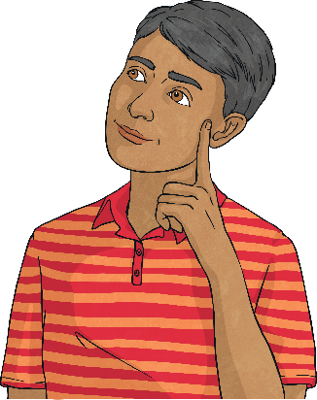
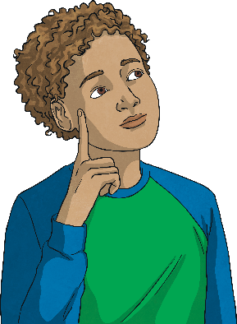
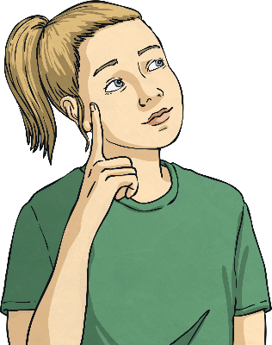
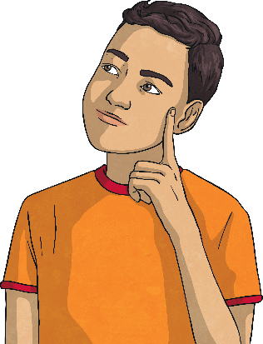
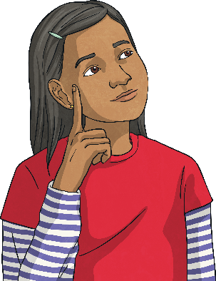
Add Whole Numbers with More Than 4 Digits (Column Method)
Diving
Five children have been playing a times tables game.
Here are their scores:
Lottie | Sam | Izzy | Abdul | Ffion
41 035 | 39 541 | 42 658 | 41 982 | 42 608
×3
Which two children have a combined score of exactly 83 693?
×2
×8
×5
×10
Izzy and Lottie
×5
Which two children have a combined score of exactly 81 523?
Sam and Abdul

Slide 6



Add Whole Numbers with More Than 4 Digits
Add Whole Numbers with More Than 4 Digits (Column Method)
Deeper
Andy has been practising column addition but he has made some mistakes.
For each sum, identify the mistakes and explain his errors.
Then, carry out the sum yourself to find the correct total.
 | 4 | 0 | 8 | 3 | 2
+ |  | 6 | 4 | 0 | 8
 | 4 | 7 | 2 | 3 | 0
 | 8 | 7 | 7 | 6
+ | 7 | 6 | 0 | 5 | 3
 | 16 | 3 | 8 | 1 | 3

Slide 7

Add Whole Numbers with More Than 4 Digits
Add Whole Numbers with More Than 4 Digits (Column Method)
Deeper
Andy has not lined the digits up in the correct place value columns. The value of the 6 is 6 ones, not 6 tens. He should only write one digit in each square.
The correct total is 84 829.
8 + 2 = 10. Andy should have regrouped the ten ones in the tens column, so 30 + 10 = 40.
The correct total is 47 240.
 | 4 | 0 | 8 | 3 | 2
+ |  | 6 | 4 | 0 | 8
 | 4 | 7 | 2 | 3 | 0
 | 8 | 7 | 7 | 6
+ | 7 | 6 | 0 | 5 | 3
 | 16 | 3 | 8 | 1 | 3
1

Slide 8

Add Whole Numbers with More Than 4 Digits
Add Whole Numbers with More Than 4 Digits (Column Method)
Deeper
Amara is playing a maths game. She scores 2400 in the first round, 5300 in the next and 10 600 in the final round.
Would you use column addition to find her total score?
Use the numbers in the question to explain your answer.
Column addition would not be the most efficient method. You should always look at the numbers first to decide whether you can add these mentally.
A mental method, with jottings if needed, would be the most efficient method. You could use your number bond knowledge to add 2400 to 10 600, giving a total of 13 000, and then add 5300 to give a final total of 18 300.

Slide 9


Add Whole Numbers with More Than 4 Digits (Column Method)
Deepest
Can you identify the missing digits in these two calculations?
 | 5 | 5 |  | 3 | 9
+ |  |  | 6 | 5
 |  | 0 | 6 | 9 | 1
 |  |  | 3 | 0 | 2
+ | 3 | 5 |  |  | 4
 | 6 | 0 | 0 | 0 | 6
0
2
4
5
2
7
0
6
1
1
1
1

Slide 10


Add Whole Numbers with More Than 4 Digits (Column Method)
Deepest
Each letter represents a number between 1 and 9.
There is no regrouping in the calculation.
Can you work out what the letters represent to make the addition calculation work?
 | F | L | E | A
+ | M | O | L | E
 | P | E | S | T
Click here to get clues for one possible solution.
Hint 1: E = 4
Hint 2: S = 7
flea + mole = pest

Slide 11
Add Whole Numbers with More Than 4 Digits (Column Method)
Deepest
Here is a possible solution.
How many other solutions can you find?
 | F | L | E | A
+ | M | O | L | E
 | P | E | S | T
 | 2 | 3 | 4 | 5
+ | 6 | 1 | 3 | 4
 | 8 | 4 | 7 | 9
flea + mole = pest
2345 + 6134 = 8479

Slide 12
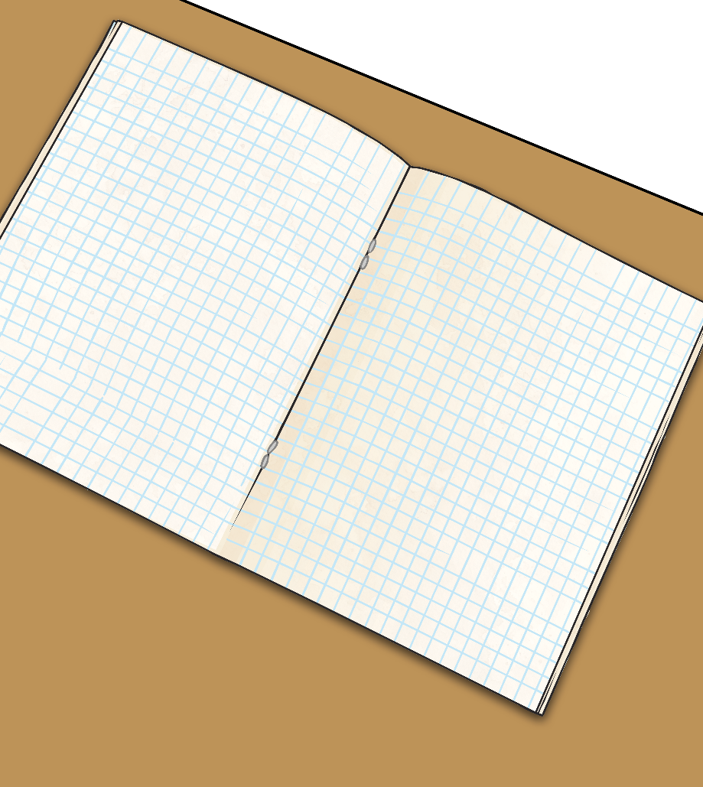

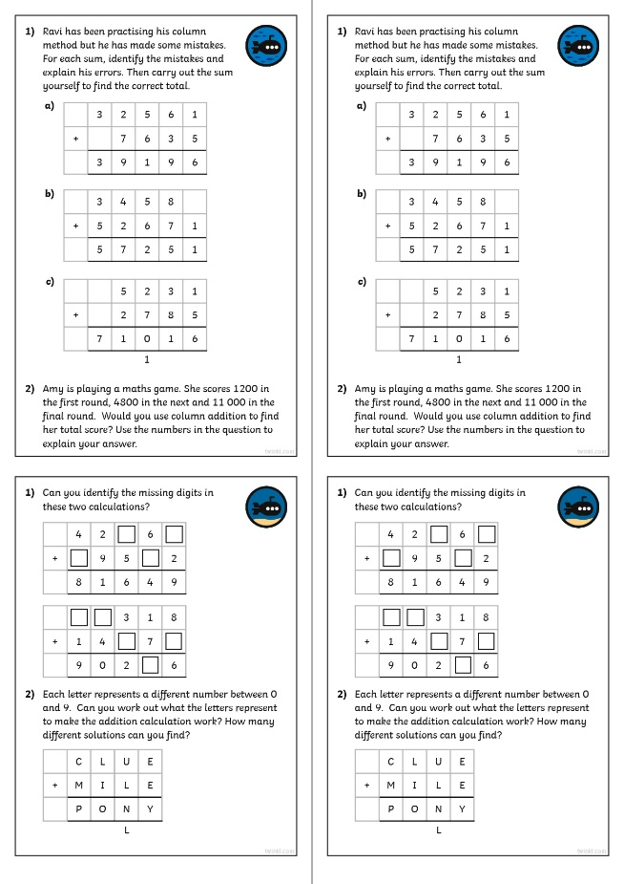
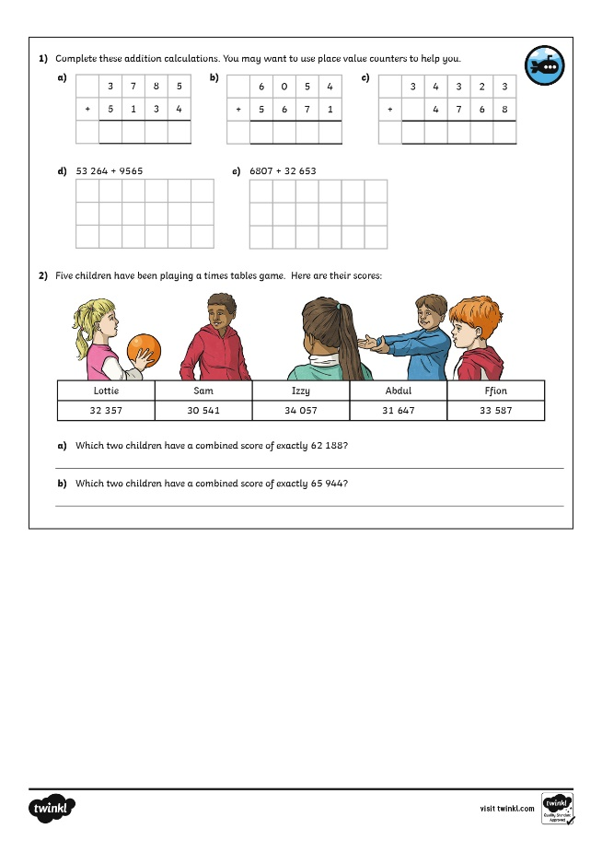

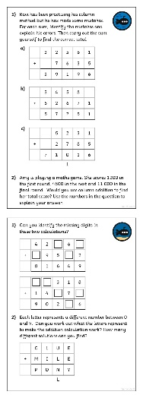
Add Whole Numbers with More Than 4 Digits (Column Method)
Dive in by completing your own activity!

