Slide 1
Aim
Identify multiples and factors, including finding all factor pairs of a number, and common factors of two numbers.

Slide 2
Multiples
Diving
Sort the numbers into the correct columns. Some numbers might belong in more than one column.
Multiples of 2 | Multiples of 6 | Multiples of 9 | Multiples of 10
Multiples of 2 | Multiples of 6 | Multiples of 9 | Multiples of 10
36 48 90 72 54 24 | 36 48 90 72 54 24 | 36 27 90 72 54 | 90
36
27
48
90
72
54
24

Slide 3
Multiples
Diving
Can you think of a rule for each column about how to identify if a number is a multiple?
Look at the numbers in each column. What do you notice?
+
×
Multiples of 2 | Multiples of 6 | Multiples of 9 | Multiples of 10
Multiples of 2
Multiples of 2 | Multiples of 6 | Multiples of 9 | Multiples of 10
36 48 90 72 54 24 | 36 48 90 72 54 24 | 36 27 90 72 54 | 90
+
The final digit is even and the digit total is 3, 6 or 9. (If the digit total is a 2-digit number, add the digits again until you have a 1-digit answer.)
×
Multiples of 6
The final digit is even.
The final digit is 0.
The digit total is 9.
+
×
Multiples of 9
+
×
Multiples of 10

Slide 4
Multiples
Diving
Which of the numbers are not multiples of 2, 6, 9 or 10?
Multiples of 2
The final digit is even.
Use your rules to sort these numbers:
5742
8544
3140
6821
6821
7180
Multiples of 6
The final digit is even and the digit total is 3, 6 or 9. (If the digit total is a 2-digit number, add the digits again until you have a 1-digit answer.)
6573
6573
8534
5354
3600
Multiples of 2 | Multiples of 6 | Multiples of 9 | Multiples of 10
5742
5742
5742
3140
8544
8544
3600
7180
Multiples of 9
The digit total is 9.
3140
3600
3600
7180
8534
Multiples of 10
The final digit is 0.
5354
3600

Slide 5
Multiples
Deeper
Look at these statements. Decide if each one is always, sometimes or never true. Explain your reasoning for each statement.
Multiples of 9 are also multiples of 3.
A number ending with 4 is a multiple of 4.
This is always true. This is because every third multiple of 3 is a multiple of 9.
3, 6, 9, 12, 15, 18, 21, 24, 27, 30, 33, 36
However, multiples of 3 aren’t always multiples of 9.
This is sometimes true. 24 is a multiple of 4, but 14 is not.

Slide 6
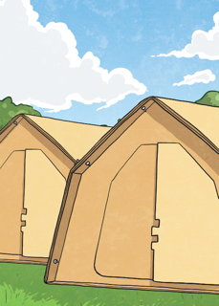
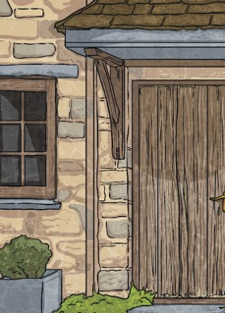
Multiples
Deeper
Jasmine says, “My gran’s age this year is a multiple of 6. Next year, it will be a multiple of 5.”
How old is Jasmine’s gran?
Jasmine’s gran could be 54, 84 or 114 years old. She couldn’t be 24 because then she would be too young to have a grandchild!

Slide 7
Multiples
Deepest
Abram says,
What could the numbers be?
“I am thinking of 3 consecutive numbers. The first number is a multiple of 2, the second is a multiple of 3 and the third is a multiple of 4.”
Find 3 possible sets of numbers.
Multiple answers possible, including: 26, 27, 28
38, 39, 40
62, 63, 64

Slide 8
Multiples
Deepest
Adrian says,
“I am thinking of a number. It is 1 less than a multiple of 5 and 1 more than a multiple of 6.”
Possible numbers include: 19, 49, 79, 109, 139, 409, 649
What could the number be?
Find 5 possible numbers.

