Slide 2
Diving into Mastery Guidance for Educators
Each activity sheet is split into three sections, diving, deeper and deepest, which are represented by the following icons:
Always start with diving. If that is easy, then try deeper. For an extra challenge try deepest (do all three) !
Diving
Deeper
Deepest

Slide 3
Aim
Add and subtract whole numbers with more than 4 digits, including using formal written methods.

Slide 4
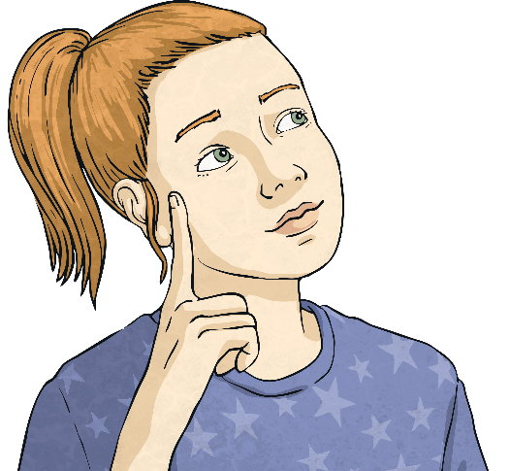
Inverse Operations (Addition and Subtraction)
Diving
Write all the other calculations you can make using these three numbers.
9862 + 23 104 = 32 966
32 966 – 9862 = 23 104
32 966 – 23 104 = 9862
23 104 + 9862 = 32 966

Slide 5
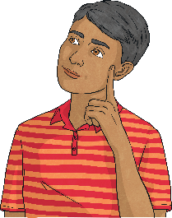
Inverse Operations (Addition and Subtraction)
Diving
Can you work out the number in each of these?
I am thinking of a number. I add 7852 and then subtract 2607. I now have 32 451. What is my number?
27 206 (32 451 + 2607 = 35 058, 35 058 – 7852 = 27 206)
I am thinking of a number. I subtract 19 657 and then add 26 205. I now have 61 305. What is my number?
54 757 (61 305 – 26 205 = 35 100, 35 100 + 19 657 = 54 757)
I am thinking of a number. I add 32 981, subtract 6305 and then add 25 154. I now have 56 287. What is my number?
4457 (56 287 – 25 154 = 31 133, 31 133 + 6305 = 37 438, 37 438 – 32 981 = 4457)

Slide 6
Inverse Operations (Addition and Subtraction)
Deeper
Tony has written the different calculations that can be made from each original calculation.
He has made some mistakes. Can you find them all?
32 255 + 25 251 = 57 506 | 74 258 – 34 102 = 40 156 | 6721 + 25 973 = 32 694
25 251 + 32 255 = 57 506 57 506 – 32 255 = 25 251 32 255 – 57 506 = 25 251 | 40 156 + 34 102 = 74 258 34 102 + 40 156 = 74 258 34 102 – 74 258 = 40 156 | 25 973 + 32 694 = 6721 32 694 – 25 973 = 6721 32 694 – 6721 = 25 973
25 973 + 32 694 = 6721
32 255 – 57 506 = 25 251
34 102 – 74 258 = 40 156

Slide 7
Inverse Operations (Addition and Subtraction)
Deeper
Tony has written the different calculations that can be made from each original calculation.
What should Tony have written?
32 255 + 25 251 = 57 506 | 74 258 – 34 102 = 40 156 | 6721 + 25 973 = 32 694
25 251 + 32 255 = 57 506 57 506 – 32 255 = 25 251 32 255 – 57 506 = 25 251 | 40 156 + 34 102 = 74 258 34 102 + 40 156 = 74 258 34 102 – 74 258 = 40 156 | 25 973 + 32 694 = 6721 32 694 – 25 973 = 6721 32 694 – 6721 = 25 973
25 973 + 6721 = 32 694
57 506 – 25 251 = 32 255
74 258 – 40 156 = 34 102

Slide 8
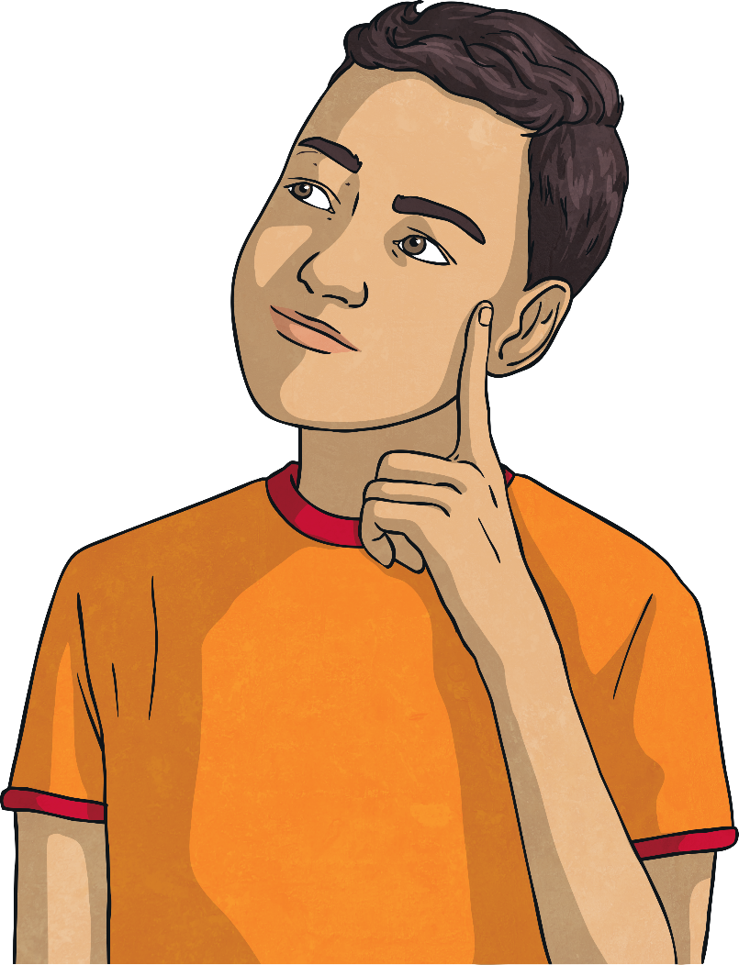
Inverse Operations (Addition and Subtraction)
Deepest
Can you fill in the missing numbers in this arithmagon?
The two corner numbers need to be added to equal the number in the rectangle between them.
675
3217
4964
2542
6831
4289

Slide 9
Inverse Operations (Addition and Subtraction)
Deepest
Can you find the missing numbers in this arithmagon?
The number in the rectangle is found by finding the difference between the two corner numbers either side of it.
18 627
12 684
14 833
5943
2149
3794

Slide 10
Inverse Operations (Addition and Subtraction)
Deepest
Find 2 possible sets of numbers using addition or difference.
What could the numbers be to complete this arithmagon?
7376
16 794
12 684
11 170
12 684
13 000
6869
10 663
3794
4110
316
3794
(using addition)
(using difference)

Slide 11
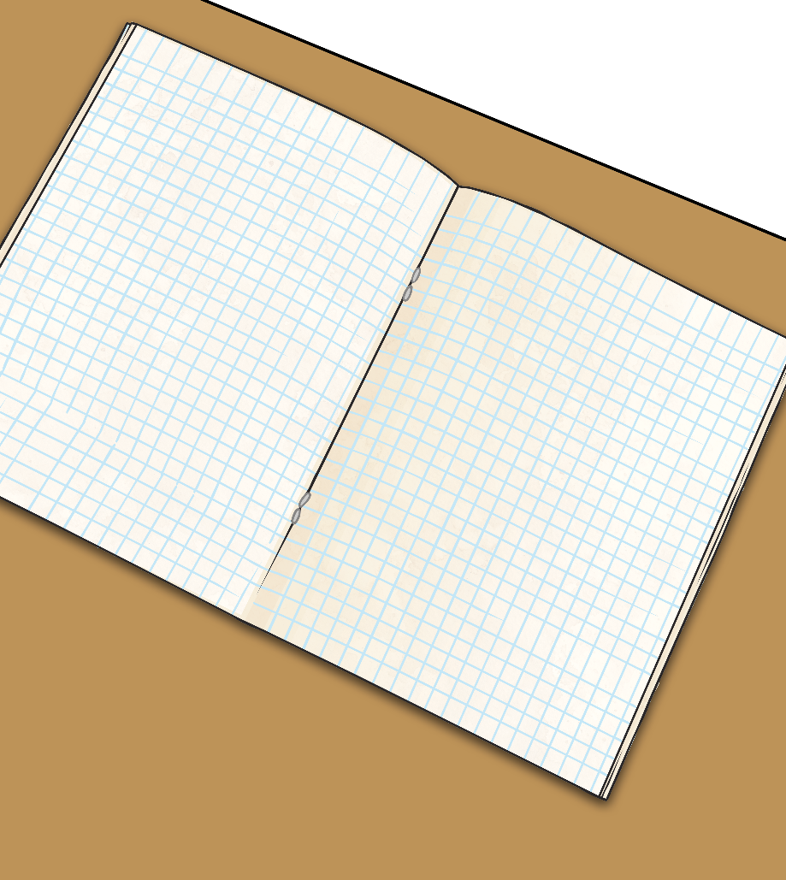
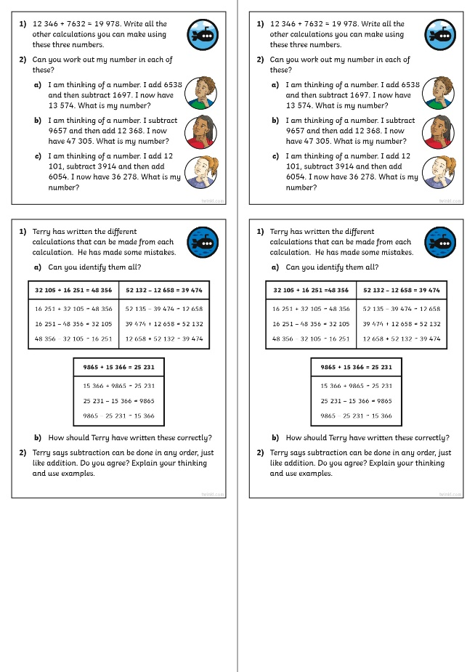
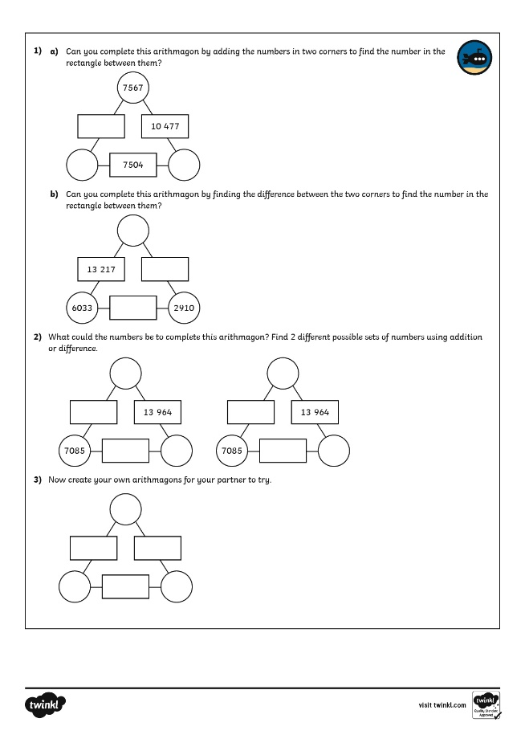
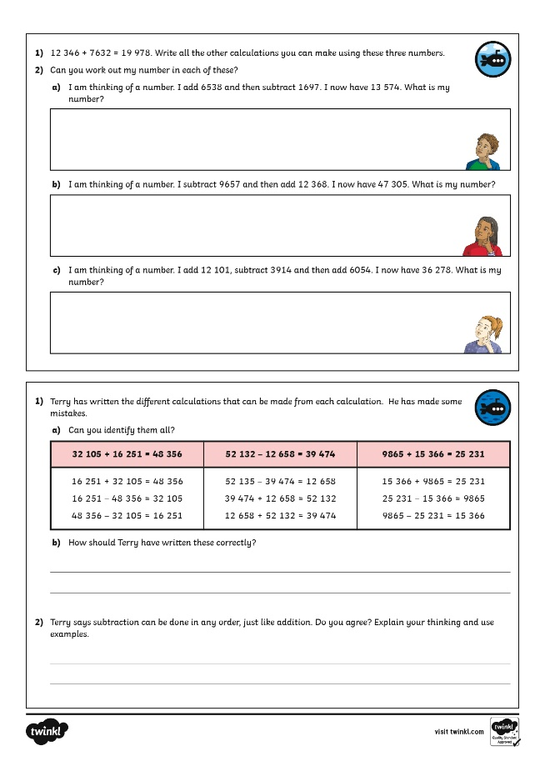
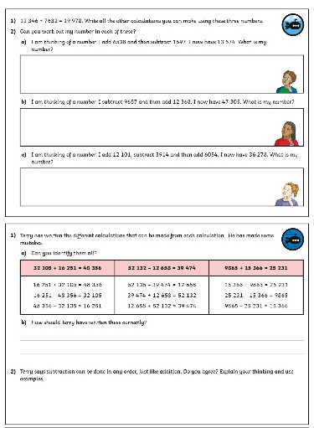
Inverse Operations (Addition and Subtraction)
Dive in by completing your own activity!

