Slide 1
lo: To find pictures for your chosen topic.
VLOG: The new Blog.

Slide 2
Staying Safe, Staying smart
As we looked at before, staying safe is still very important.
Anything you put on a vlog can be accessed by millions of people around the world.
Always think about what it is you are putting on to keep yourself safe.
This week stay safe when searching for images and pictures.

Slide 3
Prepare your vlog
You are going to be making a vlog based on what you are going to research about the Romans, including your opinion.
Choose ONE from the following 3 topics:
Roman Religion (gods and myths)
Roman sports and leisure (Gladiators, competitions)
Roman Army (Soldiers and road building)
Write down a brief script of what you are going to say.
NOT word for word – it should be natural.
An outline of what you are going to be saying.

Slide 4
To find images/pictures for your vlog
All you need to do this week is find the images/pictures, based on the topic you have chosen. Use Google images for this purpose.
You can save the images on a ppt slide. Add a sentence to this slide. HINT: Sentences should not be too long.
Your comments about your topic will be recorded on Powerpoint, this will happen next week.

Slide 5
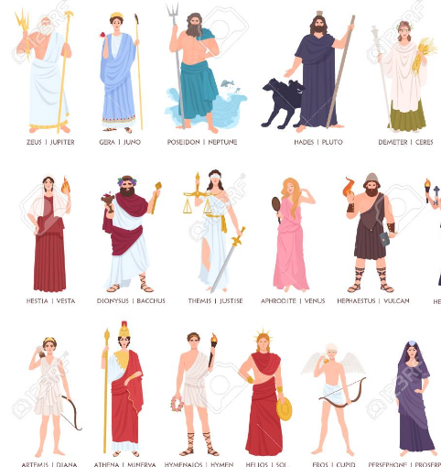
GOOD luck

