Slide 1
lo: To understand what a VlOg is and how to make one.
VLOG: The new Blog.

Slide 2
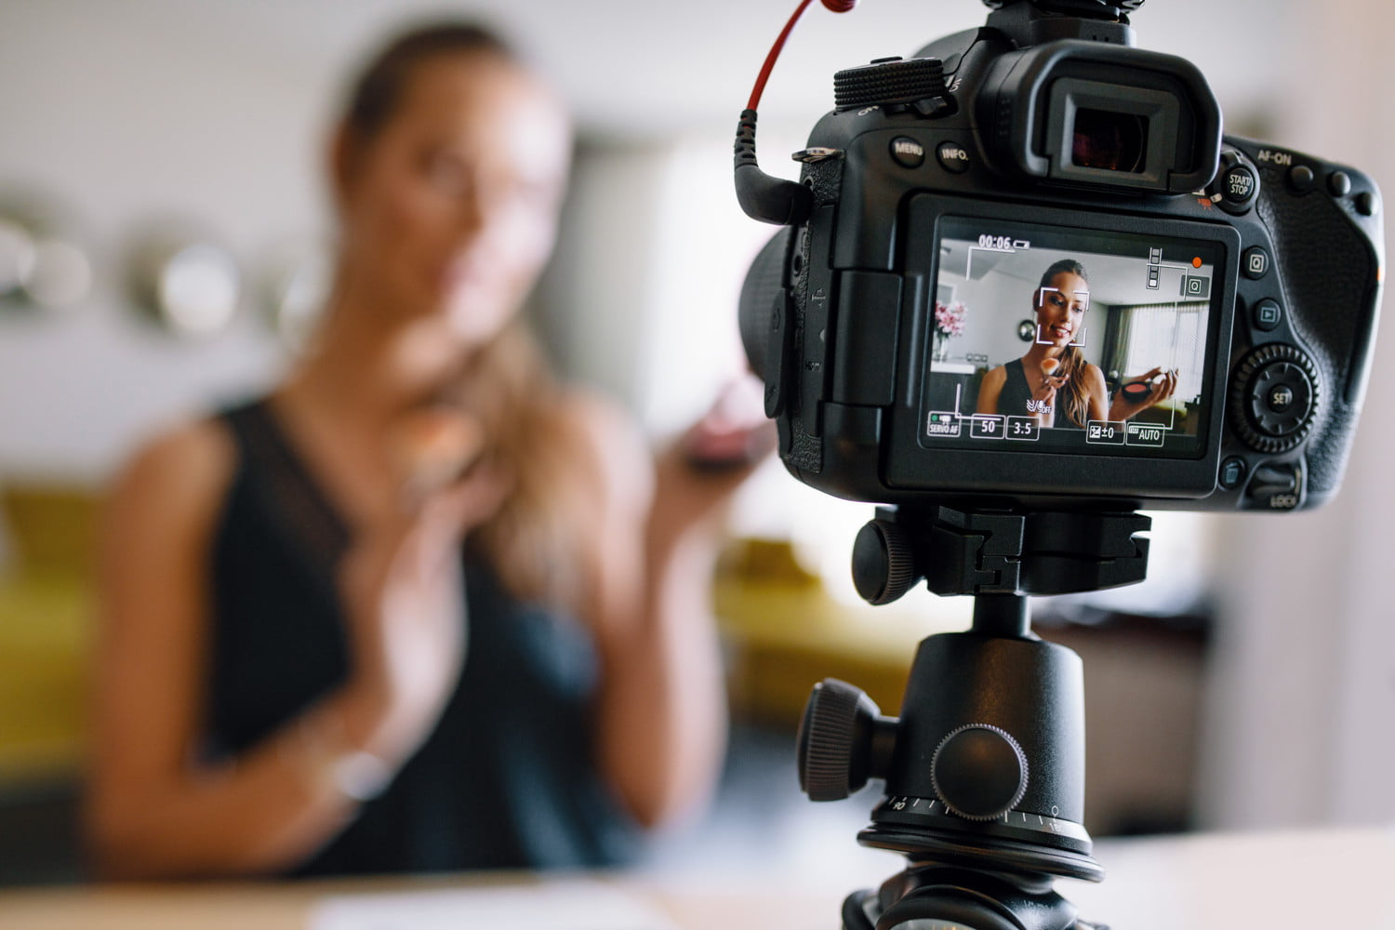
What is a VLOG?
A vlog is the same as a blog but rather than using text they use video.
As technology has got better they have become more popular as more people can make them.
Websites, such as Youtube, mean it is free for people to upload their vlogs to a massive audience.

Slide 3
Staying Safe, Staying smart
As we looked at before, staying safe is still very important.
Anything you put on a vlog can be accessed by millions of people around the world.
Always think about what it is you are putting on to keep yourself safe.
What mistakes could you make if you uploaded a blog?

Slide 4
Famous Vloggers
You are going to research child vloggers online.
You need to find the names of some successful vloggers who are 18 or younger, how many people watch them and what they vlog about.
You have 10 minutes to find as many as possible.

Slide 5
What would you look for?
Which do you think you’d most likely watch? Why?
If you were looking for a vlogger what things would you look for?
In the boxes underneath write down what you would look for in a Vlog.

Slide 6
Top Tips
Watch this video.
https://www.youtube.com/watch?v=u5si3NF-q88
Can you think of any more tips?
Write down the three most important things you need to think about when starting a Vlog on the back of your sheet.

Slide 7
Prepare your vlog
You are going to be making a vlog based on what you are going to research about the Romans, including your opinion.
Choose ONE from the following 3 topics:
Roman Religion (gods and myths)
Roman sports and leisure (Gladiators, competitions)
Roman Army (Soldiers and road building)
Write down a brief script of what you are going to say.
NOT word for word – it should be natural.
An outline of what you are going to be saying.

